Slide 1
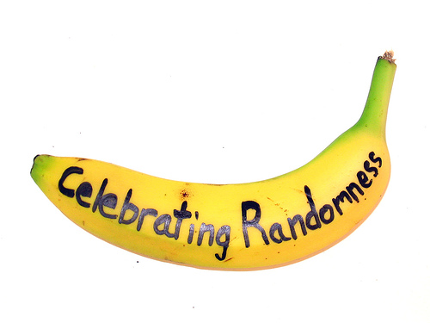
Chapter 10
Understanding Randomness

Slide 2
Why Be Random?
The most important aspect of randomness is that it needs to be fair.
Randomness is an essential tool of Statistics.
But truly random values are very hard to get.
To see why, try the next example…

Slide 3
Look at the numbers quickly and choose one at random…
1 2 3 4

Slide 4
Why Be Random?
Did you pick 3?
Almost 75% of all people pick 3.
About 20% pick 2 or 4.
About 5% pick 1.
That was not random.
Psychologists have proposed reasons for why this happens.

Slide 5
Why Be Random?
What is it about chance outcomes being random that makes random selection seem fair? Two things:
Nobody can guess the outcome before it happens.
Each outcome is equally likely to happen.

Slide 6
Why Be Random? (cont.)
Example:
Pick “heads” or “tails.”
Flip a fair coin. Does the outcome match your choice? Did you know before flipping the coin whether or not it would match?

Slide 7
It’s Not Easy Being Random
It’s surprisingly difficult to generate random values even when they’re equally likely.
Computers, calculators, and even smartphones have become a popular way to generate random numbers.
There are ways to generate random numbers so that they are both equally likely and truly random.
There are published tables of carefully generated random numbers.

Slide 8
It’s Not Easy Being Random (cont.)
www.random.org
The Random Integer Generator is good.
The best ways we know to generate data that give a fair and accurate picture of the world rely on randomness.
The ways in which we draw conclusions from those data depend on the randomness, too.

Slide 9
Practical Randomness
We need an imitation of a real process so we can manipulate and control it.
In short, we are going to simulate reality.

Slide 10
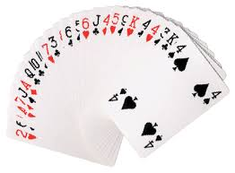
Do you think shuffling cards will produce results that are random? Why?

Slide 11
Do you think shuffling cards will produce results that are random? Why?
If you shuffle cards from the usual method, you have to shuffle the cards at least 7 times.
Fewer than that leaves order in the deck.
After 7 shuffles, shuffling any more does little good.
Most people don’t shuffle that many times though.
This can cause problems during tournaments, in casinos, etc.
There has been history of people complaining.

Slide 12
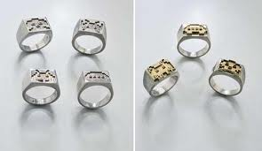
Suppose a cereal manufacturer puts toys in a box.
20% of the boxes contain temporary tattoos, 30% contain compasses, and the rest are filled with rings.
You want all three prizes.
How many boxes will you need to buy?
How can we answer a question like this?

Slide 13
One way is to buy hundreds of boxes of cereal to see what may happen.
But let’s not do that.
Instead, consider using a random model.
Why do you think it has to be random?

Slide 14
We will assume that the prizes are randomly placed in the boxes and that the boxes are randomly distributed to stores around the country.
Why are we using a model?
Because it is ridiculous to buy all those boxes. It is a waste of money and food.
So we need to figure out a way to imitate reality so that we can manipulate and control.
We are going to simulate reality.

Slide 15
A simulation mimics reality by using random numbers to represent the outcome of real events.
We cannot answer the question by completing the prize collection just once.
We want to understand the typical number of boxes to open, how that number varies, and the shape of that distribution.
So we will have to do this over and over.

Slide 16
Each time you obtain a simulated answer to your question is called a trial.
For the prizes, a trial’s outcome is the number of boxes.
How many boxes do you need to get each prize.
3 boxes.
But with REALLY bad luck, you could buy tons of boxes and still not get all 3 prizes.
So the possible outcomes for this trial are what?
{3, 4, 5, 6, 7, …}

Slide 17
{3, 4, 5, 6, 7, …}
We cannot just pick one of these at random because they are not all equally likely.
It is very hard to guess how many boxes you would need to open.
We need to now do a simulation on this to give us more of an idea.
How do you think we can do this?

Slide 18
We can generate random numbers.
20% = temporary tattoos
30% = compasses
50% = rings
We can say 0 and 1 are for tattoos; 2, 3, and 4 are for compasses; 5, 6, 7, 8, 9 are for rings.

Slide 19
A Simulation
Opening one box is the basic building block of a simulation and is called a component.
We need to observe a sequence of components until our prize collection is complete.
After the trial, we record what happened—our response variable.
There are seven steps to a simulation…

Slide 20
Simulation Steps
1. Identify the component to be repeated.
In this case, the component is opening our box of cereal.
2. Explain how you will model the component’s outcome.
The digits 0-9 are equally likely to occur.
Because 20% of the boxes contain temporary tattoos we will use 2 of the 10 digits to represent that outcome. (0 and 1)
30% compasses means we will use 3 of the 10 digits to represent this outcome. (2, 3, and 4)
50% rings means we will use 5 of the 10 digits to represent this outcome. (5, 6, 7, 8, 9)

Slide 21
Simulation Steps
3. Explain how you will combine the components to model a trial.
We pretend to open boxes (repeat components) until our collection is complete.
We do this by looking at each random digit and indicating which prize it represents.
We continue until we find all 3.
4. State clearly what the response variable is.
What are we interested in?
We want to find out the number of boxes it might take to get all three prizes.

Slide 22
Simulation Steps
5. Run several trials.
For example, let’s look at the 1st line of the random digits generated from random.org.
We get Ring, Compass, Tattoo.
This trials outcome is 3 boxes (this is rare by the way).
Now keep going with more random trials using our line of random digits.
Keep a chart and record what happens.
Let’s do 10 trials.
Label chart with the “Trial Number”, “Component Outcomes”, and “Trial Outcomes (y = number of boxes)”

Slide 23
Simulation Steps
6. Collect and summarize the response of all the trials.
You know how to summarize and display a response variable.
Report the shape, center, and spread.
Depending on the question you may want to report more.
Now make a boxplot of your outcomes.
7. State your conclusions.
Based on this simulation, we estimate that customers hoping to complete their prize collection will need to open a median of ______________ boxes, but it could take a lot more.

Slide 24
Note:
If you fear that you may not have accurate estimates, you can always do more trials.
The more trials the better?
But how many?
We will answer this question in a bit.

Slide 25
Just Checking Box on Pg # 272
Solutions:
The component is one game.
I will generate random numbers and assign numbers from 0 to 54 to the home team winning and numbers 55 to 99 to the visiting team winning.
I’ll generate components until one team wins 4 games. Then I will record which team wins the series.
The response is who wins the series.
I’ll calculate the percent of wins by team A (who starts at home)

Slide 26
Homework:
Pg 276 – 277 Examples: 2, 4, 6, 8, 10, 12, 14, 15, 19
Read Chapter 10
Complete the Guided Reading

Slide 27
Activity:
Simulating a Dice Game

Slide 28
Activity:
Graphing Calculator Activity: Generating Random Numbers

Slide 29
Activity
Using a Simulation to Pick Roommates

Slide 30
What Can Go Wrong?
Don’t overstate your case.
Beware of confusing what really happens with what a simulation suggests might happen.
Model outcome chances accurately.
A common mistake in constructing a simulation is to adopt a strategy that may appear to produce the right kind of results.
Run enough trials.
Simulation is cheap and fairly easy to do.

Slide 31
What have we learned?
How to harness the power of randomness.
A simulation model can help us investigate a question when we can’t (or don’t want to) collect data, and a mathematical answer is hard to calculate.
How to base our simulation on random values generated by a computer, generated by a randomizing device, or found on the Internet.
Simulations can provide us with useful insights about the real world.

Slide 32
Homework:
Pg # 278 – 279
Exercises: 21 – 25, 27, 28, 31 – 35

