Slide 1
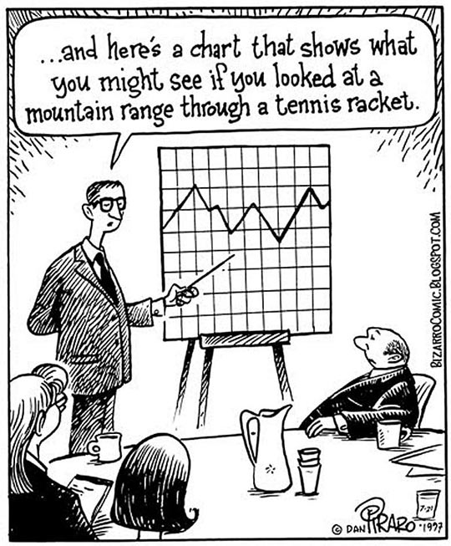
Chapter 12
Experiments and Observational Studies

Slide 2
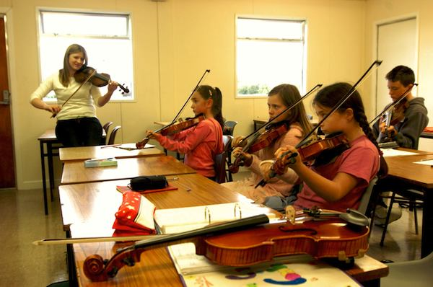
Observational Studies
In an observational study, researchers don’t assign choices; they simply observe them.
The text’s example looked at the relationship between music education and grades.
Since the researchers did not assign students to get music education and simply observed students “in the wild,” it was an observational study.

Slide 3
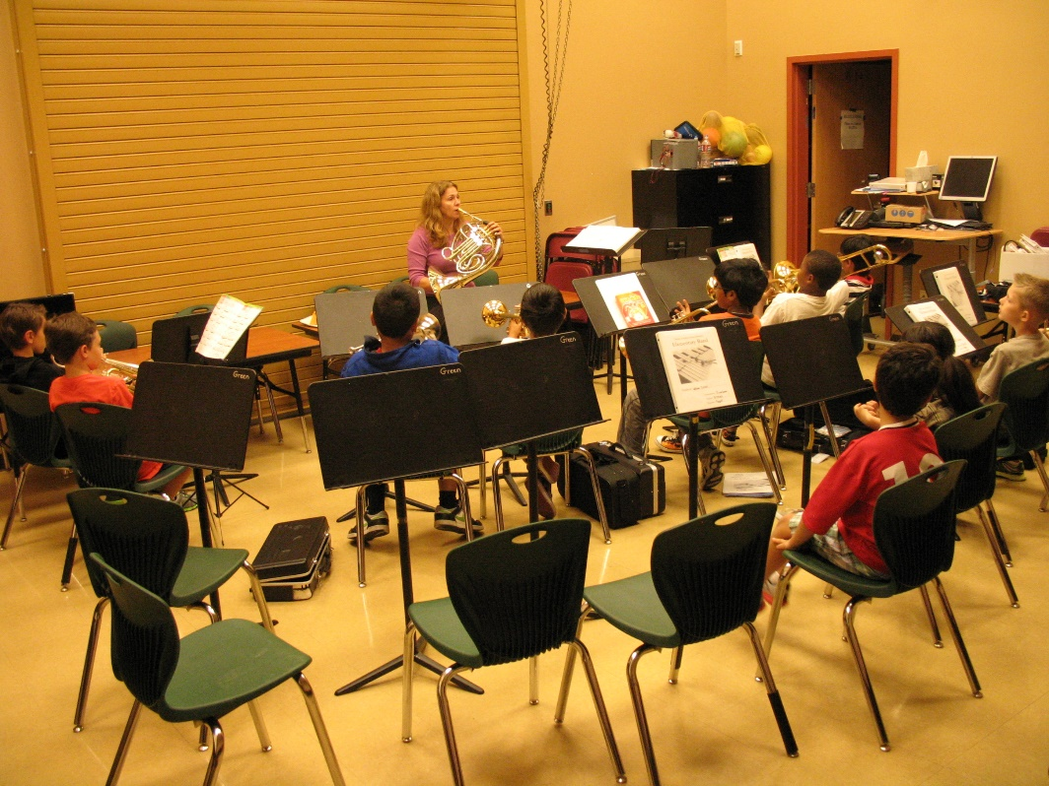
Observational Studies (cont.)
Because researchers first identified subjects who studied music and then collected data on their past grades, this was a retrospective study.
Had the researchers identified subjects in advance and collected data as events unfolded, the study would have been a prospective study.

Slide 4
Observational Studies (cont.)
Observational studies are valuable for discovering trends and possible relationships.
However, it is not possible for observational studies, whether prospective or retrospective, to demonstrate a causal relationship.
Possible lurking variables?

Slide 5
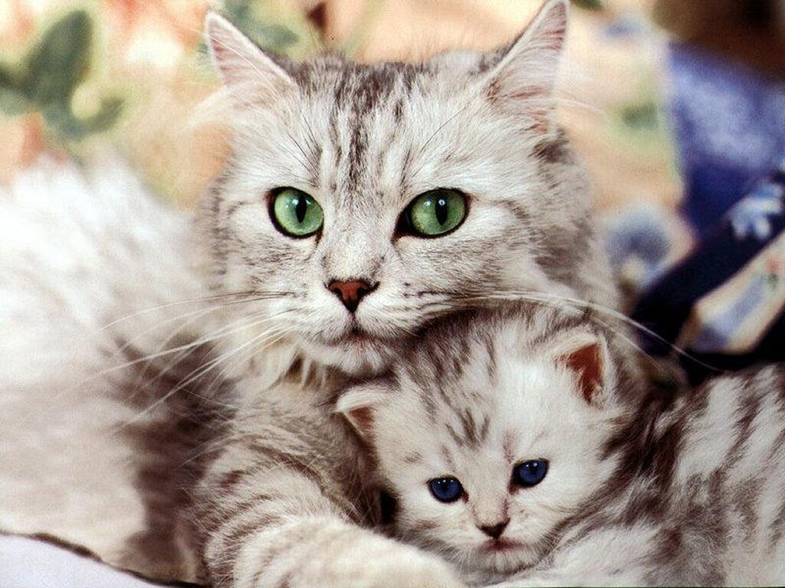
Question:
In early 2007, a larger-than-usual number of cats and dogs developed kidney failure; many died.
Initially, researchers didn’t know why, so they used an observational study to investigate.
Suppose you were called on to plan a study seeking the cause of this problem. Would your design be retrospective or prospective? Why?

Slide 6
Randomized, Comparative Experiments
An experiment is a study design that allows us to prove a cause-and-effect relationship.
In an experiment, the experimenter must identify at least one explanatory variable, called a factor, to manipulate and at least one response variable to measure.
An experiment:
Manipulates factor levels to create treatments.
Randomly assigns subjects to these treatment levels.
Compares the responses of the subject groups across treatment levels.

Slide 7
Randomized, Comparative Experiments (cont.)
For example, we might design an experiment to see whether the amount of sleep and exercise you get effects your performance.
What are the factors here?
What is the response variable?

Slide 8
Randomized, Comparative Experiments (cont.)
The individuals on whom or which we experiment are called experimental units.
When humans are involved, they are commonly called subjects or participants.
The specific values that the experimenter chooses for a factor are called the levels of the factor.
A treatment is a combination of specific levels from all the factors that an experimental unit receives.

Slide 9
Question:
When determining how much sleep and exercise affects performance, what would be potential levels of the factors?
What would be an example of a treatment given?

Slide 10
How do you think we should assign our participants to treatments?
To have any hope of drawing a fair conclusion, we must assign our participants to their treatments at random.

Slide 11
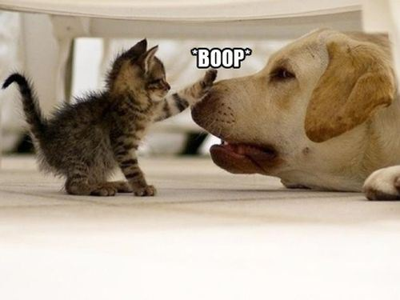
Question:
In 2007, deaths of a large number of pet dogs and cats were ultimately traced to contamination of some brands of pet food.
The manufacturer now claims that the food is safe, but before it can be released, it must be tested.
In an experiment to test whether the food is now safe for dogs to eat, what would be the treatments and what would be the response variable?

Slide 12
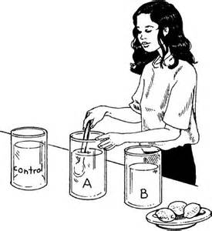
The Four Principles of Experimental Design
Control:
We control sources of variation (other than the factors we are testing) by making conditions as similar as possible for all treatment groups.

Slide 13
The Four Principles of Experimental Design
2. Randomize:
Randomization allows us to equalize the effects of unknown or uncontrollable sources of variation.
Without randomization, you do not have a valid experiment.
“Control what you can, and randomize the rest.”

Slide 14
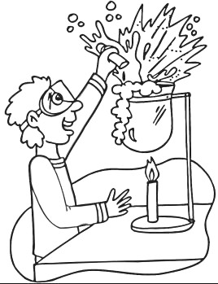
The Four Principles of Experimental Design (cont.)
Replicate:
Repeat the experiment, applying the treatments to a number of subjects.
You must asses the variation of the experiment.

Slide 15
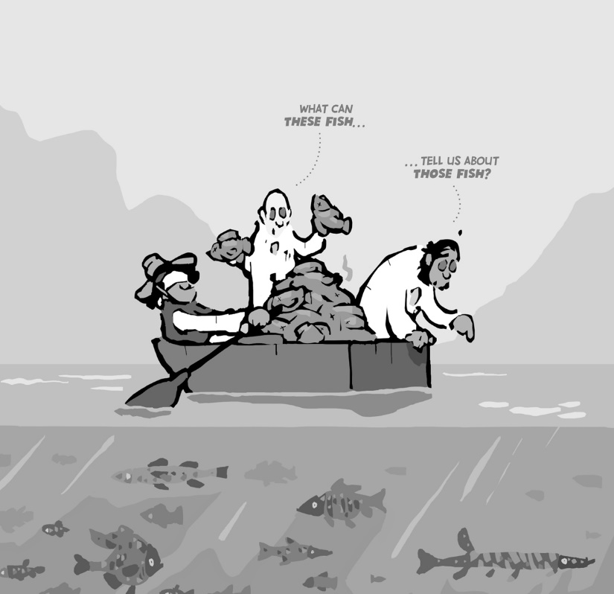
The Four Principles of Experimental Design (cont.)
Replicate:
When the experimental group is not a representative sample of the population of interest, we might want to replicate an entire experiment for different groups, in different situations, etc.
Replication of an entire experiment with the controlled sources of variation at different levels is an essential step in science.

Slide 16
The Four Principles of Experimental Design (cont.)
Block:
If we group similar individuals together and then randomize within each of these blocks, we can remove much of the variability due to the difference among the blocks.

Slide 17
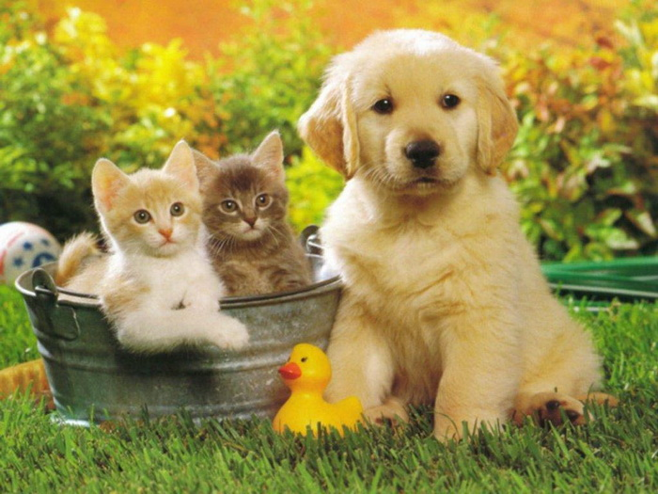
Question:
We’re planning an experiment to see whether the new pet food is safe for dogs to eat. We’ll feed some animals the new food and others a food known to be safe, comparing their health over a period of time.
In this experiment, how will you implement the principles of control, randomization, and replication?

Slide 18
Homework
FRAPPY 2010 #1
Read Chapter 12
Complete the Chapter 12 Guided Reading

Slide 19
Diagrams of Experiments
It’s often helpful to diagram the procedure of an experiment.
The diagram emphasizes the random distribution of subjects to treatment groups, the separate treatments applied to these groups, and the ultimate comparison of results.
A good way to start comparing results for the treatment groups is with boxplots.

Slide 20
Classwork:
Designing an Experiment

Slide 21
Homework:
Pg 264 – 266
Multiple Choice Questions 1 - 15

Slide 22
Does the Difference Make a Difference?
How large do the differences need to be to say that there is a difference in the treatments?
Differences that are larger than we’d get just from the randomization alone are called statistically significant.
A difference is statistically significant if we don’t believe that it’s likely to have occurred only by chance.

Slide 23
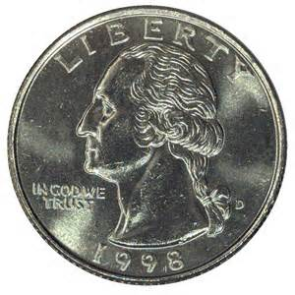
Example: How will you decide if something is different enough to be statistically significant?
Think about deciding whether a coin is fair.
If we flip a fair coin 100 times, we expect, on average, to get 50 heads.
If we get 54 heads out of 100, does that sound surprising?
No. It is within the bounds of ordinary random fluctuation.

Slide 24
Example: How will you decide if something is different enough to be statistically significant?
What about if we see 94 heads?
That is clearly outside the bounds.
We would be pretty sure that the coin flips were not random.

Slide 25
Example: How will you decide if something is different enough to be statistically significant?
What about if we see 74 heads?
Is this far enough from 50-50 to make us suspicious?
That is the sort of questions we need to ask from out experiment results.

Slide 26
Example: How will you decide if something is different enough to be statistically significant?
We would say that 94 heads would be a statistically significant difference from 50, and 54 would not.
Whether 74 is statistically significant will depend on the probability of this occurring and on our tolerance for believing that rare events can happen to us.
This will be for later!

Slide 27
Classwork:
Just Checking Questions

Slide 28
Experiments vs. Samples
Both experiments and sample surveys use randomization to get unbiased data.
But they do so in different ways and for different purposes.
Think, Pair, Share:
Discuss reasons on how the randomization differs.

Slide 29
Experiments vs. Samples
Sample surveys try to estimate population parameters, so the sample needs to be as representative of the population as possible.
Experiments try to assess the effects of treatments, and experimental units are not always drawn randomly from a population.

Slide 30
Experiments vs. Samples
In an experiment, the randomization is not in the selection of the people, it is in the assignment of the therapy.
In a population, we want to randomize to get the diversity and variability of the population.
In an experiment, we actually want subjects that are more homogeneous so that we can more easily spot differences in the effects of the treatment.

Slide 31
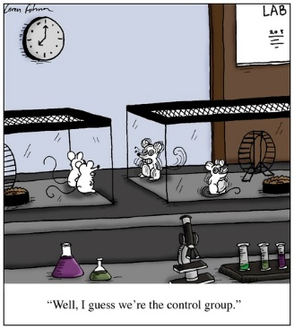
Control Treatments
Often, we want to compare a situation involving a specific treatment to a situation in which “nothing happens.
A baseline measurement is called a control treatment, and the experimental units to whom it is applied is called the control group.
In the tomato example, what was the control group?

Slide 32
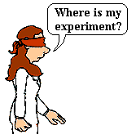
Blinding
When we know what treatment was assigned, it’s difficult not to let that knowledge influence our assessment of the response, even when we try to be careful.
In order to avoid the bias that might result from knowing what treatment was assigned, we use blinding.

Slide 33
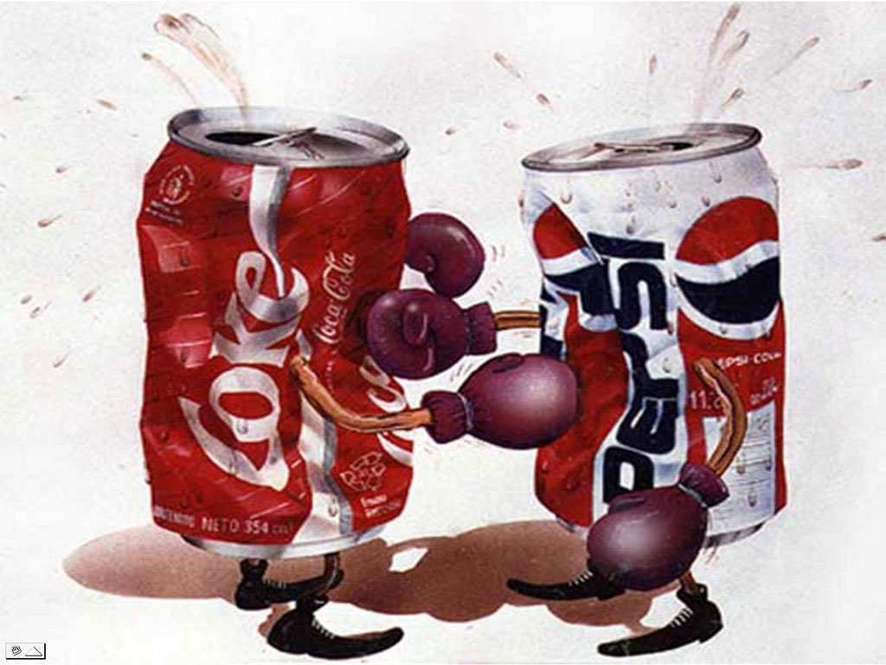
Example:
Let’s say the school is trying to determine what type of cola to put into vending machines: Coke or Pepsi?
They set up an experiment to see which of the brands students prefer.
How would you set up this experiment? Why?

Slide 34
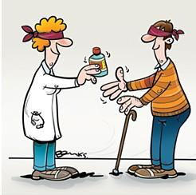
Blinding:
It isn’t just the subjects who should be blind.
Who else do you think should be blind and why?
Experimenters can also subconsciously behave in ways that favor what they believe.

Slide 35
Blinding
There are two main classes of individuals who can affect the outcome of the experiment:
those who could influence the results (subjects, treatment administrators, technicians)
those who evaluate the results (judges, treating physicians, etc.)

Slide 36
Blinding
When all individuals in either one of these classes are blinded, an experiment is said to be single-blind.

Slide 37
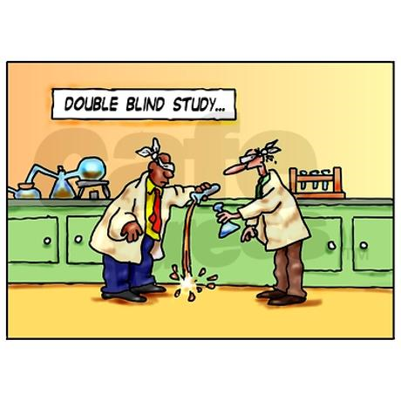
Blinding
When everyone in both classes is blinded, the experiment is called double-blind.

Slide 38
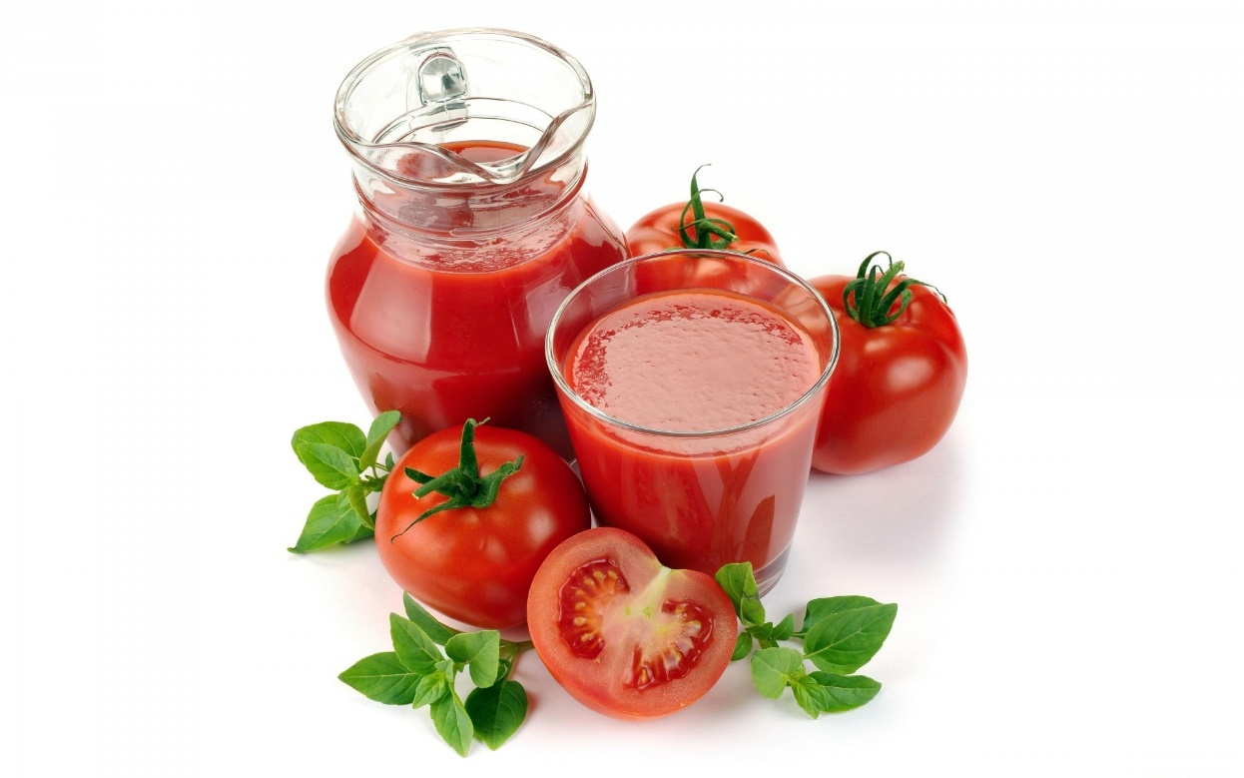
Question:
In the tomato experiment, how could you make the experiment double-blind?
We do not want the people tasting the tomatoes to know which ones got the fertilizer and we would maybe have some fake fertilizer for the people to put on the other plants.

Slide 39
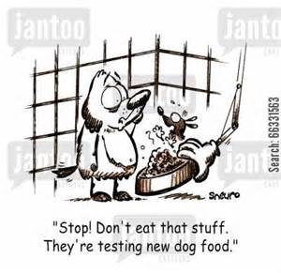
Question:
In our experiment to see if the new pet food is now safe, we are feeding one group of dogs the new food and another group a food we know to be safe. Our response variable is the health of the animals as assessed by a veterinarian.
Should the vet be blinded? Why or why not? How would you do this? Can this experiment be double blind? Would that mean that the test animals would not know what they are eating?

Slide 41
Homework
Pg 325 – 328, Ex: 2, 4, 5, 6, 17, 30
Read Chapter 12
Complete the Chapter 12 Guided Reading
Chapter 12 Test on Monday?

Slide 42
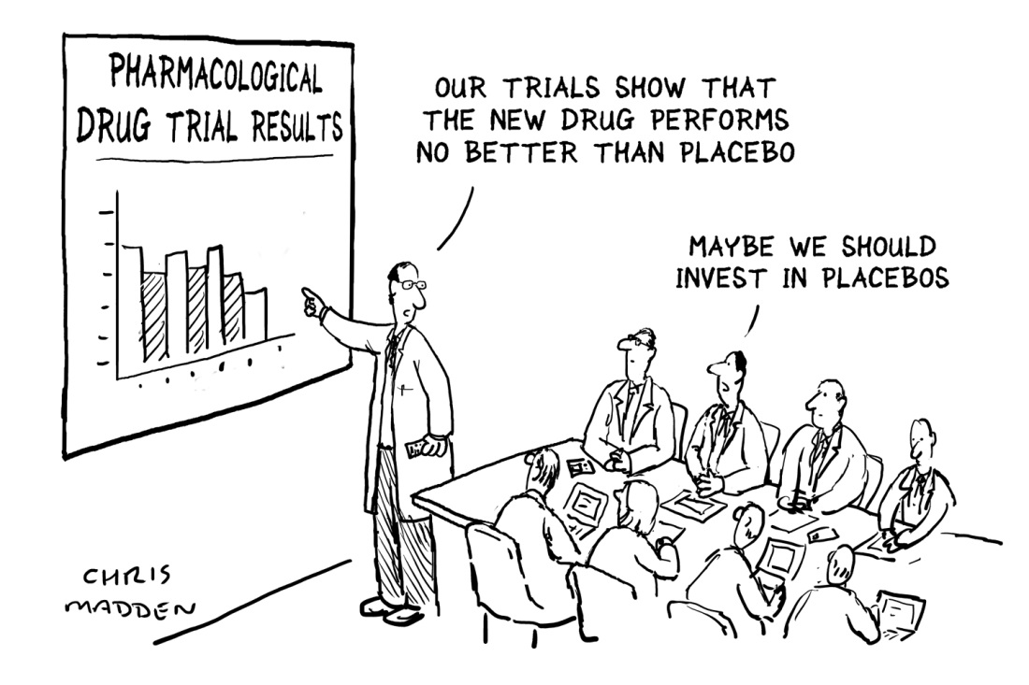
Placebos
Often applying any treatment can induce an improvement.
To separate out the effects of the treatment of interest, we can use a control treatment that mimics the treatment itself.
A “fake” treatment that looks just like the treatment being tested is called a placebo.
Placebos are the best way to blind subjects from knowing whether they are receiving the treatment or not.

Slide 43
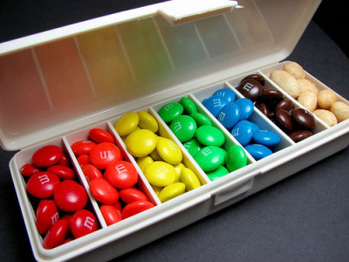
Placebos
Example: One common placebo during drug testing is a “sugar pill.”
People may psychologically improve with placebos.
It is not unusual for 20% or more subjects to report improvement.

Slide 44
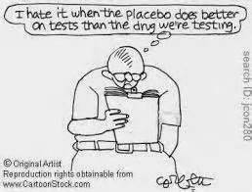
Placebos
Placebo controls are so effective that you should use them as an essential tool for blinding whenever possible.

Slide 45
The Best Experiments…
are usually:
randomized.
comparative.
double-blind.
placebo-controlled.

Slide 46
Blocking
When groups of experimental units are similar, it’s often a good idea to gather them together into blocks.
Blocking isolates the variability due to the differences between the blocks so that we can see the differences due to the treatments more clearly.
When randomization occurs only within the blocks, we call the design a randomized block design.

Slide 47
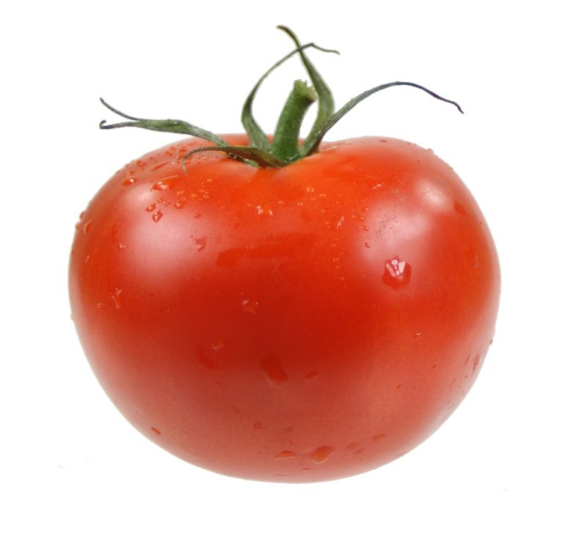
Example”
Go back to the tomato example with the OptiGrow.
We want to use 18 tomatoes of the same variety and we go to the store and they only have 12 tomatoes.
Now we decide to go to another store and buy 6 more tomatoes of the same variety.
Why might you want to use blocking here?
Create a diagram showing your experimental units, blocks, random assignments, treatments, and response.

Slide 48
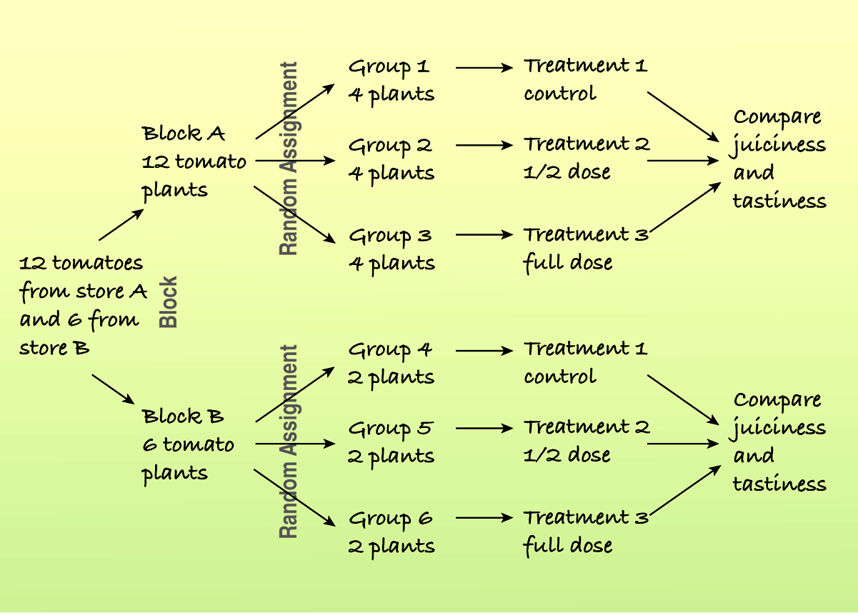
Here is a diagram of the blocked experiment:

Slide 49
Matching:
In a retrospective or prospective study, subjects are sometimes paired because they are similar in ways not under study.
Matching subjects in this way can reduce variability in much the same way as blocking.
For Example: You may pair up a non-music student and a music student together based upon their gender and family income and compare their grades.
This matching would reduce variability.

Slide 50
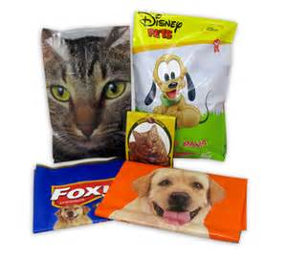
Question:
Back to the pet food issue.
The contamination put cats at risk, as well as dogs. Our experiment should probably test the safety of the new food on both animals.
Why shouldn’t we randomly assign a mix of cats and dogs to the two treatment groups? What would you recommend instead?

Slide 51
Classwork:
Just Checking Box Pg # 318

Slide 52
Adding More Factors
It is often important to include multiple factors in the same experiment in order to examine what happens when the factor levels are applied in different combinations.

Slide 53
Classwork:
Designing a Completely Randomized Two-Factor Experiment

Slide 54
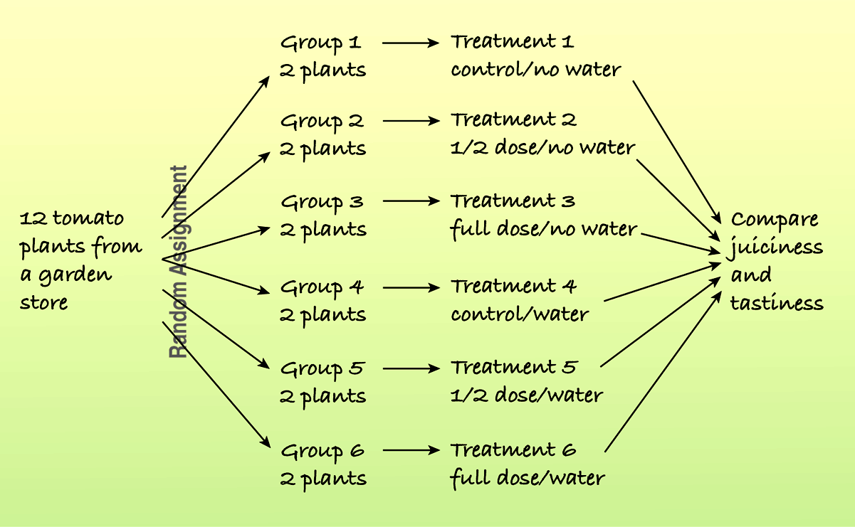
Diagram of the completely randomized two-factor experiment:
The following diagram shows a study of the effects of different fertilizer/water combinations on the juiciness and tastiness of tomatoes:

Slide 55
Confounding
When the levels of one factor are associated with the levels of another factor, we say that these two factors are confounded.
When we have confounding factors, there are two or more factors that could have caused our results and it is not possible to determine which one caused it.

Slide 56
Videos
https://www.youtube.com/watch?v=7ybuE39BpQ8
https://www.youtube.com/watch?v=BtqCDd6yV9E
(Start at 2:15 end at 5:25)

Slide 57
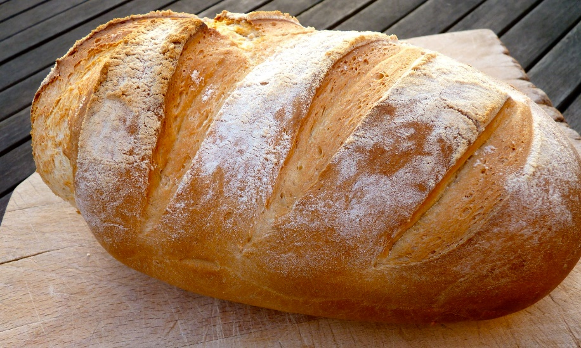
Example:
You conduct an experiment into the effects of smell on the perceived attractiveness of food.
Participants were asked to rate the attractiveness of a loaf of bread on a range of criteria.
Two groups of participants are arranged to attend experimental sessions from 9am onwards.

Slide 58
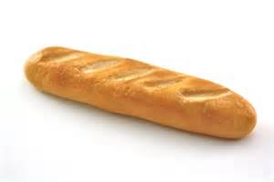
Example:
The first 20 participants just rated the attractiveness of the bread.
The next 20 participants did the same task while the smell of freshly baked bread was being piped into the room through a vent (they were unaware of this).
The researchers found that ratings were higher in the “bread scent” condition and concluded that the smell had the effect of enhancing the attractiveness of the food.
What are potential confounding variables?

Slide 59
Lurking vs. Confounding
Confounding may sound a lot like lurking variables.
They are alike because they interfere with our ability to interpret our analyses simply.

Slide 60
Lurking vs. Confounding
A lurking variable creates an association between two other variables that tempts us to think that one may cause the other.
This can happen in a regression analysis or an observational study when a lurking variable influences both the explanatory and response variable.
A lurking variable is usually thought of as a prior cause of both y and x that makes it appear that x may be causing y.

Slide 61
Lurking vs Confounding
Confounding can arise in experiments when some other variables associated with a factor has an effect on the response variable.
A confounding variable, then, is associated in a noncausal way with a factor and affects the response.
Because of the confounding, we find that we can’t tell whether any effect we see was caused by our factor or by the confounding factor (or by both working together).

Slide 62
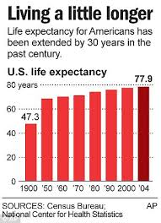
Example:
Countries with more TV sets per capita tend to have longer life expectancies.
Would there be a lurking variable or confounding variable? Explain why.
The lurking variable may be a higher standard of living.
This variable is associated with more TVs and with better health care.

Slide 63
Example:
When people are stressed out, their muscles tend to cramp up more.
Would there be a lurking variable or confounding variable? Explain why.
The confounding variable may be that when they are stressed, they are drinking more coffee and getting less sleep.
It is hard to determine what is causing the muscle cramps. Is it the stress, the coffee, the lack of sleep?

Slide 64
What Can Go Wrong?
Don’t give up just because you can’t run an experiment.
If we can’t perform an experiment, often an observational study is a good choice.

Slide 65
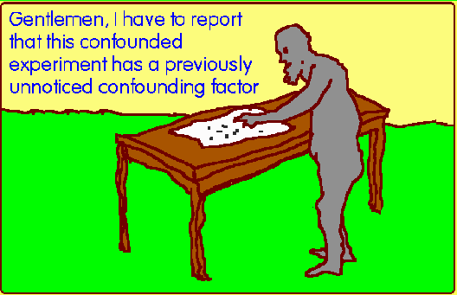
What Can Go Wrong?
Beware of confounding.
Use randomization whenever possible to ensure that the factors not in your experiment are not confounded with your treatment levels.
Be alert to confounding that cannot be avoided, and report it along with your results.

Slide 66
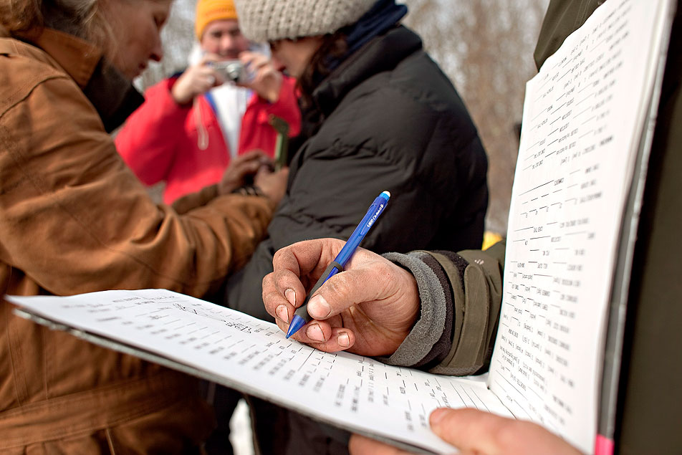
What Can Go Wrong? (cont.)
Bad things can happen even to good experiments.
Protect yourself by recording additional information.

Slide 67
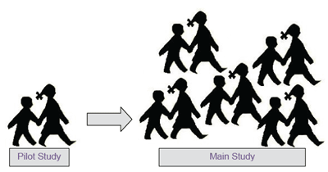
What Can Go Wrong? (cont.)
Don’t spend your entire budget on the first run.
Try a small pilot experiment before running the full-scale experiment.
You may learn some things that will help you make the full-scale experiment better.

Slide 68
What have we learned?
We can recognize sample surveys, observational studies, and randomized comparative experiments.
These methods collect data in different ways and lead us to different conclusions.

Slide 69
What have we learned?
We can identify retrospective and prospective observational studies and understand the advantages and disadvantages of each.
Only well-designed experiments can allow us to reach cause-and-effect conclusions.
We manipulate levels of treatments to see if the factor we have identified produces changes in our response variable.

Slide 70
What have we learned? (cont.)
We know the principles of experimental design:
Identify and control as many other sources of variability as possible so we can be sure that the variation in the response variable can be attributed to our factor.
Try to equalize the many possible sources of variability that cannot be identified by randomly assigning experimental units to treatments.
Replicate the experiment on as many subjects as possible.
Control the sources of variability we can, and consider blocking to reduce variability from sources we recognize but cannot control.

Slide 71
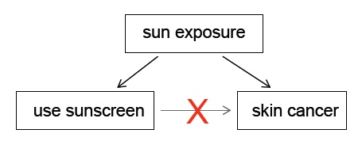
What have we learned? (cont.)
We’ve learned the value of having a control group and of using blinding and placebo controls.
We can recognize problems posed by confounding variables in experiments and lurking variables in observational studies.

Slide 72
Homework
Pg 325 – 328, Ex: 7, 8, 13, 20, 35, 36, 38
Read Chapter 12
Complete the Chapter 12 Guided Reading
Chapter 12 Test Monday

