Slide 1
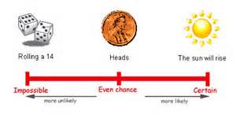
Chapter 13
From Randomness to Probability

Slide 2
Dealing with Random Phenomena
A random phenomenon is a situation in which we know what outcomes could happen, but we don’t know which particular outcome did or will happen.
In general, each occasion upon which we observe a random phenomenon is called a trial.
At each trial, we note the value of the random phenomenon, and call it an outcome.

Slide 3
Dealing with Random Phenomena
When we combine outcomes, the resulting combination is an event.
The collection of all possible outcomes is called the sample space.
We will use the letter S to denote sample space.

Slide 4
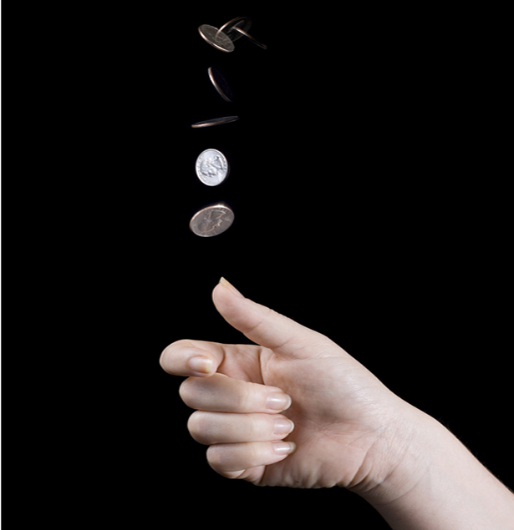
Examples
What would be the sample space of flipping a coin?
S = {H, T}
What would be the sample space of flipping two coins?
S = {HH, HT, TH, TT}

Slide 5
The Law of Large Numbers
First a definition . . .
When thinking about what happens with combinations of outcomes, it is easier to deal with trials that are independent.
This means that the outcome of one trial doesn’t influence or change the outcome of another.
For example, coin flips are independent.

Slide 6
The Law of Large Numbers (cont.)
The Law of Large Numbers (LLN) says that as we repeat a random process over and over, the proportion of times that an event occurs does settle down to one number.
We call that value the probability of the event.
Because this definition is based on repeatedly observing the event’s outcome, this definition of probability is often called empirical probability.

Slide 7
Go to this on Calculator
APPS → Probability Simulation
Long term probability of getting a head?
Long term probability of getting a 1?

Slide 8
The Nonexistent Law of Averages
The Law of Large Numbers (LLN) says nothing about short-run behavior.
Relative frequencies even out only in the long run, and this long run is really long (infinitely long, in fact).
The so called Law of Averages (that an outcome of a random event that hasn’t occurred in many trials is “due” to occur) doesn’t exist at all.

Slide 9
Example:
What is wrong with these statements?
“Many gamblers bet on numbers that they haven’t seen in a while.”
“A good hitter who has struck out the last six times is due for a hit his next time up.”
“You are doing very well on all you statistics tests. You are now due for a bad grade.”
This is NOT how random phenomena work.
Sometimes it may take an infinite amount of trials before you see the actual probabilities.

Slide 10
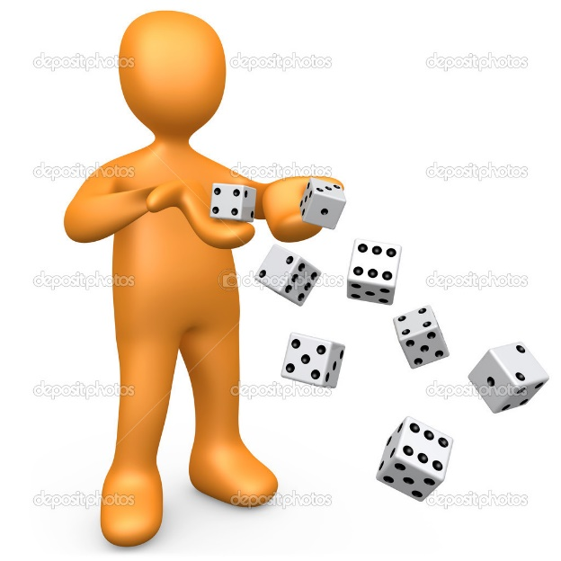
Question:
You have rolled a die 50 times and have seen every number except a six.
Does the die “owe” you some sixes?
Of course not! Each roll is a new event. The die cannot remember what it did in the past, so it cannot owe you any particular outcomes.

Slide 11
Modeling Probability
Probability was first studied by a group of French mathematicians who were interested in games of chance.
They focused on games in which all the possible outcomes were equally likely.
Instead of wasting all their money experimenting with games, they developed mathematical models.

Slide 12
Modeling Probability
They developed mathematical models of theoretical probability.
It’s equally likely to get any one of six outcomes from the roll of a fair die.
It’s equally likely to get heads or tails from the toss of a fair coin.

Slide 13
Modeling Probability
However, keep in mind that events are not always equally likely.
A skilled basketball player has a better than 50-50 chance of making a free throw.

Slide 14
Modeling Probability (cont.)
The probability of an event is the number of outcomes in the event divided by the total number of possible outcomes.
P(A) =
# of outcomes in A
# of possible outcomes

Slide 15
Question:
What is the probability of drawing a face card from a deck of cards?
12/52 = 3/13

Slide 16
Questions:
What is the probability of flipping two coins and getting two heads?
1/4
What is the probability of flipping three coins and getting two heads?
3/8
What is the probability of flipping 100 coins and getting 67 heads? (Note: This is Saturday school session stuff!)
There are way too many outcomes to do this by hand. We will figure out how to do this in Chapter 16.

Slide 17
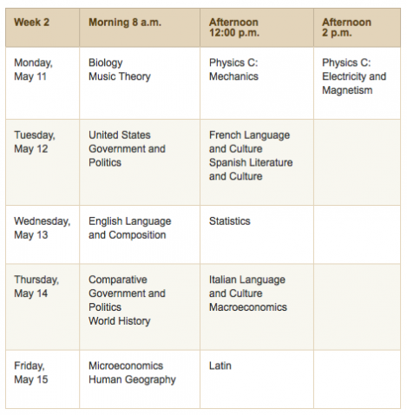
Personal Probability
Question: What is the probability that you will get a 4 or 5 on the AP Statistics Exam?

Slide 18
Personal Probability
People do this all the time in everyday speech.
When we express a degree of uncertainty without basing it on long-run relative frequencies or mathematical models, we are stating subjective or personal probabilities.
Personal probabilities don’t display the kind of consistency that we will need probabilities to have, so we’ll stick with formally defined probabilities.

Slide 19
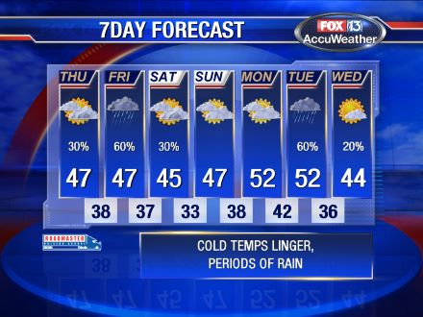
Which kind of probability?
When a weather forecaster predicts a 50% chance of rain, is this a personal probability or a relative frequency probability?
The National Weather service may base this claim on decades worth of data.
A local forecaster may be offering you a personal opinion based on past experience.

Slide 20
The First Three Rules of Working with Probability
We are dealing with probabilities now, not data, but the three rules don’t change.
Make a picture.
Make a picture.
Make a picture.

Slide 21
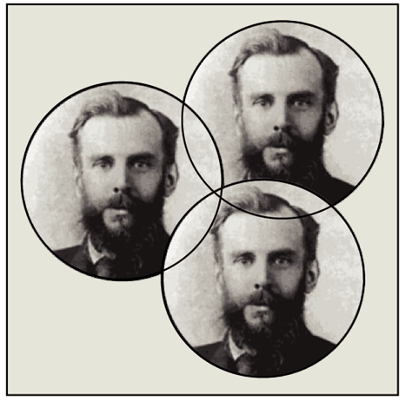
The First Three Rules of Working with Probability (cont.)
The most common kind of picture to make is called a Venn diagram.
We will see Venn diagrams in practice shortly…

Slide 22
Formal Probability
Rule 1: Two requirements for a probability
A probability is a number between 0 and 1.
For any event A, 0 ≤ P(A) ≤ 1.

Slide 23
Formal Probability (cont.)
Rule 2: Probability Assignment Rule
The probability of the set of all possible outcomes of a trial must be 1.
P(S) = 1 (S represents the set of all possible outcomes.)

Slide 24
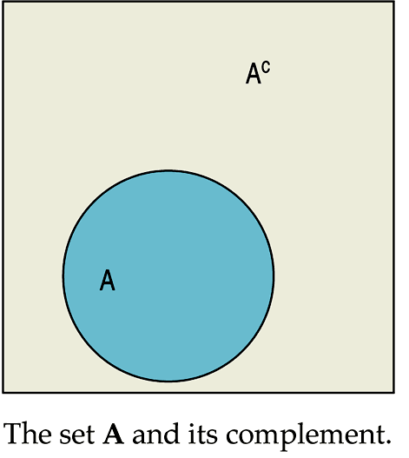
Formal Probability (cont.)
Rule 3: Complement Rule
The set of outcomes that are not in the event A is called the complement of A, denoted A^{C}.
The probability of an event occurring is 1 minus the probability that it doesn’t occur: P(A) = 1 – P(A^{C})

Slide 25
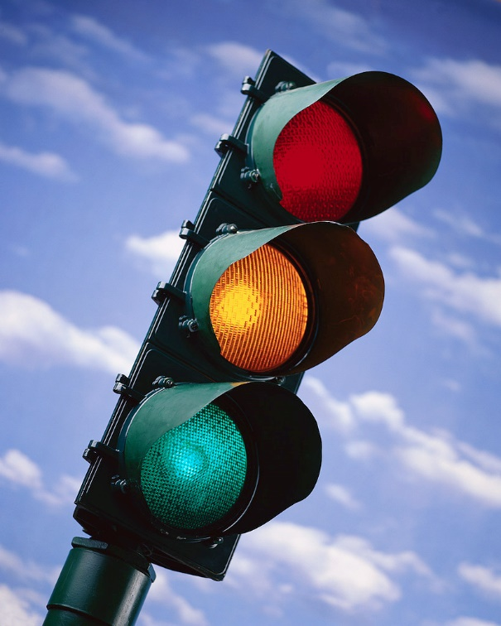
Question:
The traffic light at the corner of College and Main is green about 37% of the time.
If P(green) = 0.37, what is the probability that it isn’t green when you get to College and Main?
Solution:
There is a 63% chance that I won’t have a green light.

Slide 26
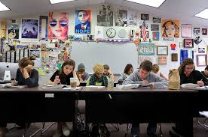
Question:
(A) Suppose that the probability of randomly selecting a student that is a freshman is 0.24.
(B) Suppose that the probability of randomly selecting a student that is a senor is 0.36.
What is the probability that the student is either a freshman or a senior?
P(AUB) = 0.60

Slide 27
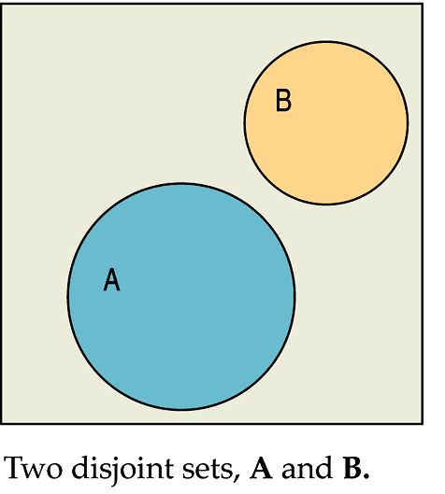
Formal Probability (cont.)
Rule 4: Addition Rule
Events that have no outcomes in common (and, thus, cannot occur together) are called disjoint (or mutually exclusive).

Slide 28
Formal Probability (cont.)
Rule 4: Addition Rule
For two disjoint events A and B, the probability that one or the other occurs is the sum of the probabilities of the two events.
P(A ∪ B) = P(A) + P(B), provided that A and B are disjoint.

Slide 29
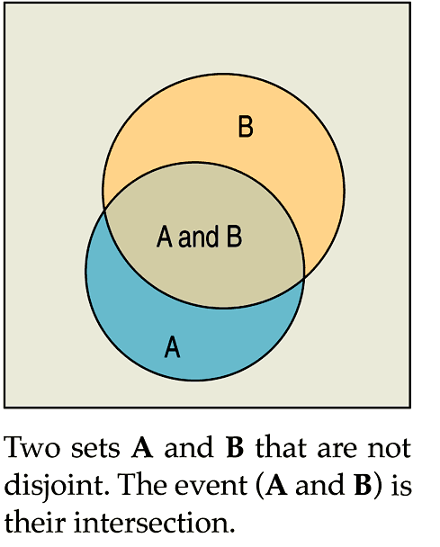
Formal Probability (cont.)
In this diagram, the two independent events A and B are not disjoint.
The addition rule would not work for this.

Slide 30
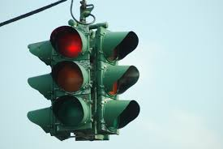
Question:
When you get to the light at College and Main street, it is either red, green, or yellow.
We know that P(green)=0.37.
Suppose we also find out that P(yellow)= 0.07.
What is the probability the light is red?
P(red) = 0.56

Slide 31
Note:
Rule 2(The Assignment Rule), tells us that to be a legitimate assignment of probabilities, the sum of the probabilities of all the possible outcomes has to be 1.

Slide 32
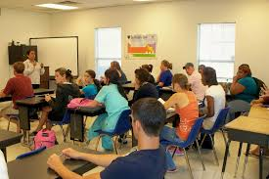
What is wrong with these statements?
The probability of selecting a random freshman, sophomore, junior, or senior is 0.25, 0.21, 0.24, and 0.22 respectively.
The probability of selecting a random freshman, sophomore, junior, or senior is 0.35, 0.31, 0.34, and 0.32 respectively.

Slide 33
Be careful:
The addition rule does not work for events that are not mutually exclusive.
Example: If the probability of owning a smartphone is 0.76 and the probability of owning a TV is .81, what is the probability of owning either a smartphone or a TV?
Why can’t you just add the probabilities?
We will see how to do this in the next chapter.

Slide 34
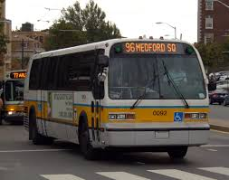
Question:
Suppose that you have to take the bus everyday to work.
The transportation website reports that the bus will be on time 75% of the time.
What is the chance that it will be on time 2 days in a row?
This is asking for the probability that the bus is on time today AND is on time tomorrow.

Slide 35
Formal Probability (cont.)
Rule 5: Multiplication Rule
For two independent events A and B, the probability that both A and B occur is the product of the probabilities of the two events.
P(A ∩ B) = P(A) × P(B), provided that A and B are independent.

Slide 36
Question:
The transportation website reports that the bus will be on time 75% of the time.
What is the chance that it will be on time 4 days in a row?
P(on time 1st day ∩ on time 2nd day ∩ on time 3rd day ∩ on time 4th day) = 0.3164

Slide 37
Formal Probability (cont.)
Rule 5: Multiplication Rule
Many Statistics methods require an Independence Assumption, but assuming independence doesn’t make it true.
Always Think about whether that assumption is reasonable before using the Multiplication Rule.

Slide 38
Question:
We have determined that the probably of getting each light at College and Main street are as follows.
P(green)=0.37 P(yellow)= 0.07 P(red) = 0.56
Now, let’s think about your morning commute for the next week.
What is the probability you get a red light both Monday and Tuesday?
P(red Monday ∩ red Tuesday) = 0.3136

Slide 39
Question:
P(green)=0.37 P(yellow)= 0.07 P(red) = 0.56
What is the probability you don’t encounter a red light until Wednesday?
P(not red Monday ∩ not red Tuesday ∩ red Wednesday)
= 0.1084

Slide 40
Question:
P(green)=0.37 P(yellow)= 0.07 P(red) = 0.56
What is the probability you have to stop at least once during the week.
P(having to stop at least once in 7 days) =
1 – P(no red lights for 7 days) =
1 – P(not red ∩ not red ∩ not red ∩ not red ∩ not red ∩ not red
∩ not red)
.9981
There is a 99.8% chance that you will hit a red light at least once.

Slide 41
The phrase “AT LEAST”
The phrase “at least” is often a hint that you should think about the complement.
Happening “at least once” is the complement of not happening at all, and that is much easier to find.

Slide 42
Formal Probability - Notation
Notation alert:
In this text we use the notation P(A ∪ B) and P(A ∩ B).
In other situations, you might see the following:
P(A or B) instead of P(A ∪ B)
P(A and B) instead of P(A ∩ B)

Slide 43
Putting the Rules to Work
In most situations where we want to find a probability, we’ll use the rules in combination.
A good thing to remember is that it can be easier to work with the complement of the event we’re really interested in.

Slide 44
What Can Go Wrong?
Beware of probabilities that don’t add up to 1.
To be a legitimate probability distribution, the sum of the probabilities for all possible outcomes must total 1.
Don’t add probabilities of events if they’re not disjoint.
Events must be disjoint to use the Addition Rule.

Slide 45
What Can Go Wrong? (cont.)
Don’t multiply probabilities of events if they’re not independent.
The multiplication of probabilities of events that are not independent is one of the most common errors people make in dealing with probabilities.
Don’t confuse disjoint and independent—disjoint events can’t be independent.

Slide 46
What have we learned?
Probability is based on long-run relative frequencies.
The Law of Large Numbers speaks only of long-run behavior.
Watch out for misinterpreting the LLN.

Slide 47
What have we learned? (cont.)
There are some basic rules for combining probabilities of outcomes to find probabilities of more complex events. We have the:
Probability Assignment Rule
Complement Rule
Addition Rule for disjoint events
Multiplication Rule for independent events

