Slide 1
Chapter 14
Probability Rules!

Slide 2
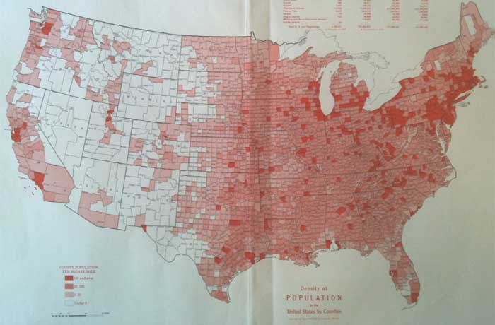
Do Now:
According to the 2010 US Census, 6.7% of the population is aged 10 to 14 years, and 7.1% of the population is aged 15 to 19 years.
If you pick a person at random, what’s the probability that they are aged 10 to 19 years?

Slide 3
From Chapter 13:
When two events A and B are disjoint, we can use the addition rule for disjoint events:
P(A ∪ B) = P(A) + P(B)

Slide 4
However, when our events are not disjoint, this earlier addition rule will double count the probability of both A and B occurring.
Therefore, we need the General Addition Rule.
Let’s look at a picture…

Slide 5
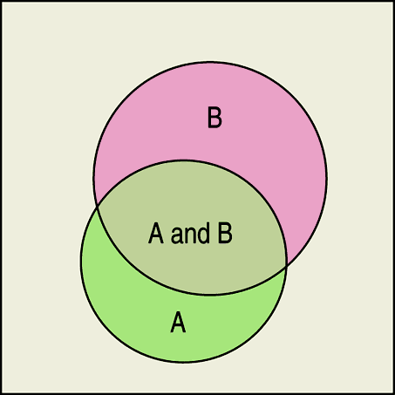
Can you write a new rule for the probability of A OR B happening?
General Addition Rule
For any two events A and B,
P(A ∪ B) = P(A) + P(B) – P(A ∩ B)

Slide 6
Example 1:
The probability that a student owns a car is 0.65, and the probability that a student owns a computer is 0.82.
The probability that a student owns both is 0.55.
What is the probability that a randomly selected student owns a car or computer?
What is the probability that a randomly selected student does not own a car or computer?

Slide 7
Example 2:
A survey of college students found that 65% live on campus, 78% have a campus meal plan, and 52% do both.
Draw a Venn Diagram to help you answer the following questions:
What is the probability that a randomly selected student lives off campus and doesn’t have a meal plan?
What is the probability that a randomly selected student lives on campus but doesn’t have a meal plan?

Slide 8
Example 3:
Let’s say we sampled pages of our stats book to see whether they held an equation, a graph, or other data display and found the following.
51% of pages had some kind of data display
32% of pages had an equation
11% of pages had both a data display and an equation.
Display these results in a Venn diagram.
What is the probability that a randomly selected sample page had neither a data display nor an equation?
What is the probability that a randomly selected sample page had a data display but no equation?

Slide 9
Example 4:
Police report that 78% of drivers stopped on suspicion of drunk driving are given a breath test, 36% a blood test, and 22% both tests.
What is the probability that a randomly selected suspect is given
A test?
A blood test or a breath test, but not both?
Neither test?

Slide 10
Back in Chapter 2, we looked at contingency tables and talked about conditional distributions.
Here is a contingency table giving the counts of 313 students by their hair color and eye color.
Using these 313 students as our sample space, some probabilities are not hard to find…
Hair↓ Eye→ | Brown | Blue | Hazel | Green | Total
Black | 36 | 9 | 5 | 2 | 52
Brown | 66 | 34 | 29 | 14 | 143
Red | 16 | 7 | 7 | 7 | 37
Blonde | 4 | 64 | 5 | 8 | 81
Total | 122 | 114 | 46 | 31 | 313

Slide 11
What is the probability that a person selected will be a blonde?
P(blonde) = 0.2588
What is the probability that a person selected will have hazel eyes?
P(hazel) = 0.147
What is the probability that a person selected will be a blonde with brown eyes?
P(blonde ∩ hazel) = 0.016
Hair↓ Eye→ | Brown | Blue | Hazel | Green | Total
Black | 36 | 9 | 5 | 2 | 52
Brown | 66 | 34 | 29 | 14 | 143
Red | 16 | 7 | 7 | 7 | 37
Blonde | 4 | 64 | 5 | 8 | 81
Total | 122 | 114 | 46 | 31 | 313

Slide 12
Now, what about these questions?
What is the probability that a selected student has hazel eyes given that we have selected someone with blonde hair?
P(hazel│blonde) = 5/81 = 0.0617
What is the probability that a selected student has blonde hair given that we have selected someone with hazel eyes?
P(blonde│hazel) = 5/46= 0.1087
Hair↓ Eye→ | Brown | Blue | Hazel | Green | Total
Black | 36 | 9 | 5 | 2 | 52
Brown | 66 | 34 | 29 | 14 | 143
Red | 16 | 7 | 7 | 7 | 37
Blonde | 4 | 64 | 5 | 8 | 81
Total | 122 | 114 | 46 | 31 | 313

Slide 13
When we want the probability of an event from a conditional distribution, we write P(B|A) and pronounce it “the probability of B given A.”
A probability that takes into account a given condition is called a conditional probability.

Slide 14
To find the probability of the event B given the event A, we restrict our attention to the outcomes in A.
We then find the fraction of those outcomes B that also occurred.
Note: P(A) cannot equal 0, since we know that A has occurred.
In this formula you are using probabilities and before we were using counts.
Either way, you will get the same answer.

Slide 15
Now, let’s recalculate these questions using the rule:
What is the probability that a selected student has hazel eyes given that we have selected someone with blonde hair?
P(hazel│blonde) = (5/313) / (81/313) = 0.0617
What is the probability that a selected student has blonde hair given that we have selected someone with hazel eyes?
P(blonde│hazel) = (5/313) / (46/313) = 0.1087
Hair↓ Eye→ | Brown | Blue | Hazel | Green | Total
Black | 36 | 9 | 5 | 2 | 52
Brown | 66 | 34 | 29 | 14 | 143
Red | 16 | 7 | 7 | 7 | 37
Blonde | 4 | 64 | 5 | 8 | 81
Total | 122 | 114 | 46 | 31 | 313

Slide 16
Note:
P(A│B) ≠ P(B│A)
Whenever finding a conditional probability, THINK about which event is given.

Slide 17
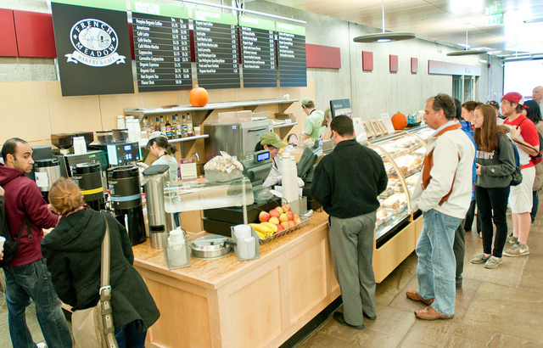
Example 5:
A survey of college students found that 65% live on campus, 78% have a campus meal plan, and 52% do both.
While dining in a campus facility only open to students with meal plans, you meet someone interesting.
What is the probability that your new acquaintance lives on campus?

Slide 18
Independence
Remember, independence of two events means that the outcome of one event does not influence the probability of the other.
Events A and B are independent whenever P(B|A) = P(B).
(Equivalently, events A and B are independent whenever P(A|B) = P(A).)

Slide 19
Question: Is having blue eyes independent of hair color?
Check this condition: P(B|A) = P(B).
P(blue│blonde) = P(blue)
64/81 = 114/313?
0.79 ≠ 0.36
These two conditions are not independent.
For example, those with blonde hair have a higher probability of having blue eyes.
Hair↓ Eye→ | Brown | Blue | Hazel | Green | Total
Black | 36 | 9 | 5 | 2 | 52
Brown | 66 | 34 | 29 | 14 | 143
Red | 16 | 7 | 7 | 7 | 37
Blonde | 4 | 64 | 5 | 8 | 81
Total | 122 | 114 | 46 | 31 | 313

Slide 20
Example 6: The table shows the distribution of goals for boys and girls:
 | Grades | Popular | Sports | Total
Boy | 117 | 50 | 60 | 227
Girl | 130 | 91 | 30 | 251
Total | 247 | 141 | 90 | 478
Questions:
Is wanting to excel at sports independent of a student’s gender?
Is getting good grades as a goal independent of gender?
Solutions:
1) not independent.
2) independent

Slide 21
Example 7:
A survey of college students found that 65% live on campus, 78% have a campus meal plan, and 52% do both.
Questions:
Are living on campus and having a meal plan independent?
Are living on campus and having a meal plan disjoint?

Slide 22
Independent ≠ Disjoint
Disjoint events cannot be independent! Well, why not?
Since we know that disjoint events have no outcomes in common, knowing that one occurred means the other didn’t.
Thus, the probability of the second occurring changed based on our knowledge that the first occurred.
It follows, then, that the two events are not independent.
A common error is to treat disjoint events as if they were independent, and apply the Multiplication Rule for independent events—don’t make that mistake.

Slide 23
Example 8
A company’s office of Human Resources reports a breakdown of employees by job type and gender as seen in the table.
Are being male and having a supervision job disjoint events?
Is having a supervisor’s job independent of the gender of the employee?
 | Male | Female
Management | 7 | 6
Supervision | 8 | 12
Production | 45 | 72

Slide 24
Depending on Independence: Note of Caution!
It’s much easier to think about independent events than to deal with conditional probabilities.
Don’t fall into this trap: whenever you see probabilities multiplied together, stop and ask whether you think they are really independent.

Slide 25
Tables, Venn Diagrams, and Probability
Sometimes we are given probabilities without table.
Constructing a table or Venn diagram an be very helpful.

Slide 26
The General Multiplication Rule
When two events A and B are independent, we can use the multiplication rule for independent events from Chapter 13:
P(A ∩ B) = P(A) x P(B)
However, when our events are not independent, this earlier multiplication rule does not work.
Thus, we need the General Multiplication Rule.

Slide 27
The General Multiplication Rule (cont.)
General Multiplication Rule:
For any two events A and B,
P(A ∩ B) = P(A) × P(B|A)
or
P(A ∩ B) = P(B) × P(A|B)

Slide 28
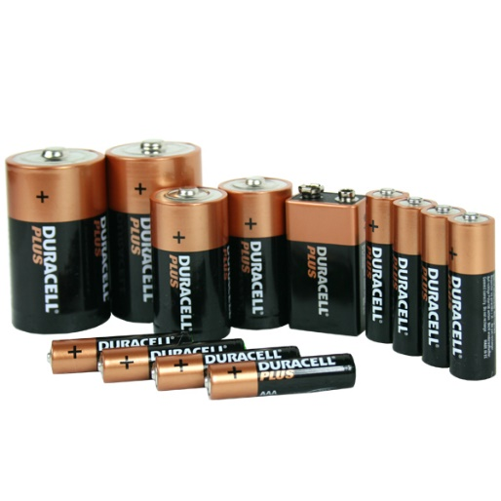
Example 9:
A factory produces two types of batteries, regular and rechargeable.
Quality inspection tests show that 3% of the regular batteries come off the manufacturing line with a defect, while only 2% of the rechargeable batteries have a defect.
Rechargeable batteries make up 30% of the company’s production.
What is the probability that if we choose one of the company’s batteries at random we get
A defective rechargeable battery?
A regular battery and it’s not defective?

Slide 29
Drawing Without Replacement
Sampling without replacement means that once one individual is drawn it doesn’t go back into the pool.
We often sample without replacement, which doesn’t matter too much when we are dealing with a large population.
However, when drawing from a small population, we need to take note and adjust probabilities accordingly.
Drawing without replacement is just another instance of working with conditional probabilities.

Slide 30
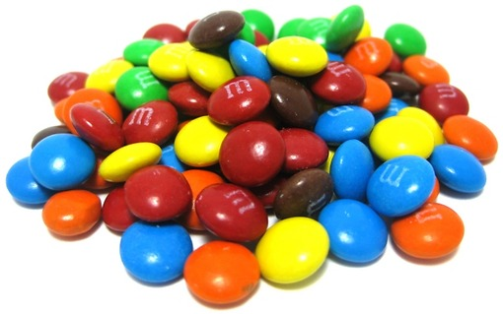
Example 10:
You just bought a small bag of m&m’s.
Inside the bag are 20 candies: 8 green, 4 orange, 4 red, 2 yellow, 1 blue, and 1 brown.
You tear open one corner and begin eating them by shaking out one at a time.
a) What is the probability that your first two m&m’s are both
orange?
b) What is the probability that your first three m&m’s are not
green?

Slide 31
Example 10:
You just bought a small bag of m&m’s.
Inside the bag are 20 candies: 8 green, 4 orange, 4 red, 2 yellow, 1 blue, and 1 brown.
You tear open one corner and begin eating them by shaking out one at a time.
c) What is the probability that your first two m&m’s are both red?
d) What is the probability that you eat three without seeing a
yellow one?
e) What is the probability that the fourth candy out of the bag is
the brown one?

Slide 32
Tree Diagrams
A tree diagram helps us think through conditional probabilities by showing sequences of events as paths that look like branches of a tree.
Making a tree diagram for situations with conditional probabilities is the best way to organize information.
Whenever you don’t know what to do, “MAKING A PICTURE” can help.

Slide 33
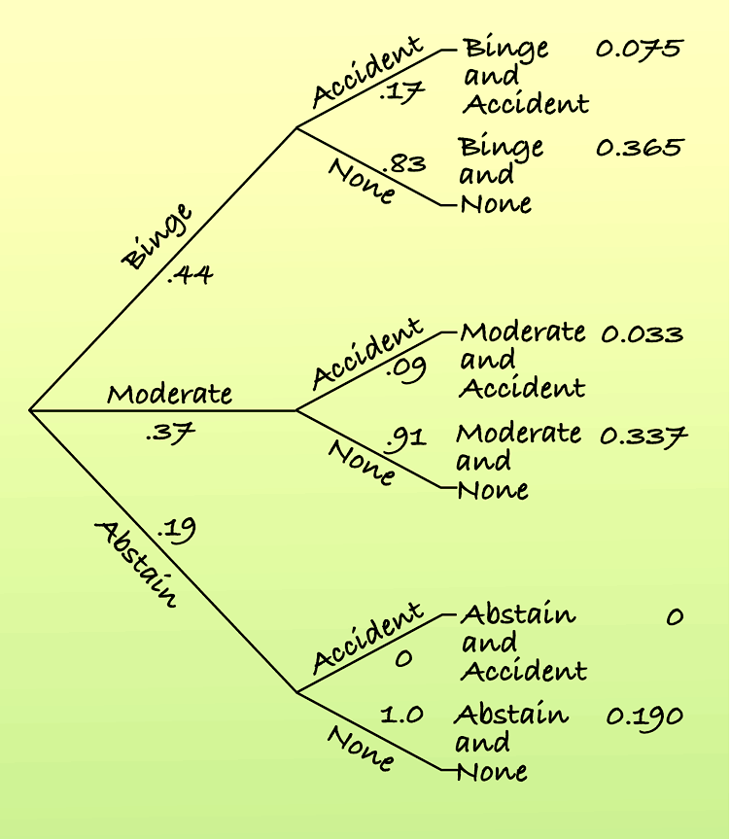
Tree Diagrams
All the final outcomes are disjoint and must add up to one.
We can add the final probabilities to find probabilities of compound events.

Slide 34
Reversing the Conditioning
Suppose we want to know P(A|B), and we know only P(A), P(B), and P(B|A).
We also know P(A ∩ B), since
P(A ∩ B) = P(A) x P(B|A)
From this information, we can find P(A|B):

Slide 35
Bayes’s Rule
When we have P(A│B) and we want to find P(B│A), we need to know P(A∩B) and P(A).
A tree is often a convenient way.
Instead of a tree, we can write the calculation algebraically.

Slide 36
Bayes’s Rule
When we reverse the probability from the conditional probability that you’re originally given, you are actually using Bayes’s Rule.

Slide 37
Example 11:
A factory produces two types of batteries, regular and rechargeable.
Quality inspection tests show that 3% of the regular batteries come off the manufacturing line with a defect, while only 2% of the rechargeable batteries have a defect.
Rechargeable batteries make up 30% of the company’s production.
A quality control inspector inspects some batteries selected at random from each shipment. If one of those batteries turns out to be defective, what is the probability that it is a rechargeable type?
Solve this using both a tree diagram and Bayes’s Rule.

Slide 38
What Can Go Wrong?
Don’t use a simple probability rule where a general rule is appropriate:
Don’t assume that two events are independent or disjoint without checking that they are.
Don’t find probabilities for samples drawn without replacement as if they had been drawn with replacement.
Don’t reverse conditioning naively.
Don’t confuse “disjoint” with “independent.”

Slide 39
What have we learned?
The probability rules from Chapter 13 only work in special cases—when events are disjoint or independent.
We now know the General Addition Rule and General Multiplication Rule.
We also know about conditional probabilities and that reversing the conditioning can give surprising results.

Slide 40
What have we learned? (cont.)
Venn diagrams, tables, and tree diagrams help organize our thinking about probabilities.
We now know more about independence—a sound understanding of independence will be important throughout the rest of this course.

