Slide 1
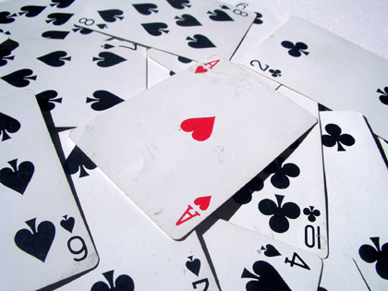
Chapter 16
Probability Models

Slide 2
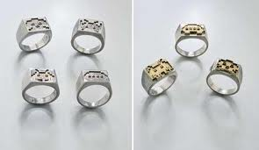
Suppose a cereal manufacturer puts toys in a box.
20% of the boxes contain temporary tattoos, 30% contain compasses, and the rest are filled with rings.
In Chapter 10, we wanted to know how many boxes we would have to open to get one of each prize.
We used simulations.
Now, we can answer questions like this more directly by using simple probability models.

Slide 3
20% of the boxes contain temporary tattoos, 30% contain compasses, and the rest are filled with rings.
Let’s suppose that you just want to get the temporary tattoos.
How many boxes would you expect to open until you get a tattoo?
We can answer this with a probability model.

Slide 4
When you open a box, the probability that you succeed in finding a tattoo is .20.
We call the act of opening each box a trial.
There are only two possible outcomes, called a success or a failure, on each trial.
Either you get a tattoo (success) or you don’t (failure).

Slide 5
The probability of success is denoted p.
It is the same on every trial.
Here p = .20 for each box.
The trials are also independent.
Finding the tattoo in the first box does not change what may happen when you reach for the next box.

Slide 6
Simulations like this one are called Bernoulli trials.
We have Bernoulli trials if:
there are two possible outcomes (success and failure).
the probability of success, p, is constant.
the trials are independent.
Examples that you can think of?:
Tossing a Coin
Rolling a die
Shooting free throws in a basketball game

Slide 7
Questions:
1) What is the probability that you find the tattoos in the first box?
Let’s call this random variable Y = # of boxes.
P(Y = 1) = 0.2

Slide 8
Questions:
2) What is the probability that you don’t find the tattoos until the second box?
The probability of failure is called q.
Here q = .80
Remember, all trials are independent.
P(Y = 2) = (0.8)(0.2) = 0.16

Slide 9
Questions:
3) What is the probability that you don’t find the tattoos until the fifth box?
P(Y = 5) = (0.8)⁴(0.2) = 0.08192

Slide 10
Questions:
4) What is the probability that you don’t find the tattoos until the 8th box?
P(Y = 8) = (0.8)⁷(0.2) = 0.0419

Slide 11
Questions:
5) How many boxes would you expect to have to open to find a tattoo?
Since the tattoos are in 1/5 boxes, you would expect to find a tattoo, on average, in the fifth box.
E(Y) = 1/0.2 = 5 boxes.

Slide 12
The 10% “Rule”
One of the important requirements for Bernoulli trials is that the trials be independent.
Sometimes, that is a reasonable assumption, like when we flip a coin or roll a die.
But what about when we look at situations without replacement?

Slide 13
We said earlier that finding a tattoo in one box has no effect on the probabilities in the other boxes.
This is ALMOST true.
With a few million boxes of cereal, the difference isn’t worth mentioning.
But if you had 10 boxes of cereal with two containing the tattoo, grabbing a box with the tattoo would change the probability of finding the tattoo in the next box.

Slide 14
If we had an infinite amount of boxes, there wouldn’t be a problem.
It’s selecting from a finite population that causes the probabilities to change, making the trials not independent.
However, there is a rule in statistics that relates to all of this…

Slide 15
The 10% “Rule”
The 10% Condition:
Bernoulli trials must be independent.
If that assumption is violated, it is still okay to proceed as long as we randomly sample fewer than 10% of the population.

Slide 16
Classwork:
Bernoulli Trials or Not Bernoulli Trials?

Slide 17
Homework
Chapter 16 Guided Reading
Complete Chapter 16 Guided Reading
Pg 430 Exercises: 1, 4, 7, 9

Slide 18
The Geometric Model
We want to see how long it will take to get the first success in a series of Bernoulli trials.
A Geometric probability model tells us the probability for a random variable that counts the number of Bernoulli trials until the first success.
Geometric models are completely specified by one parameter, p, the probability of success, and are denoted Geom(p).

Slide 19
The Geometric Model (cont.)
Geometric probability model for Bernoulli trials: Geom(p)
p = probability of success
q = 1 – p = probability of failure
X = number of trials until the first success occurs
P(X = x) = q^{x-1}p

Slide 20
Classwork:
Working with a Geometric Model Worksheet

Slide 21
Classwork:
Finding Geometric Probabilities on the Graphing Calculator Worksheet

Slide 22
Homework
Chapter 16 Guided Reading
Complete Chapter 16 Guided Reading
FRAPPY 2008 #3

Slide 23
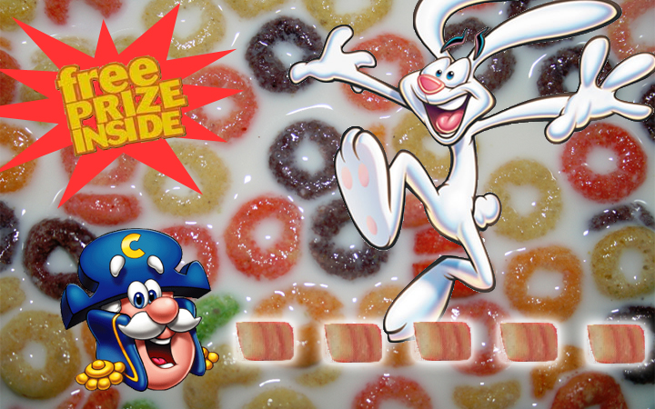
The Binomial Model:
Now what if you buy 5 boxes of cereal. What is the probability that you get exactly 2 temporary tattoos?
We want to find the probability of getting 2 successes among five trials.
There are so many possibilities for when we could get these successes.
We are still talking about Bernoulli trials, but we are asking a different question.

Slide 24
The Binomial Model:
This time we are interested in the number of successes in the 5 trials.
X = number of successes
We want to find P(X = 2).
This is called a Binomial Probability.

Slide 25
The Binomial Model
A Binomial model tells us the probability for a random variable that counts the number of successes in a fixed number of Bernoulli trials.
Two parameters define the Binomial model: n, the number of trials; and, p, the probability of success.
We denote this Binom(n, p).

Slide 26
The Binomial Model:
Exactly 2 successes in 5 trials means 2 successes and 3 failures.
It seems like the probability would be ${(0.2)}^{2}{(0.8)}^{3}$.
It’s not that easy.
This calculation would tell you the probability of getting tattoos in the first two boxes and not in the next 3 – in that order.

Slide 27
The Binomial Model:
You could also find tattoos in the third and fifth box and still have 2 successes.
The probability of this outcome would be (0.8)(0.8)(0.2)(0.8)(0.2).
This is also (0.2)²(0.8)³.
In fact, this probability will always be the same, no matter what order the failures and successes are in.
We now need to count all the possible orders in which the outcomes can occur.

Slide 28
Trick to finding the amount of combinations you can have.
Each different order in which we can have k successes is called a combination.
In n trials, the total number of ways to have k successes is written $\left({n \atop k}\right)$ or _{n}C_{k.}
Note: n! = n × (n – 1) × … × 2 × 1, and n! is read as “n factorial.”

Slide 29
Using Combinations
Now, what is the total amount of ways you can have 2 boxes of tattoos (successes) out of the five boxes?
$\left({5 \atop 2}\right)$ = $\frac{5!}{2!\left(5−2\right)!}$ = $\frac{5 x 4 x 3 x 2 x 1}{2 x 1 x 3 x 2 x 1}$ = $\frac{5 x 4}{2 x 1}$ = 20/2 = 10
Now, what is the chance of getting tattoos in 2 out of the 5 boxes?
P(#success = 2) = 10(0.2)²(0.8)³ = 0.2048

Slide 30
The Binomial Model (cont.)
Binomial probability model for Bernoulli trials: Binom(n,p)
n = number of trials
p = probability of success
q = 1 – p = probability of failure
X = # of successes in n trials
P(X = x) = _{n}C_{x} p^{x} q^{n–x}

Slide 31
Classwork:
Working with a Binomial Model Worksheet

Slide 32
Classwork:
Finding Binomial Probabilities on the Graphing Calculator Worksheet

Slide 33
Homework
Read Chapter 16
Complete Chapter 16 Guided Reading
Pg 431 – 433 Ex: 11, 13, 18, 20, 22, 24, 25, 27, 37

Slide 34
Classwork:
The Normal Model to the Rescue! (First Page)

Slide 35
The Normal Model to the Rescue
As long as the Success/Failure Condition holds, we can use the Normal model to approximate Binomial probabilities.
Success/failure condition: A Binomial model is approximately Normal if we expect at least 10 successes and 10 failures:
np ≥ 10 and nq ≥ 10
(Math box if you are interested on pg 424)

Slide 36
Classwork:
The Normal Model to the Rescue! (Finish)

Slide 37
Classwork:
Looking for Statistical Significance Worksheet

Slide 38
What Can Go Wrong?
Be sure you have Bernoulli trials.
You need two outcomes per trial, a constant probability of success, and independence.
Remember that the 10% Condition provides a reasonable substitute for independence.
Don’t confuse Geometric and Binomial models.
Don’t use the Normal approximation with small n.
You need at least 10 successes and 10 failures to use the Normal approximation.

Slide 39
What have we learned?
Bernoulli trials show up in lots of places.
Depending on the random variable of interest, we might be dealing with a
Geometric model
Binomial model
Normal model

Slide 40
What have we learned? (cont.)
Geometric model
When we’re interested in the number of Bernoulli trials until the next success.
Binomial model
When we’re interested in the number of successes in a certain number of Bernoulli trials.
Normal model
To approximate a Binomial model when we expect at least 10 successes and 10 failures.

Slide 41
Homework
Read Chapter 16
Complete Chapter 16 Guided Reading
Pg 432 – 433 Ex: 30, 31, 32, 36, 39, 40, 42
Chapter 16 Test Tomorrow

