Slide 1
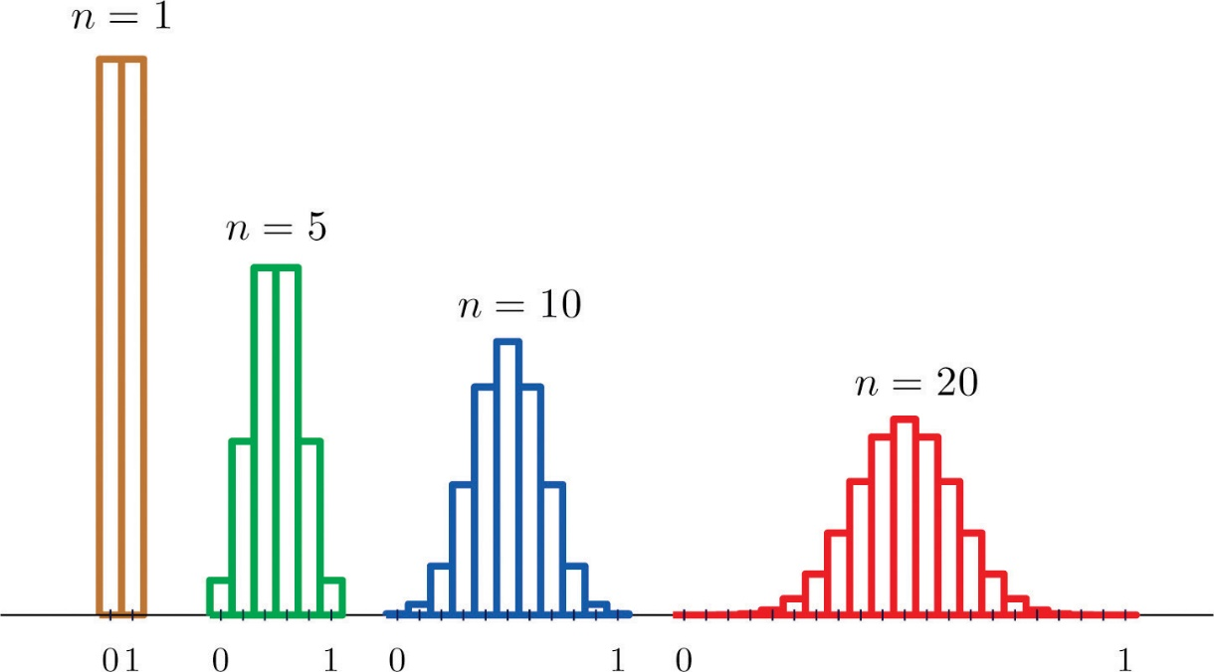
Chapter 17
Sampling Distribution Models

Slide 2
Classwork:
Introduction to Sampling Distribution Activity: Beads

Slide 3
Summary of what we just did…
We figured out what would happen if we drew many samples.
We figured out what would happen if we looked at the sample proportions for these samples.
The histogram we get when we can see all the proportions from all possible samples is called the sampling distribution of the proportions.

Slide 4
Summary of what we just did…
The histogram of the sample proportions is unimodal, symmetric, and centered at the true proportion, p, in the population.
A Normal model is the right one for the histogram of sample proportions.

Slide 5
Modeling the Distribution of Sample Proportions
Modeling how sample proportions vary from sample to sample is important
A sampling distribution model allows us to see that variation and how likely it is that we’d observe a sample proportion in any particular interval.

Slide 6
Modeling the Distribution of Sample Proportions
The sampling distribution of is modeled by a Normal model with
Mean:
Standard deviation:

Slide 7
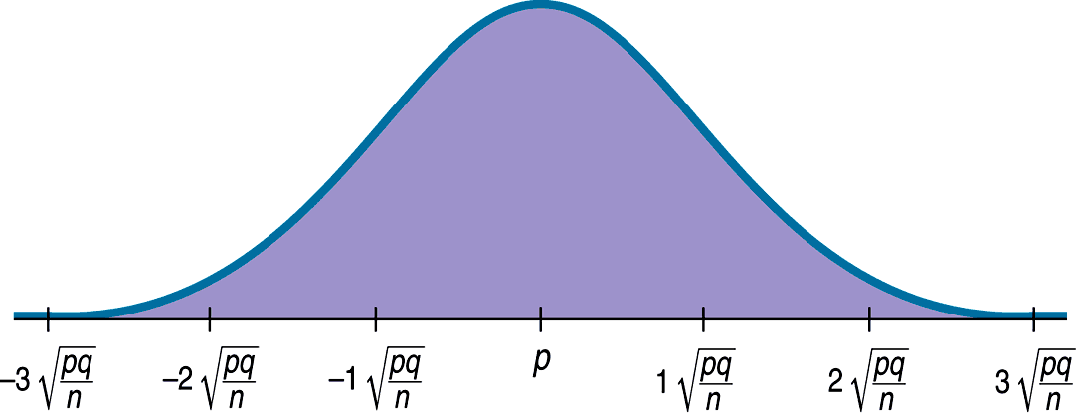
Modeling the Distribution of Sample Proportions
A picture of what we just discussed is as follows:

Slide 8
The Central Limit Theorem for Sample Proportions
95% of Normally distributed values are within two standard deviations of the mean.
95% of samples should give results that are near the mean, but vary above and below that by no more than two standard deviations.
This is what we mean by sampling error. (It’s not really an error at all, but the variability you’d expect to see from one sample to another)
A better term would be sampling variability.

Slide 9
How Good Is the Normal Model?
The Normal model becomes a better model as the sample size gets bigger.
Just how big of a sample do we need?

Slide 10
Assumptions and Conditions
Most models are useful only when specific assumptions are true.
There are two assumptions for the model for the distribution of sample proportions:
The Independence Assumption: The sampled values must be independent of each other.
The Sample Size Assumption: The sample size, n, must be large enough.

Slide 11
Assumptions and Conditions (cont.)
We need to check whether the assumptions are reasonable by checking conditions that provide information about the assumptions…

Slide 12
Assumptions and Conditions (cont.)
Randomization Condition: The sample should be a simple random sample of the population.
10% Condition: the sample size, n, must be no larger than 10% of the population.
Success/Failure Condition: The sample size has to be big enough so that both np (number of successes) and nq (number of failures) are at least 10.

Slide 13
A Sampling Distribution Model for a Proportion
Sampling distribution models are important because they enable us to say something about the true population proportion when all we have is data from the real world.

Slide 14
AP Stats Guy (Watch until 6:50)
https://www.youtube.com/watch?feature=player_detailpage&list=UUKs7JbggJzbNEIw0t-PaiQA&v=uPX0NBrJfRI

Slide 15
Classwork:
Using the Sampling Distribution Model for Proportions

Slide 16
Homework:
Read Chapter 17
Complete Chapter 17 Guided Reading
Pg 465 – 467; Ex: 6, 11, 13, 15, 22

Slide 17
What About Quantitative Data?
Proportions summarize categorical variables.
The Normal sampling distribution model is very useful.
Can we do something similar with quantitative data?
Is the Normal model a good model for all statistics?
It just so happens that the mean has a sampling distribution that is well approximated by a Normal model.

Slide 18
Simulating the Sampling Distribution of a Mean
Like any statistic computed from a random sample, a sample mean also has a sampling distribution.
We can use simulation to get a sense as to what the sampling distribution of the sample mean might look like…

Slide 19
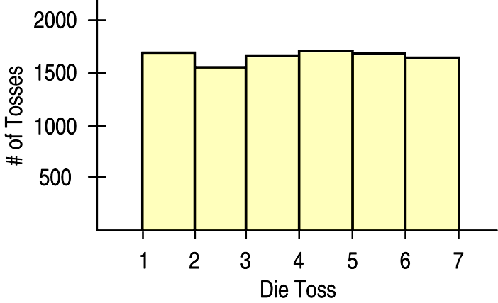
Means – The “Average” of One Die
Let’s start with a simulation of 10,000 tosses of a die.
A histogram of the results is:

Slide 20
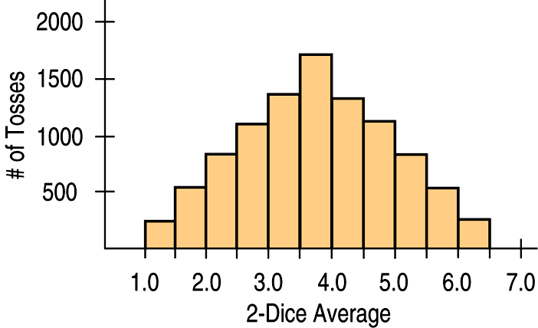
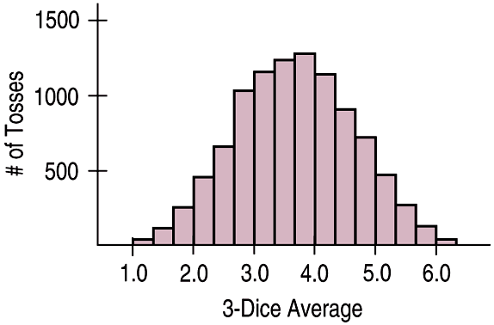
Means – Averaging More Dice
Looking at the average of two dice after a simulation of 10,000 tosses:
The average of three dice after a simulation of 10,000 tosses looks like:

Slide 21
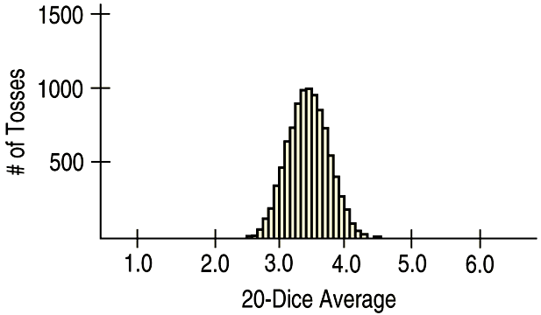
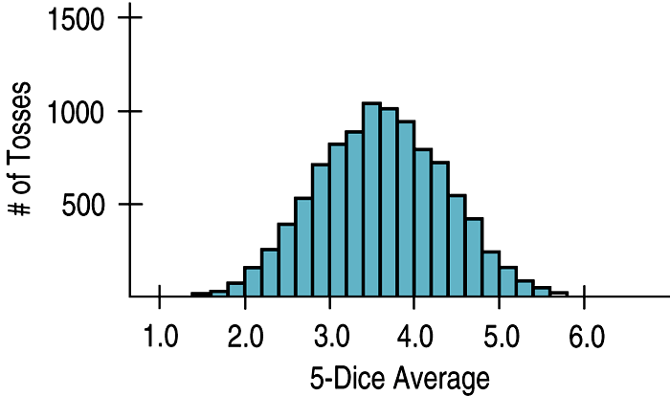
Means – Averaging Still More Dice
The average of 5 dice after a simulation of 10,000 tosses looks like:
The average of 20 dice after a simulation of 10,000 tosses looks like:

Slide 22
Means – What the Simulations Show
As the sample size (number of dice) gets larger, each sample average is more likely to be closer to the population mean.
So, we see the shape continuing to tighten around 3.5

Slide 23
The Fundamental Theorem of Statistics
The Central Limit Theorem (CLT)
The mean of a random sample is a random variable whose sampling distribution can be approximated by a Normal model. The larger the sample, the better the approximation will be.

Slide 24
The Fundamental Theorem of Statistics
The CLT is surprising and a bit weird:
Not only does the histogram of the sample means get closer and closer to the Normal model as the sample size grows, but this is true regardless of the shape of the population distribution.
The CLT works better (and faster) the closer the population model is to a Normal itself. It also works better for larger samples.

Slide 25
Assumptions and Conditions
The CLT requires the same assumptions we saw for modeling proportions:
Independence Assumption: The sampled values must be independent of each other.
Sample Size Assumption: The sample size must be sufficiently large.

Slide 26
Assumptions and Conditions (cont.)
We can’t check these directly, but we can think about whether the Independence Assumption is plausible. We can also check some related conditions:
Randomization Condition: The data values must be sampled randomly.
10% Condition: When the sample is drawn without replacement, the sample size, n, should be no more than 10% of the population.
Large Enough Sample Condition: The CLT doesn’t tell us how large a sample we need. For now, you need to think about your sample size in the context of what you know about the population.

Slide 27
But Which Normal?
The CLT says that the sampling distribution of any mean or proportion is approximately Normal.
But which Normal model?
For proportions, the sampling distribution is centered at the population proportion.
For means, it’s centered at the population mean.
But what about the standard deviations?

Slide 28
But Which Normal? (cont.)
The Normal model for the sampling distribution of the proportion has a standard deviation equal to
The Normal model for the sampling distribution of the mean has a standard deviation equal to
where σ is the population standard deviation.

Slide 29
AP Stats Guy (From 6:50 until the end)
https://www.youtube.com/watch?feature=player_detailpage&list=UUKs7JbggJzbNEIw0t-PaiQA&v=uPX0NBrJfRI

Slide 30
Classwork:
Using the Central Limit Theorem for Means

Slide 31
Homework:
Read Chapter 17
Complete Chapter 17 Guided Reading
Pg 465 – 470; Ex: 2, 3, 4, 8, 9, 19, 33, 36, 40, 43

Slide 32
“Do Now”
Means vary less than individual data values.
Explain why. Use an example.

Slide 33
About Variation
Note: $SD\left(\hat{p}\right)= \sqrt{\frac{pq}{n}}$ and $SD\left(\overline{x}\right)=\frac{σ}{\sqrt{n}}$ both have n in the denominator.
This shows that the standard deviation of the sample size decreases as the sample size increases.

Slide 34
About Variation
The standard deviation of the sampling distribution declines only with the square root of the sample size (the denominator contains the square root of n).
Therefore, the variability decreases as the sample size increases.

Slide 35
The Real World and the Model World
Be careful! Now we have two distributions to deal with.
The first is the real world distribution of the sample, which we display with a histogram or a bar chart.
The second is the sampling distribution model of the statistic, which we model with a Normal model based on the Central Limit Theorem.
Don’t confuse the two!

Slide 36
The Real World and the Model World
Don’t think that DATA are normally distributed as long as the sample is large enough.
As samples get larger, the distribution of the data will look more and more like the population from which they are drawn.
It could be skewed, bimodal, whatever – but not necessarily normal.

Slide 37
Example:
You collect a sample of CEO salaries for the next 1000 years. Will this histogram ever look normal?
What will the distribution of this data look like?
Note: The Central Limit Theorem doesn’t talk about the distribution of the data from the sample.
It talks about the sample MEANS and sample PROPORTIONS of many different random samples drawn from the same population.

Slide 38
Classwork:
Just Checking Questions

Slide 39
Sampling Distribution Models
Always remember that the statistic itself is a random quantity.
We can’t know what our statistic will be because it comes from a random sample.
Fortunately, for the mean and proportion, the CLT tells us that we can model their sampling distribution directly with a Normal model.

Slide 40
Sampling Distribution Models (cont.)
There are two basic truths about sampling distributions:
Sampling distributions arise because samples vary. Each random sample will have different cases and, so, a different value of the statistic.
Although we can always simulate a sampling distribution, the Central Limit Theorem saves us the trouble for means and proportions.

Slide 41
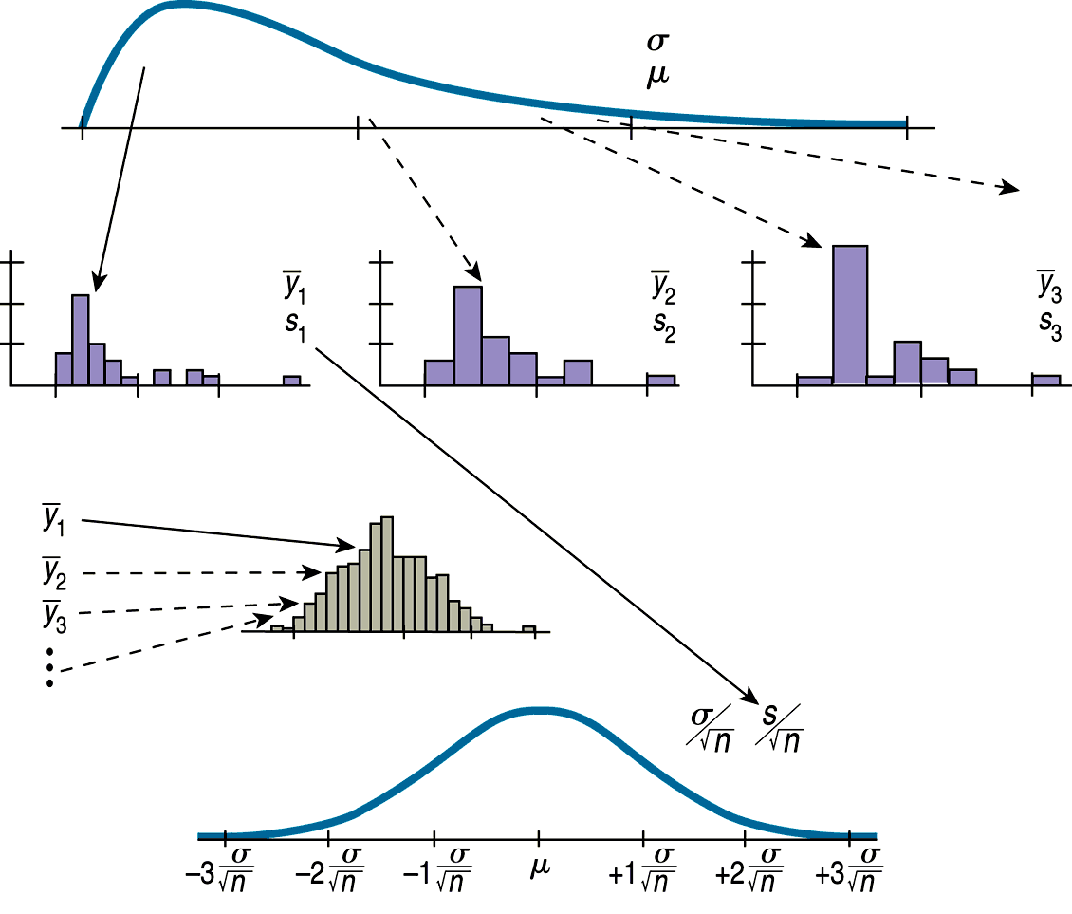
The Process Going Into the Sampling Distribution Model

Slide 42
Videos
http://www.apstatsguy.com/

Slide 43
What Can Go Wrong?
Don’t confuse the sampling distribution with the distribution of the sample.
When you take a sample, you look at the distribution of the values, usually with a histogram, and you may calculate summary statistics.
The sampling distribution is an imaginary collection of the values that a statistic might have taken for all random samples—the one you got and the ones you didn’t get.

Slide 44
What Can Go Wrong? (cont.)
Beware of observations that are not independent.
The CLT depends crucially on the assumption of independence.
You can’t check this with your data—you have to think about how the data were gathered.
Watch out for small samples from skewed populations.
The more skewed the distribution, the larger the sample size we need for the CLT to work.

Slide 45
What have we learned?
Sample proportions and means will vary from sample to sample—that’s sampling error (sampling variability).
Sampling variability may be unavoidable, but it is also predictable!

Slide 46
What have we learned? (cont.)
We’ve learned to describe the behavior of sample proportions when our sample is random and large enough to expect at least 10 successes and failures.
We’ve also learned to describe the behavior of sample means (thanks to the CLT!) when our sample is random (and larger if our data come from a population that’s not roughly unimodal and symmetric).

Slide 47
Homework:
Read Chapter 17
Complete Chapter 17 Guided Reading
Pg 467 – 472 Ex: 20, 28, 38, 47, 50, 52, 55, 57
Chapter 17 Quiz Tomorrow

