Slide 1
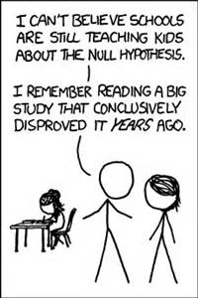
Chapter 20
More About Tests and Intervals

Slide 2
Zero In on the Null
To perform a hypothesis test, the null must be a statement about the value of a parameter for a model.
We then use this value to compute the probability that the observed sample statistic—or something even farther from the null value—might occur.

Slide 3
Classwork:
Writing Hypotheses

Slide 4
How to Think About P-Values
A P-value is a conditional probability—the probability of the observed statistic given that the null hypothesis is true.
The P-value is NOT the probability that the null hypothesis is true.
It’s not even the conditional probability that null hypothesis is true given the data.
Be careful to interpret the P-value correctly.

Slide 5
What to Do with a Small P-Value
When we see a small P-value, we could continue to believe the null hypothesis and conclude that we just witnessed a rare event.
But instead, we trust the data and use it as evidence to reject the null hypothesis.

Slide 6
What to Do with a High P-Value
Big P-values just mean what we observed isn’t surprising.
That is, the results are now in line with our assumption that the null hypothesis models the world, so we have no reason to reject it.

Slide 7
What to Do with a High P-Value
A big P-value doesn’t prove that the null hypothesis is true, but it certainly offers no evidence that it is not true.
Thus, when we see a large P-value, all we can say is that we “don’t reject the null hypothesis.”

Slide 8
Classwork:
Step-by-Step Example: Another One-Proportion Z-Test

Slide 9
Jury Trials Vs. Hypothesis Testing
What is the null hypothesis?
The defendant is innocent.
Evidence starts rolling in. Say when you think you can reject the null hypothesis?

Slide 10
Jury Trials Vs. Hypothesis Testing
Evidence (Bank robber):
A car the same color as his was parked in front of the bank.
No. The probability of that happening (given innocent) is high.

Slide 11
Jury Trials Vs. Hypothesis Testing
Evidence (Bank robber):
The security camera showed the robber was male and about the same height and weight.
No. The probability of that happening (given innocent) is still possible, but we are starting to question his innocence.

Slide 12
Jury Trials Vs. Hypothesis Testing
Evidence (Bank robber):
Witnesses then said the robber wore a blue jacket just like the police found in the defendant's trash.
The probability of that happening (given innocent) is getting low. Our P-value my be low enough to constitute “reasonable doubt” and lead to a conviction.

Slide 13
Jury Trials Vs. Hypothesis Testing
The more evidence we have, the more unlikely it would be were he innocent.
Additional evidence doesn’t make him guiltier, it just makes us more confident that we did the right thing when we convicted him.
The lower the P-value, the more comfortable we feel like our decision to reject the null hypothesis, but the null hypothesis doesn’t get any more false.

Slide 14
Homework:
Read Chapter 20
Complete Guided Reading
Pg 535 – 537, Ex: 2, 4, 5, 10, 11

Slide 15
Alpha Levels
Sometimes we need to make a firm decision about whether or not to reject the null hypothesis.
When the P-value is small, it tells us that our data are rare given the null hypothesis.
How rare is “rare”?

Slide 16
Alpha Levels (cont.)
We can define “rare event” by setting a threshold for our P-value.
If our P-value falls below that point, we’ll reject H₀. We call such results statistically significant.
The threshold is called an alpha level, denoted by α.

Slide 17
Alpha Levels (cont.)
Common alpha levels are 0.10, 0.05, and 0.01.
Consider your alpha level carefully and choose an appropriate one for the situation.
The alpha level is also called the significance level.
When we reject the null hypothesis, we say that the test is “significant at that level.”

Slide 18
Alpha Levels (cont.)
What can you say if the P-value does not fall below α?
You should say that “The data have failed to provide sufficient evidence to reject the null hypothesis.”
Don’t say that you “accept the null hypothesis.”

Slide 19
Alpha Levels (cont.)
Why do we provide a P-value to the reader?
The P-value gives the reader far more information than just stating that you reject or fail to reject the null.
You allow that person to make his or her own decisions about the test.
What you consider to be statistically significant might not be the same as what someone else considers statistically significant.
There is more than one alpha level that can be used, but each test will give only one P-value.

Slide 20
Significant vs. Important
What do we mean when we say that a test is statistically significant?
This means the test statistic had a P-value lower than our alpha level.

Slide 21
Confidence Intervals and Hypothesis Tests
Confidence intervals and hypothesis tests are built from the same calculations.
They have the same assumptions and conditions.
How can you approximate a hypothesis test by examining a confidence interval?
Just look whether the null hypothesis is consistent with the confidence interval.

Slide 22
Confidence Intervals and Hypothesis Tests (cont.)
Because confidence intervals are two-sided, they correspond to two-sided tests.
A confidence interval with a confidence level of C% corresponds to a two-sided hypothesis test with an α-level of 100 – C%.

Slide 23
Confidence Intervals and Hypothesis Tests (cont.)
The relationship between confidence intervals and one-sided hypothesis tests is a little more complicated.
A confidence interval with a confidence level of C% corresponds to a one-sided hypothesis test with an α-level of ½(100 – C)%.

Slide 24
Classwork
Making a Decision Based on a Confidence Interval
Step-by-Step Example: Wear that Seatbelt!

Slide 25
*A 95% Confidence Interval for Small Samples
When the Success/Failure Condition fails, all is not lost.
A simple adjustment to the calculation lets us make a confidence interval anyway.
All we do is add four phony observations, two successes and two failures.
So instead of we use the adjusted proportion

Slide 26
*A Better Confidence Interval for Proportions
Now the adjusted interval is
The adjusted form gives better performance overall.
It has the additional advantage that we no longer need to check the Success/Failure Condition.

Slide 27
Classwork:
Confidence Intervals for Small Samples

Slide 28
Homework:
Read Chapter 20
Complete Guided Reading
Pg 537 – 538 Ex: 13, 16, 17, 22

Slide 29
Making Errors
Even with lots of evidence we can still make the wrong decision.
When we perform a hypothesis test, we can make mistakes in two ways:
The null hypothesis is true, but we mistakenly reject it. (Type I error)
The null hypothesis is false, but we fail to reject it. (Type II error)

Slide 30
Example:
In medical disease testing, the assumption is that the person is healthy.
The alternative is that they have the disease.
What would a type I error be here?
It’s a false positive. A healthy person is diagnosed with the disease.
What would a type II error be here?
It’s a false negative. An infected person is diagnosed as healthy.

Slide 31
Example:
In a jury trial…
What would be a type I error?
The jury convicts an innocent person.
What would be a type II error?
The jury lets a guilty person go free.

Slide 32
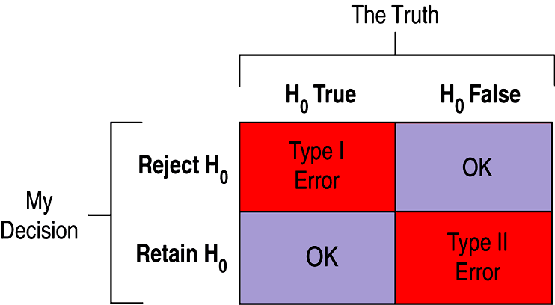
Making Errors (cont.)
Which type of error is more serious depends on the situation at hand.
Here’s an illustration of the four situations in a hypothesis test:

Slide 33
Making Errors (cont.)
How often will a Type I error occur?
Since a Type I error is rejecting a true null hypothesis, the probability of a Type I error is our α level.

Slide 34
Making Errors (cont.)
When H₀ is false and we fail to reject it, we have made a Type II error.
We assign the letter β to the probability of this mistake.
It’s harder to assess the value of β because we don’t know what the value of H₀ really is.

Slide 35
Making Errors (cont.)
We could reduce β by increasing α.
By making it easier to reject the null, we would reduce the chance of retaining a false null.
This would reduce β but increase the chance of a Type I error.
This tension between Type I and Type II errors is inevitable.
The only way to reduce both types of errors is to collect more data. Otherwise, we just wind up trading off one kind of error against the other.

Slide 36
Making Errors (cont.)
When H₀ is false and we reject it, we have done the right thing.
A test’s ability to detect a false hypothesis is called the power of the test.
In a jury trial, what would be the power?
The ability of the criminal justice system to convict people that are guilty.

Slide 37
Classwork:
Thinking about Errors

Slide 38
Power
The power of a test is the probability that it correctly rejects a false null hypothesis.
When the power is high, we can be confident that we’ve looked hard enough at the situation.
The power of a test is 1 – β ; because β is the probability that a test fails to reject a false null hypothesis and power is the probability that it does reject.

Slide 39
Power (cont.)
Whenever a study fails to reject its null hypothesis, the test’s power comes into question.
These would all be reasons why an experiments could lack power:
Was our sample size big enough to detect an effect had there been one?
Might we have missed an effect large enough to be interesting because we failed to gather sufficient data?
Was there too much variability in the data we gathered?

Slide 40
Classwork:
Errors and Power

Slide 41
Effect Size
When we calculate power, we imagine that the null hypothesis is false.
The value of the power depends on how far the truth lies from the null hypothesis value.
The distance between the null hypothesis value, p₀, and the truth, p, is called the effect size.
Power depends directly on effect size.

Slide 42
Classwork:
Just Checking Questions

Slide 43
Homework:
Read Chapter 20
Complete Guided Reading
Pg 538 – 539 Ex: 23, 25, 30, 32

Slide 44
A Picture Worth Words
The larger the effect size, the easier it should be to see it.
Obtaining a larger sample size decreases the probability of a Type II error, so it increases the power.
It also makes sense that the more we’re willing to accept a Type I error, the less likely we will be to make a Type II error.

Slide 45
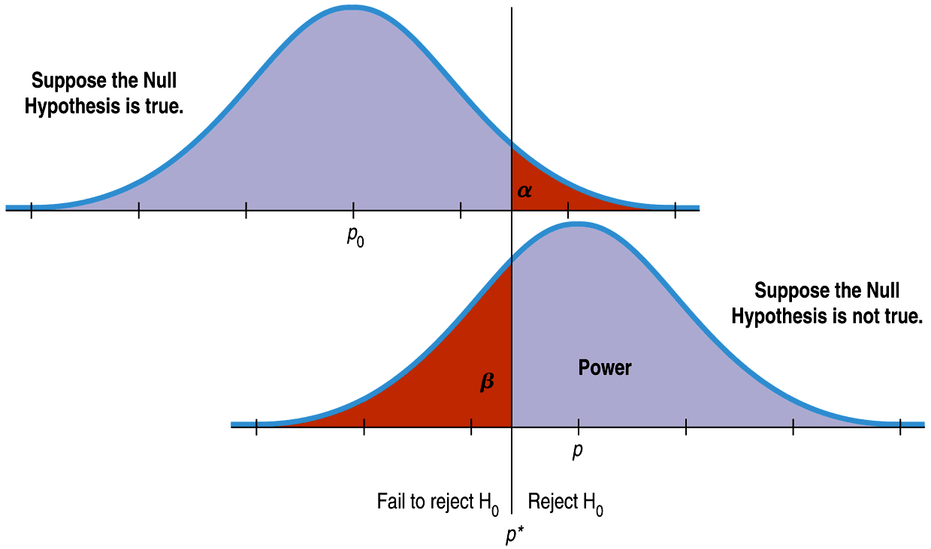
This diagram shows the relationship between these concepts:

Slide 46
Reducing Both Type I and Type II Error
The figure seems to show that if we reduce Type I error, we must automatically increase Type II error.
But, we can reduce both types of error by making both curves narrower.
How do we make the curves narrower?
Increase the sample size.

Slide 47
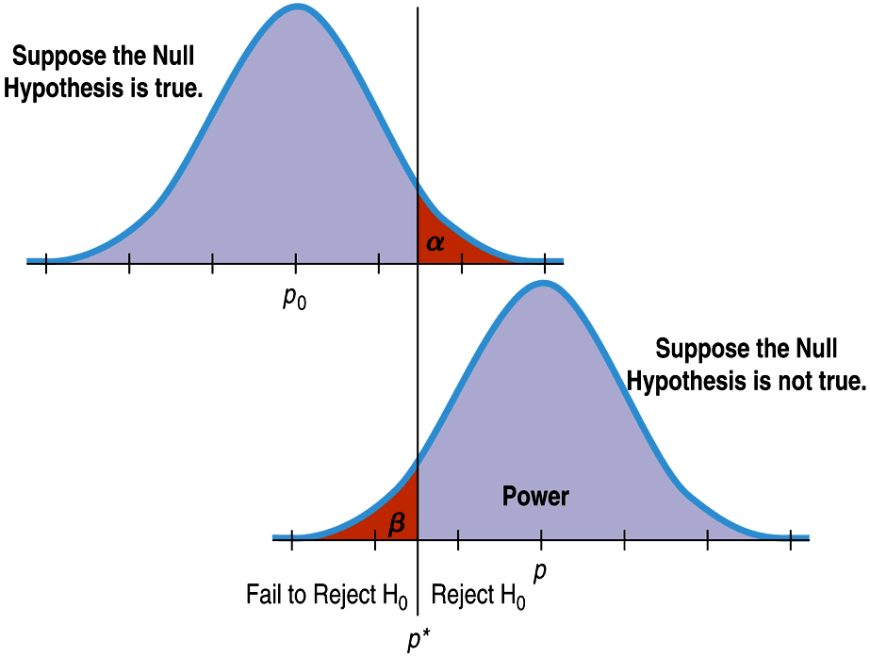
Reducing Both Type I and Type II Error (cont.)
This figure has means that are just as far apart, but the sample sizes are larger, the standard deviations are smaller, and the error rates are reduced:

Slide 48
Reducing Both Type I and Type II Error (cont.)
Original comparison of errors:
Comparison of errors with a larger sample size:

Slide 49
Classwork:
Sample Size, Errors, and Power
https://www.youtube.com/watch?v=FcBOhivfzOo

Slide 50
What Can Go Wrong?
Don’t interpret the P-value as the probability that H₀ is true.
The P-value is about the data, not the hypothesis.
It’s the probability of observing data this unusual, given that H₀ is true, not the other way around.
Don’t believe too strongly in arbitrary alpha levels.
It’s better to report your P-value and a confidence interval so that the reader can make her/his own decision.

Slide 51
What Can Go Wrong? (cont.)
Don’t confuse practical and statistical significance.
Just because a test is statistically significant doesn’t mean that it is significant in practice.
And, sample size can impact your decision about a null hypothesis, making you miss an important difference or find an “insignificant” difference.
Don’t forget that in spite of all your care, you might make a wrong decision.

Slide 52
What have we learned?
There’s a lot more to hypothesis testing than a simple yes/no decision.
Small P-value, indicates evidence against the null hypothesis, not that it is true.
Alpha level establishes level of proof, determines the critical value z that leads us to reject null hypothesis.
Hypothesis test gives answer to decision about parameter; confidence interval tells us plausible values of that parameter.

Slide 53
What have we learned?
And, we’ve learned about the two kinds of errors we might make and seen why in the end we’re never sure we’ve made the right decision.
Type I error, reject a true null hypothesis, probability is α.
Type II error, fail to reject a false null hypothesis, probability is β.
Power is the probability we reject a null hypothesis when it is false, 1 – β.
Larger sample size increase power and reduces the chances of both kinds of errors.

Slide 54
Homework:
Read Chapter 20
Complete Guided Reading
Pg 539 – 540 Ex: 34, 36, 38, 39, 41
Test Tomorrow on Chapter 20

