Slide 1
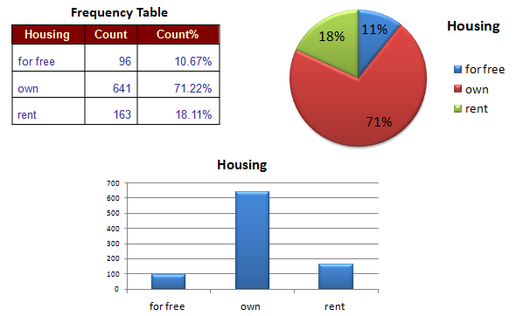
Chapter 2
Displaying and Describing Categorical Data

Slide 2
Three Rules of Data Analysis
Make a picture - things may be revealed that are not obvious in the raw data - things to think about.
Make a picture - important features and patterns in the data will show up. You may also see things that you did not expect.
Make a picture - the best way to tell others about your data is with a well-chosen picture.

Slide 3
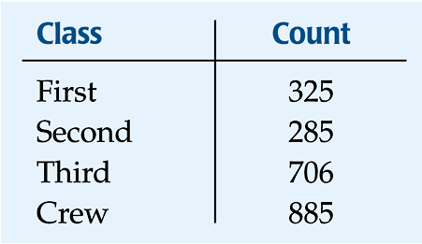
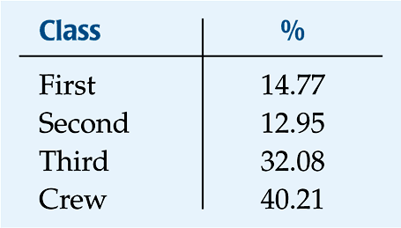
Frequency Tables
For categorical variables, we often compile data by counting the number of values in each category and display these counts in a frequency table:
A relative frequency table is similar, but shows percentages instead of counts.
Both tables show how cases are distributed across the categories.
How ???

Slide 4
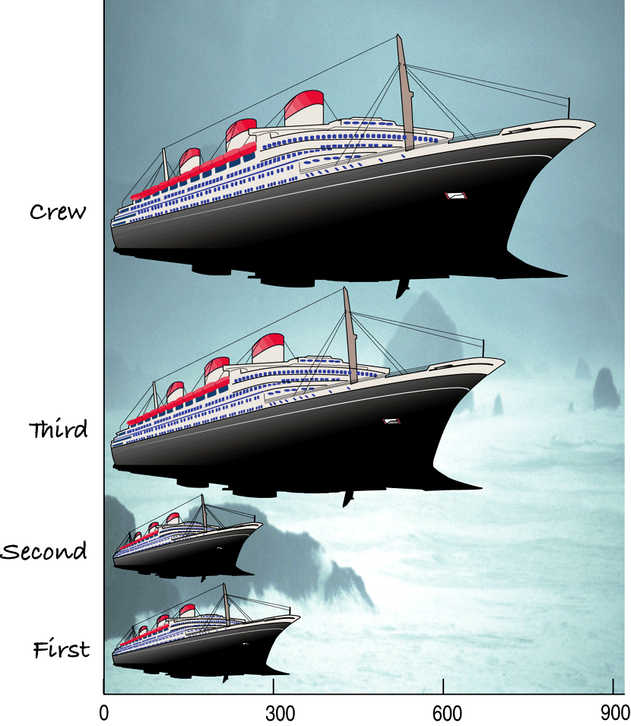
What’s Wrong With This Picture?
You might think that
a good way to show
the Titanic data is
with this display:

Slide 5
The Area Principle
The ship display makes it look like most of the people on the Titanic were crew members, with a few passengers along for the ride.
When we look at each ship, we see the area taken up by the ship, instead of the length of the ship.
The ship display violates the area principle:
The area occupied by a part of the graph should correspond to the magnitude of the value it represents.

Slide 6
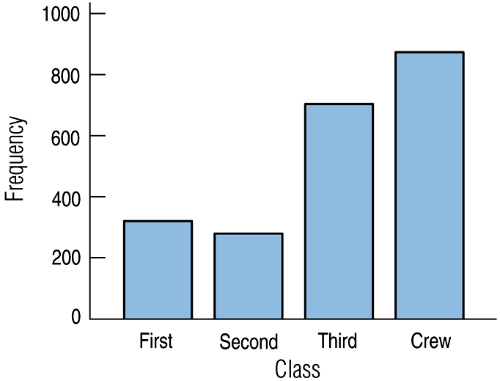
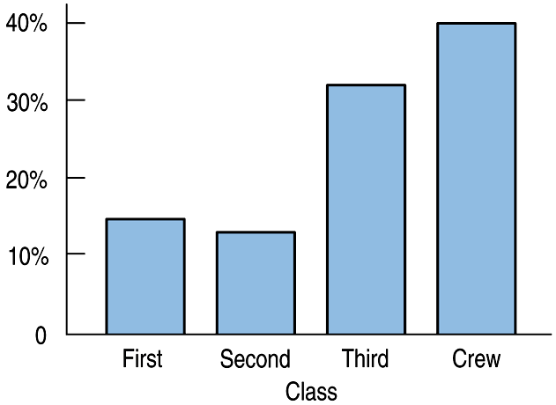
Bar Charts
Bar charts display the distribution of a categorical variables, showing the counts side-by-side.
Relative frequency bar charts display the percentages of counts.
Which do you prefer? Why?

Slide 7
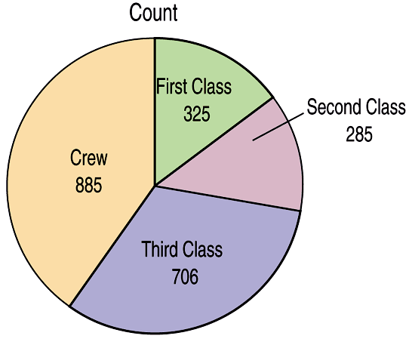
Pie Charts
When you want to display parts of a whole, you can use a pie chart. Pie charts display the counts or percentages.
Using percentages is often the better choice (why?).

Slide 8
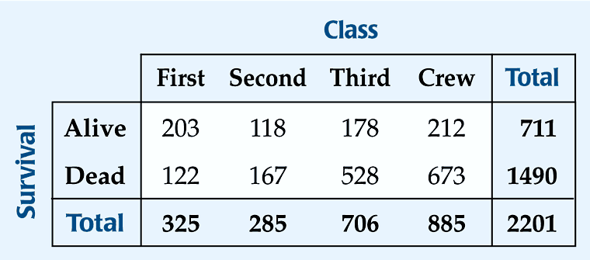
Contingency Tables…
Allow us to look at two categorical variables at the same time.
Show how individuals are distributed across each variable, contingent on the second variable.
What two variables are we looking at here??

Slide 9
Contingency Tables (cont.)
The margins (right and bottom) of a contingency table should have row and column totals (ADD THEM). We use these totals to calculate marginal distributions.
Example:
The marginal distribution of Alive is:
Find the marginal distribution of Second:
711
/2201 = 32%
285/2201 (13%)

Slide 10
Contingency Tables (cont.)
Each cell of the table gives a count for a combination of variables.
This cell tells us that 673 crew members died when the Titanic sunk.

Slide 11
Conditional Distributions
A conditional distribution shows the distribution of one variable for just the individuals who satisfy some condition on another variable.
The following is the conditional distribution of ticket Class, conditional on having survived:

Slide 12
Conditional Distributions (cont.)
The following is the conditional distribution of ticket Class, conditional on having perished:

Slide 13
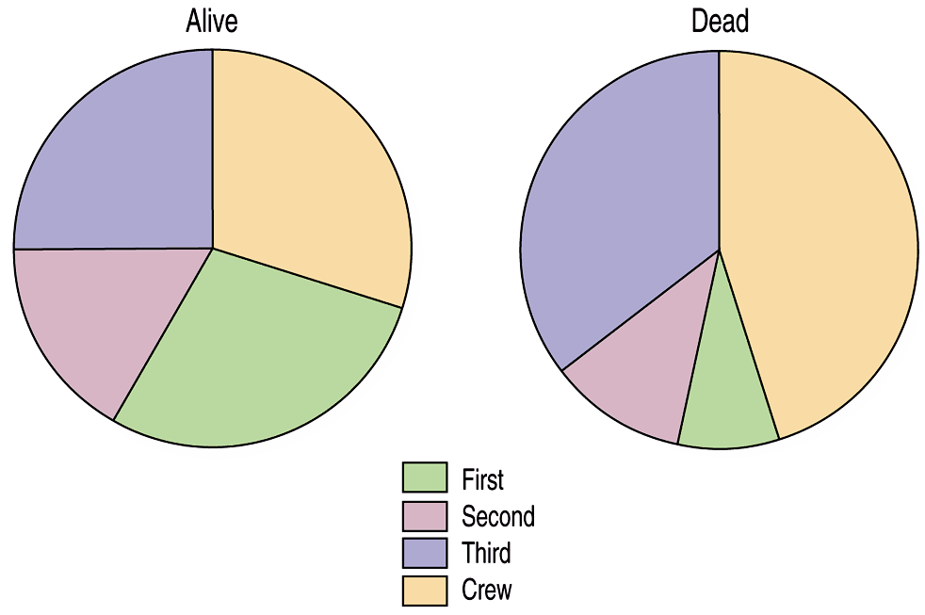
Conditional Distributions (cont.)
Is there a difference in class for those who survived and those who perished?
This is better shown with pie charts of the two distributions:

Slide 14
Conditional Distributions (cont.)
Is the distribution of Class for the survivors different from that of the non-survivors?
Do you think that Class and Survival are associated?
So is Class and Survival independent of each other?
The variables are considered independent when the distribution of one variable in a contingency table is the same for all categories of the other variable.

Slide 15
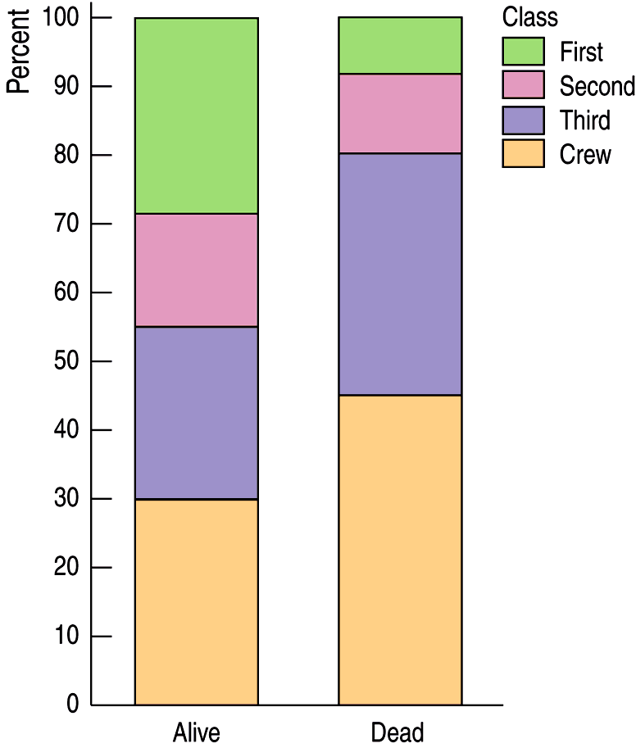
Segmented Bar Charts
A segmented bar chart displays the same information as a pie chart, but in the form of bars instead of circles.
Each bar is treated as the “whole” and is divided into segments corresponding to the percentage in each group.
Here is the segmented bar chart for ticket Class by Survival status:

Slide 16
Homework 1:
Find a graph in a newspaper, magazine, or on the internet that is an example of a violation of the area principle. Explain how the graph is misleading and what should be changed to improve it.
Read Chapter 2 (Reading Quiz Tomorrow)
How To #1 and #2

Slide 17
Chapter 2 Reading Quiz
On the top of your reading quiz, write down the ages of all your siblings. I will be using this data for a chapter 3 activity.

Slide 18
Example: Sneakers!!
Sneaks/Gender | Girls | Boys | Totals
Wearing | 14 | 21 | 35
Not Wearing | 20 | 3 | 23
Totals | 34 | 24 | 58
What is the marginal frequency distribution of wearing sneakers? What is the marginal frequency distribution of girls?
What percent of sneaker-wearers are girls?
What percent of the girls are sneaker-wearers?
What percent of the class are girls who are wearing sneaks?
Are the variables gender and wearing sneaks associated or independent?

Slide 19
You Try!!
Politics/Gender | Girls | Boys | Totals
Liberal | 2 | 1 | 3
Moderate | 29 | 13 | 42
Conservative | 2 | 8 | 10
Totals | 33 | 22 | 55
What are the variables?
What is the marginal frequency distribution of moderate?
What percent of liberals are girls?
What percent of the girls are liberals?
What percent of the class are girls with moderate political views?
Are the variables gender and political view associated or independent? How do we decide?
Sketch a SEGMENTED BAR GRAPH.

Slide 20
All Chapter 2 Homework Due on Friday:
How to #1 and #2
Chapter 2 Questions from Notes
Violation of the Area Principle
Chapter 2 Homework – Displaying and Describing Categorical Data
Grade yourself using the homework rubric. Remember, if you cheat and give yourself a higher grade than you deserve, you get a zero.

Slide 21
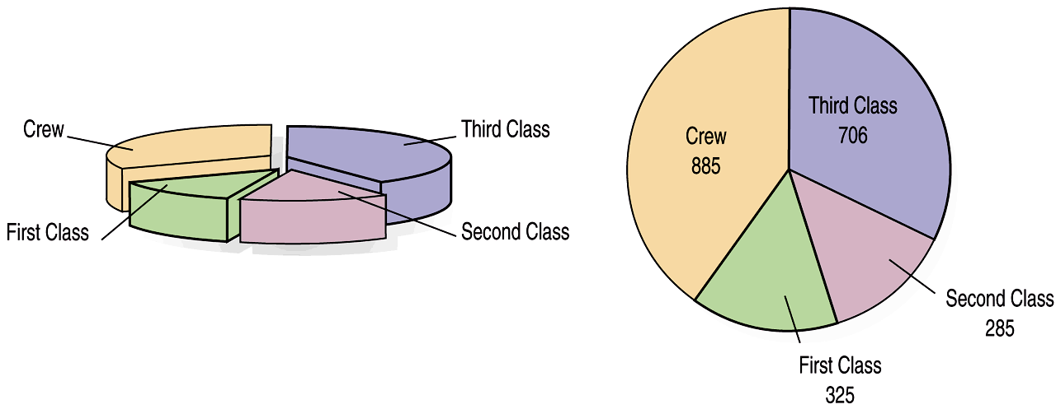
What Can Go Wrong?
Don’t violate the area principle.
Some people might like the pie chart on the left, but it violates the area principal.

Slide 22
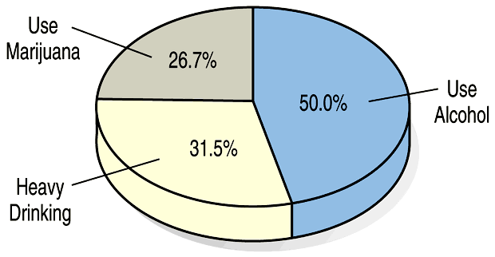
What Can Go Wrong? (cont.)
Keep it honest—make sure your display shows what it says it shows.
This plot of the percentage of high-school students who engage in specified dangerous behaviors has a problem. Can you see it?

Slide 23
What Can Go Wrong? (cont.)
Be sure to use enough individuals!
Don’t make a report like:
“66.67% of the participants in our drug study had improved health…
… the other one died.”

Slide 24
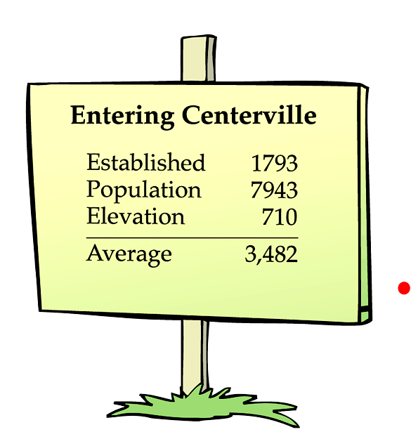
What Can Go Wrong? (cont.)
Don’t use unfair or silly averages - this could lead to Simpson’s Paradox, a statistical phenomenon where the data seems to prove the reverse of the truth.
Cancer Treatment
New England Medical Center in Boston: 1,000/3,500 (28.5%) of patients died.
Harrington Hospital in Southbridge: 10/100 (10%) of patients died.
Which hospital do you want to treat the cancer of a family member?

Slide 25
What have we learned?
We can summarize categorical data by counting the number of cases in each category (expressing these as counts or percents).
We can display the distribution in a bar chart or pie chart.
And, we can examine two-way tables called contingency tables, examining marginal and/or conditional distributions of the variables.

Slide 26
Pop Quiz YaY !!
Politics/Gender | Girls | Boys | Totals
Liberal | 15 | 8 | 23
Moderate | 29 | 13 | 42
Conservative | 6 | 9 | 15
Totals | 50 | 30 | 80
What is the marginal distribution of Gender?
What percent of liberals are boys?
What percent of the boys are liberals?
Are the variables gender and political view associated or independent?

