Slide 1
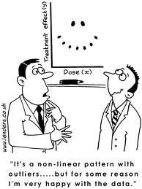
Chapter 7
Linear Regression

Slide 2
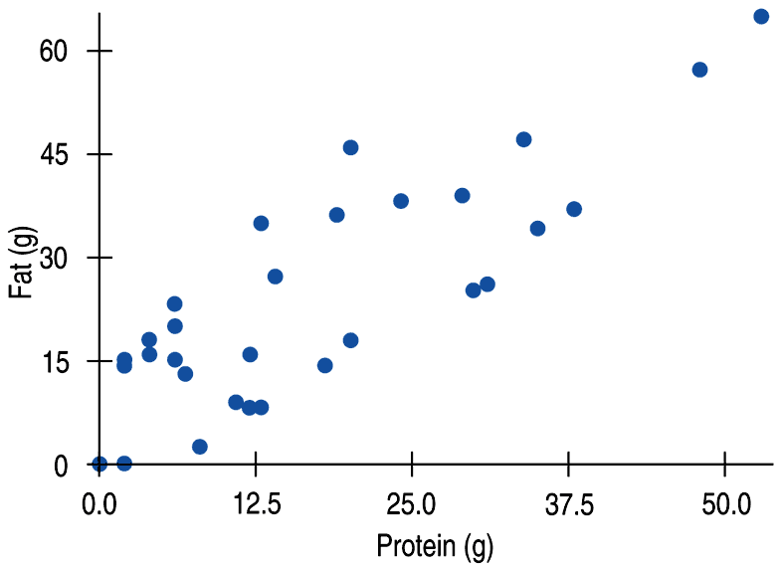
Fat Versus Protein: An Example
The following is a scatterplot of total fat versus protein for 30 items on the Burger King menu:
$$\overline{x}=18.0 grams$$
$$\overline{y}=24.26 grams$$
$$S_{x}=13.5 grams$$
$$S_{y}=15.78 grams$$

Slide 3
The Linear Model
The correlation in this example is 0.83.
We can say more about the linear relationship between two quantitative variables with a model.
A model simplifies reality to help us understand underlying patterns and relationships.

Slide 4
The Linear Model (cont.)
The linear model is just an equation of a straight line through the data.
A straight line can summarize the general pattern with only a couple of parameters.
The linear model can help us understand how the values are associated.

Slide 5
Residuals
The model won’t be perfect, regardless of the line we draw.
Some points will be above the line and some will be below.
The estimate made from a model is the predicted value (denoted as ).

Slide 6
Residuals (cont.)
The difference between the observed value and the predicted value is called the residual.

Slide 7
Residuals (cont.)
Questions:
What would a negative residual mean?
That the predicted value’s too big (an overestimate).
What would a positive residual mean?
That the predicted value’s too small (an underestimate).

Slide 8
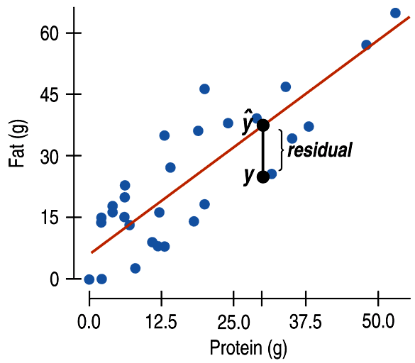
Residuals (cont.)
In the figure, the estimated fat of the BK Broiler chicken sandwich is 36 g, while the true value of fat is 25 g.
What would be the residual?
–11 g of fat.
What does this residual mean?
That the predicted value is an
overestimate.

Slide 9
“Best Fit” Means Least Squares
Some residuals are positive, others are negative, and, on average, they cancel each other out.
So, we can’t assess how well the line fits by adding up all the residuals.
So what do you think we can do?
Similar to what we did with deviations, we square the residuals and add the squares.
The smaller the sum, the better the fit.
The line of best fit is the line for which the sum of the squared residuals is smallest, the least squares regression line.

Slide 10
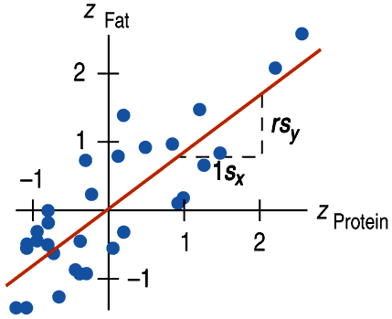
Correlation and the Line
The figure shows the scatterplot of z-scores for fat and protein.
What line would you chose to model this relationship?
Let’s pick some points.
In general, if a burger has an average protein content, it should have about an average fat content too.
This would be the point ($\overline{x},\overline{y}).$
In the plot of z-scores, this would be (0, 0).
The line passes through the origin.

Slide 11
Correlation and the Line
The line goes through (0, 0).
The equation for the line that passes through the origin is y = mx.
However, our points are not (x, y).
They are the z-scores $\left(z_{x},z_{y}\right).$
More specifically on this LINE, the point would be $\left(z_{x},\hat{z_{y}} \right).$
We need to change our equation to show this.
The equation becomes:
$$\hat{z_{y}}=mz_{x}$$

Slide 12
Correlation and the Line

Slide 13
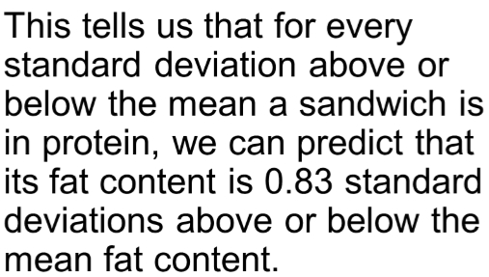
Correlation and the Line

Slide 14
Note:
What would it mean here if r = 0?
What would it mean here if r = -1 or r = 1?

Slide 15
How Big Can Predicted Values Get?
Moving one standard deviation away from the mean in x moves us r standard deviations away from the mean in y.
So which value tends to be closer to the mean?
r cannot be bigger than 1 (in absolute value), so each predicted y tends to be closer to its mean (in standard deviations) than its corresponding was.
This property is called regression to the mean.
The line is called the regression line.

Slide 16
Classwork:
Just Checking Questions 1 – 3

Slide 18
The Regression Line in Real Units
Remember from Algebra that a straight line can be written as:
In Statistics we use a slightly different notation:
We write to emphasize these are predicted values.
This model says that our predictions from our model follow a straight line.

Slide 19
The Regression Line in Real Units(cont.)
b₁ is the slope, which tells us how rapidly changes with respect to x.
b₀ is the y-intercept, which tells where the line crosses (intercepts) the y-axis.

Slide 20
The Regression Line in Real Units (cont.)
In our model, we have a slope (b₁):
The slope formula is:
(You can check the “math box” to see where this came from)
Our slope is always in units of y per unit of x.

Slide 21
The Regression Line in Real Units (cont.)
Now solve for $b_{0}.$

Slide 22
Now find the regression line for the Burger King data:
We know:
$$\overline{x}=18.0 grams$$
$$\overline{y}=24.26 grams$$
$$S_{x}=13.5 grams$$
$$S_{y}=15.78 grams$$
$$r=0.83$$
$$b_{1}=\frac{0.83 ×15.78}{13.5}$$
$$b_{1}=0.97$$
$$b_{0}=24.26 −0.97(18)$$
$$b_{0}=6.8$$
The equation is:

Slide 23
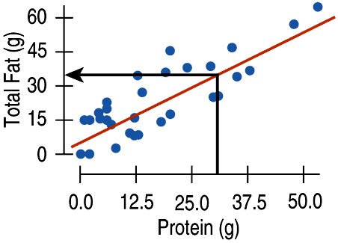
Fat Versus Protein: An Example
What does the slope mean?
This says that BK sandwiches pack about 0.97 additional grams of fat for each additional gram of protein.
Always express slope as “y-units per x-unit”

Slide 24
Fat Versus Protein: An Example
What does the y-intercept mean?
This says that a BK sandwich with no protein would have 6.8 grams of fat.
Normally, we wouldn’t analyze the y-intercept in these cases.
It serves mainly as a starting value for predictions and we don’t interpret it as a meaningful predicted value.

Slide 25
Fat Versus Protein: An Example
Questions:
What would you predict the fat content for a BK Broiler chicken sandwich to be (with 30 g of protein)?
6.8 + 0.97(30) = 35.9 grams of fat.
The BK Broiler chicken sandwich actually has 29 grams of fat.
What is its residual?
$$fat − \hat{fat}=29 −35.9=−6.9 grams.$$
What does this residual mean?
The prediction was an over estimate.

Slide 26
Classwork:
Just Checking Questions 4 – 7.

Slide 27
Homework:
Pg 198 – 203
Exercises 2, 4, 6, 13, 14, 15, 16, 31, 32, 35, 43 (a – e)
Read Chapter 7
Work on the Chapter 7 Guided Reading

Slide 28
The Regression Line in Real Units (cont.)
Regression and correlation are closely related, so we need to check the same conditions:
Quantitative Variables Condition
Straight Enough Condition
Outlier Condition

Slide 29
Residuals Revisited
The linear model assumes that the relationship is a straight line.
The residuals are the part of the data that hasn’t been modeled.
Data = Model + Residual
or (equivalently)
Residual = Data – Model
Or, in symbols,
e is used for error. It tells you how much the actual value (data) varies from the predicted value (model).

Slide 30
Residuals Revisited (cont.)
Residuals help us to see whether the model makes sense.
When a regression model is appropriate, nothing interesting should be left behind.
After we fit a regression model, we usually plot the residuals in the hope of finding…nothing.

Slide 31
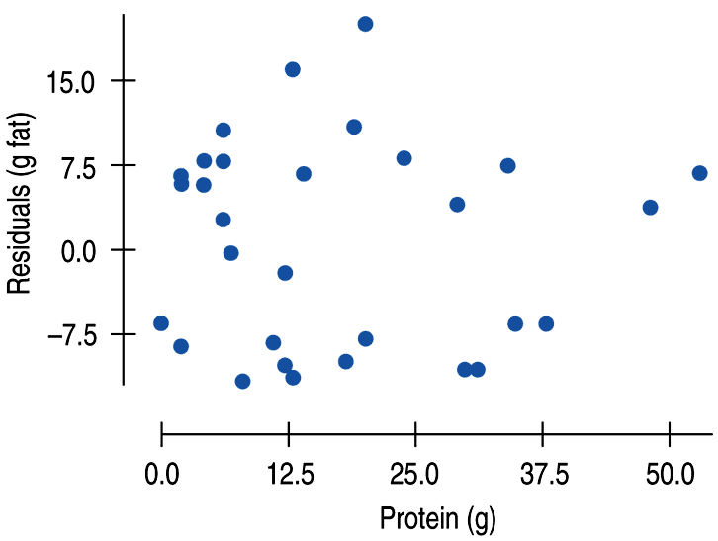
Residuals Revisited (cont.)
The residuals for the BK menu regression look appropriately boring:
It shouldn’t have any interesting features.
It should show the same amount of scatter throughout with no bends or outliers.

Slide 32
Classwork:
Just Checking Questions 8 – 10

Slide 33
The Residual Standard Deviation
What is the mean of the residuals?
Zero
The standard deviation of the residuals, s_{e}, measures how much the points spread around the regression line.
The residuals should all share the same spread.
Check to make sure the residual plot has about the same amount of scatter throughout.

Slide 34
The Residual Standard Deviation
We estimate the Standard Deviation of the residuals using:
Remember, $\overline{e}=0,$so we don’t need to subtract the mean.
Why n-2?
We used n – 1 for S when we estimated the mean.
Now we are estimating both a slope and an intercept.
We subtract one more for each parameter we estimate.

Slide 35
The Residual Standard Deviation
The standard deviation for all the residuals for the BK foods is 9.2 grams of fat.
The average distance to the mean is 9.2 grams of fat.
Remember the BK Broiler chicken sandwich had a residual of -6.9 grams.
That is within one standard deviation.

Slide 36
The Residual Standard Deviation
We can always make a histogram or normal probability plot of the residuals.
It should look unimodal and roughly symmetric.
Then we can apply the 68-95-99.7 Rule to see how well the regression model describes the data.

Slide 37
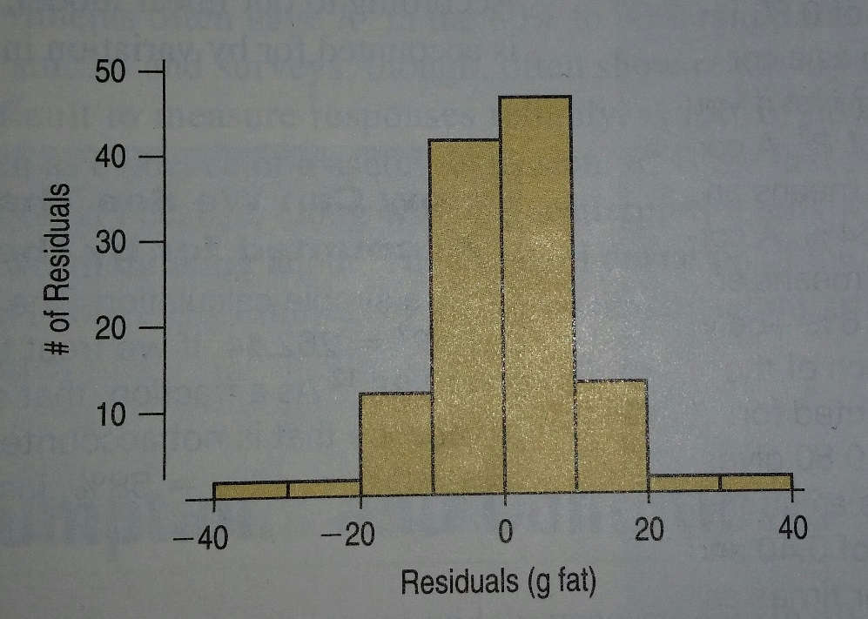
We know that 95% of the data should be within two standard deviations of the mean (0).
Most are within 2(9.2), or 18.4, grams of fat from zero.

Slide 38
R²—The Variation Accounted For
The variation in the residuals is the key to assessing how well the model fits.
How well does the BK regression model do?

Slide 39
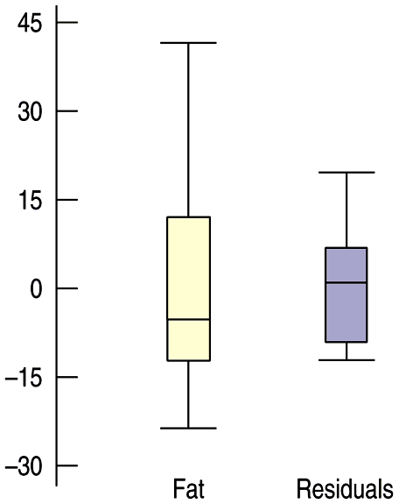
R²—The Variation Accounted For
In the BK menu items example, total fat has a standard deviation of 16.4 grams.
The standard deviation of the residuals is 9.2 grams.
Compare the boxplots:
If the correlation were 1.0, the residuals would all be zero and have no variation.
The correlation is 0.83—not perfection.
However, the model residuals have less variation than total fat alone.
We can determine how much of the variation is accounted for by the model and how much is left in the residuals.
The variation in the residuals is smalled in the data, but definitely bigger than zero.
How much of the variation is still left in the residuals?
If you had to pick a number between

Slide 40
R²—The Variation Accounted For
How much of the variation is still
left in the residuals?
If you had to pick a number between 0% and 100% on the fraction of the variation left in the residuals, what would you say?

Slide 41
R²—The Variation Accounted For (cont.)
r², gives the fraction of the data’s variability that can be explained by the model.
Thus, 1 – r² is the fraction of the original variance left in the residuals.
(Check the math box from this chapter to see why)
For the BK model, r = 0.83. What is the r²?
r² = 0.83² = 0.69
How much of the variability in total fat has been left in the residuals.
31%
How close was that to your guess?

Slide 42
R²—The Variation Accounted For (cont.)
An R² of 0% means that none of the variance in the data can be explained by the model; all of it is still in the residuals.
An R² of 100% means that the model would be a perfect fit, with no variance in the residuals.
When interpreting a regression model you need to Tell what R² means.
In the BK example, 69% of the variability in total fat is accounted for by the variability in the protein content.

Slide 43
How Big Should R² Be?
R² is always between 0% and 100%. What makes a “good” R² value depends on the kind of data you are analyzing and on what you want to do with it.

Slide 44
Good R^2 video
https://www.youtube.com/watch?v=IMjrEeeDB-Y

Slide 45
Classwork:
Just Checking Questions 11 – 14

Slide 46
Homework:
Pg 199 – 202
Exercises: 17, 20, 22, 23, 25, 27, 29, 33, 34, 37
Read Chapter 7
Complete the Chapter 7 Guided Reading

Slide 47
Assumptions and Conditions:
Linear models are only appropriate to use if some assumptions are true.
We need to check the following conditions:
Quantitative Variables Condition:
Regression can only be done on two quantitative variables (and not two categorical variables).
Straight Enough Condition:
Use a scatterplot to check that the relationship between the variables is linear.

Slide 48
Assumptions and Conditions (cont.)
Straight Enough Condition (Continued):
If the scatterplot is not straight enough, stop here.
Some nonlinear relationships can be saved by re-expressing the data to make the scatterplot more linear.

Slide 49
Assumptions and Conditions (cont.)
It’s a good idea to check linearity again after computing the regression when we can examine the residuals.
Does the Plot Thicken? Condition:
Look at the residual plot -- for the standard deviation of the residuals to summarize the scatter, the residuals should share the same spread. Check for changing spread in the residual scatterplot.

Slide 50
Assumptions and Conditions (cont.)
Outlier Condition:
Watch out for outliers.
Outlying points can dramatically change a regression model.
Outliers can even change the sign of the slope, misleading us about the underlying relationship between the variables.
If the data seem to clump or cluster in the scatterplot, that could be a sign of trouble worth looking into further.

Slide 51
Reality Check: Is the Regression Reasonable?
Statistics don’t come out of nowhere. They are based on data.
The results of a statistical analysis should reinforce your common sense, not fly in its face.
If the results are surprising, then either you’ve learned something new about the world or your analysis is wrong.
When you perform a regression, think about the coefficients and ask yourself whether they make sense.

Slide 52
A Tale of Two Regressions.
Now back to the BK model.
We were able to estimate the fat content given the protein content.
What if we wanted to do the reverse?
What if we wanted to estimate the protein content given the fat content?
Our original model is:
Our new model would have to evaluate an $\hat{x}$ based on a value of y.
Least squares criterion focuses on the VERTICAL errors to model y not the HORIZONTAL errors related to modelling x.

Slide 53
A Tale of Two Regressions.
If we just solved our equation for x, we would get a new line whose slope must be the reciprocal.
To model x in terms of y, we would need to use the slope:
$$b_{1}=\frac{rS_{x}}{S_{y}}$$
You will not get this slope by taking the reciprocal of ours…$b_{1}=\frac{rS_{y}}{S_{x}}$.
If you want to predict protein from fat, you would have to create a WHOLE NEW model.

Slide 54
A Tale of Two Regressions.
Moral of the story:
When you first make your graph, decide what variable you want to use (your x) to predict values for the other (your y).
Then find the model that does that.
Later, if you decide you want to make predictions in the other direction, you need to start over and create the other model from scratch.

Slide 55
Video (Graphing Calculator):
Regression Lines and Residual Plots
(AP Stats Guy!)
https://www.youtube.com/watch?feature=player_detailpage&v=ub4nJAiQtTQ

Slide 56
What Can Go Wrong?
Don’t fit a straight line to a nonlinear relationship.
Beware extraordinary points (y-values that stand off from the linear pattern or extreme x-values).
Don’t extrapolate beyond the data—the linear model may no longer hold outside of the range of the data.
Don’t infer that x causes y just because there is a good linear model for their relationship—association is not causation.
Don’t choose a model based on R² alone.

Slide 57
What have we learned?
When the relationship between two quantitative variables is fairly straight, a linear model can help summarize that relationship.
The regression line doesn’t pass through all the points, but it is the best compromise in the sense that it has the smallest sum of squared residuals.

Slide 58
What have we learned? (cont.)
The correlation tells us several things about the regression:
The slope of the line is based on the correlation, adjusted for the units of x and y.
For each SD in x that we are away from the x mean, we expect to be r SDs in y away from the y mean.
Since r is always between –1 and +1, each predicted y is fewer SDs away from its mean than the corresponding x was (regression to the mean).
R² gives us the fraction of the response accounted for by the regression model.

Slide 59
What have we learned?
The residuals also reveal how well the model works.
If a plot of the residuals against predicted values shows a pattern, we should re-examine the data to see why.
The standard deviation of the residuals quantifies the amount of scatter around the line.

Slide 60
What have we learned? (cont.)
The linear model makes no sense unless the Linear Relationship Assumption is satisfied.
Also, we need to check the Straight Enough Condition and Outlier Condition with a scatterplot.
For the standard deviation of the residuals, we must make the Equal Variance Assumption. We check it by looking at both the original scatterplot and the residual plot for Does the Plot Thicken? Condition.

Slide 61
Homework:
Pg 205 – 207
Exercises: 51, 53, 55, 56, 57, 59
Read Chapter 7
Complete the Chapter 7 Guided Reading

