Slide 1
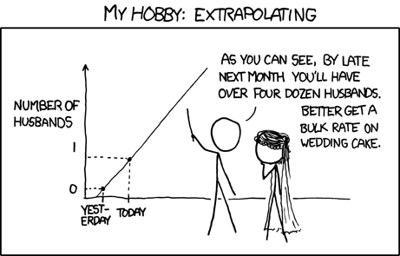
Chapter 8
Regression Wisdom

Slide 2
Getting the “Bends”
Linear regression only works for linear models.
A curved relationship between two variables might not be apparent when looking at a scatterplot alone.
What else do you think we can we look at?
Curves will be more obvious in a plot of the residuals.
Remember, we want to see “nothing” in a plot of the residuals.

Slide 3
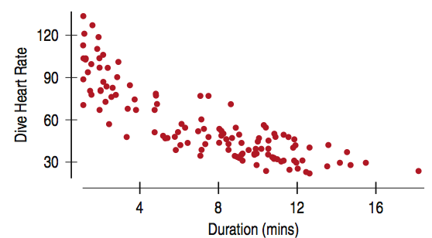
Getting the “Bends” (cont.)
Here is the scatterplot of Dive Heart Rate (in beats per minute) vs. Duration (in minutes) of emperor penguin.
Explain this graph.
The scatterplot looks fairly linear with a moderately strong negative association.
Details:
R² = 71.5%
Linear regression equation:
$\hat{Dive Heart Rate}=96.9 −5.47 (Duration)$

Slide 4
Getting the “Bends” (cont.)
R² = 71.5%
$\hat{Dive Heart Rate}=96.9 −5.47 (Durtion)$
Questions:
Explain what the R² tells us.
What does the slope mean in the context of this problem?
What does the y-intercept mean?

Slide 5
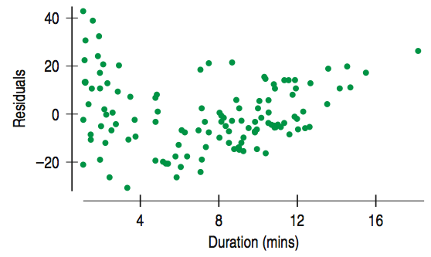
Getting the “Bends” (cont.)
The scatterplot of residuals against Duration of emperor penguin dives holds a surprise.
The Linearity Assumption says we should not see a pattern, but instead there is a bend.

Slide 6
Sifting Residuals for Groups (cont.)
No regression analysis is complete without a display of the residuals to check that the linear model is reasonable.
Sometimes we see additional details that help confirm or refine our understanding.
Sometimes they reveal violations of the regression conditions that require our attention.

Slide 7
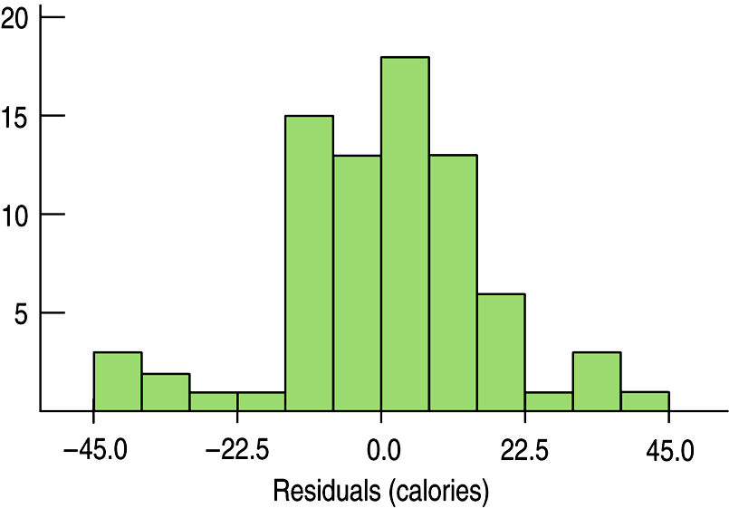
Sifting Residuals for Groups (cont.)
It is a good idea to look at both a histogram of the residuals and a scatterplot of the residuals.
Go back to page 191 in the book to look at original data for the following analysis.
Here is a histogram of the residuals in the regression predicting Calories from Sugar content in cereals:
How would you describe its shape?
It looks like there may be a small cluster on each side of the central body of the data.

Slide 8
Sifting Residuals for Groups (cont.)
There is one group of cereal with large negative residuals (fewer calories than expected)
There is one group of cereal with large positive residuals (more calories than expected)
Whenever we suspect multiple modes, we ask whether they are somehow different.
Let’s look at the residual plot…

Slide 9
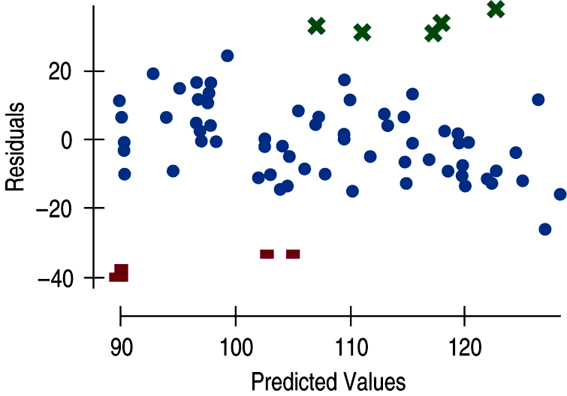
Sifting Residuals for Groups (cont.)
It is a good idea to look at both a histogram of the residuals and a scatterplot of the residuals.
The small modes in the histogram are marked with different colors and symbols in the residual plot.
What do you see?

Slide 10
Sifting Residuals for Groups (cont.)
We can see that these two groups do stand away from the central pattern in the scatterplot.
The high-residuals cereals are Just Right, Fruit & Nut, Muesli Raisins, Dates and Almonds, Peaches and Pecans, Nutri-Grain Almond Raisins, and Mueslix Crispy Blend.
What do these cereals all have in common?
They all present themselves as “healthy.”
Actually, “healthy” cereals often have more fat and calories than we may expect by looking at their low sugar content level.

Slide 11
Sifting Residuals for Groups (cont.)
We can see that these two groups do stand away from the central pattern in the scatterplot.
The low-residuals cereals are Puffed Rice, Puffed Wheat, three bran cereals, and Golden Crisps.
What do these cereals all have in common?
They have a low calorie count relative to their sugar content.

Slide 12
Sifting Residuals for Groups (cont.)
Although we may see different groups, these observations may not lead us to question the overall linear model.
They just help us understand that other factors may be part of the story.
An examination of residuals often leads us to discover groups of observations that are different from the rest.
When we discover that there is more than one group in a regression, we may decide to analyze the groups separately, using a different model for each group.
Or we can stick with the original model and make a note that there are different groups.
Whatever we choose, just remember that models are always “wrong,” but they are useful.
They always improve our understanding of the data.

Slide 13
Subsets
Here’s an important unstated condition for fitting models:
All the data must come from the same group.
When we discover that there is more than one group in a regression, neither modeling the groups together nor modeling them apart is necessarily correct.
You must determine what makes the most sense.
Think about what you are looking for from your data.
In the following example, we see that modeling them apart makes sense.

Slide 14
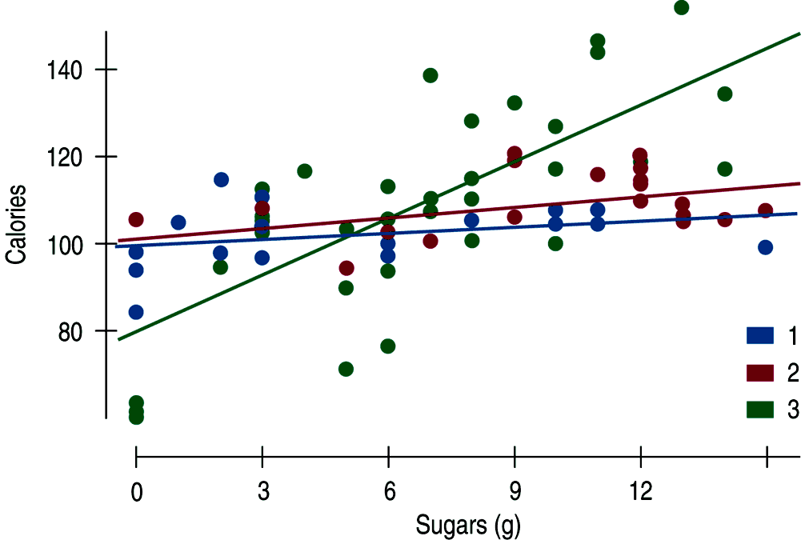
Subsets (cont.)
The figure shows regression lines fit to calories and sugar for each of the three cereal shelves in a supermarket:
They strategically placed different types of cereals on different shelves.
Based on this graph, explain how they placed cereals and think of reasons for why they did this.

Slide 15
Homework:
Pg # 222 – 225 Ex: 1, 2, 4, 5, 6, 7, 8, 11, 12, 15
Read Chapter 8
Complete the Guided Reading

Slide 16
Extrapolation: Reaching Beyond the Data
Linear models give a predicted value for each case in the data.
We cannot assume that a linear relationship in the data exists beyond the range of the data.
The farther the new x value is from the mean in x, the less trust we should place in the predicted value.
Once we venture into new x territory, such a prediction is called an extrapolation.

Slide 17
Extrapolation (cont.)
Extrapolations require the assumption that nothing about the relationship between x and y changes even at extreme values of x.
Extrapolations can get you into deep trouble.
You’re better off not making extrapolations.

Slide 18
Comment on this…

Slide 19
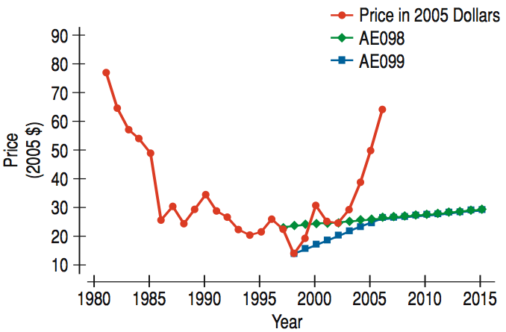
Extrapolation (cont.)
Here is a timeplot of the Energy Information Administration (EIA) predictions and actual prices of oil barrel prices.
How did forecasters do?
They seemed to have missed a sharp run-up in oil prices in the past few years.

Slide 20
Extrapolation (cont.)
Do you think you can predict where oil prices will go in the next decade?
Your guess is as good as anyone’s!

Slide 21
Predicting the Future
Extrapolation is always dangerous. But, when the x-variable in the model is time, extrapolation becomes an attempt to peer into the future.
Knowing that extrapolation is dangerous doesn’t stop people.
The temptation to see into the future is hard to resist.
Here’s some more realistic advice:
If you must extrapolate into the future, at least don’t believe that the prediction will come true.

Slide 22
Classwork:
Extrapolation: Reaching Beyond the Data

Slide 23
Outliers, Leverage, and Influence
Outlying points can strongly influence a regression.
Even a single point far from the majority of the data can dominate the analysis.
Any point that stands away from the others can be called an outlier and deserves your special attention.

Slide 24
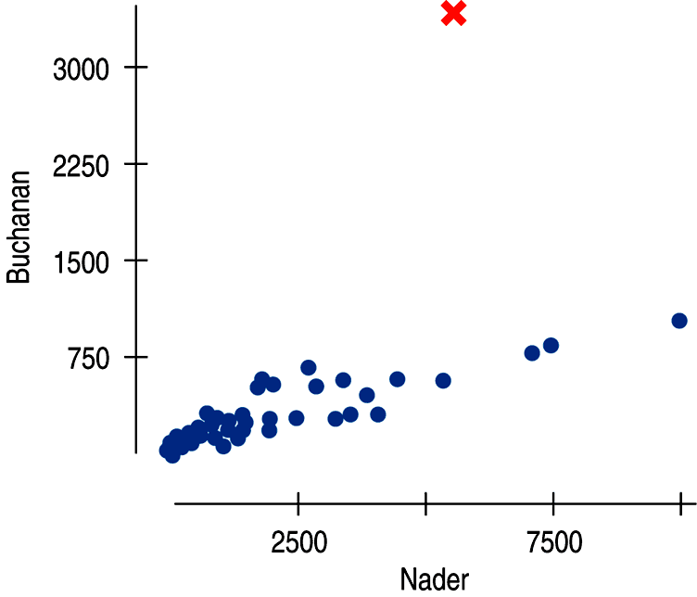
Outliers, Leverage, and Influence (cont.)
The following scatterplot shows that something was weird in Palm Beach County, Florida, during the 2000 presidential election…

Slide 25
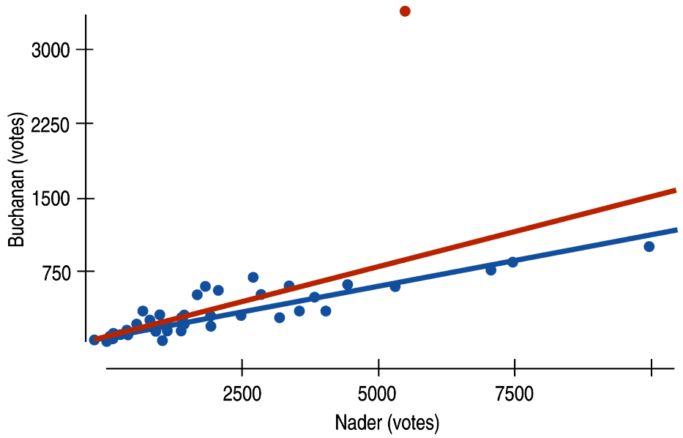
Outliers, Leverage, and Influence (cont.)
The red line shows the effects that one unusual point can have on a regression:

Slide 26
Outliers, Leverage, and Influence (cont.)
For comparison…
With the outlier:
$\hat{Buchanan}=50.3+0.14 Nader$
R² = 43%
Without the outlier:
$\hat{Buchanan}=50.3+0.10 Nader$
R² = 82%
We can now see how much Palm Beach County stands out.
It is not only a Buchanan stronghold, but a clear violation of the model begging for explanation.
What happened?
This caused a lot of controversy back in 2000.

Slide 27
Outliers, Leverage, and Influence (cont.)
The linear model doesn’t fit points with large residuals very well.
Because they seem to be different from the other cases, it is important to pay special attention to points with large residuals.

Slide 28
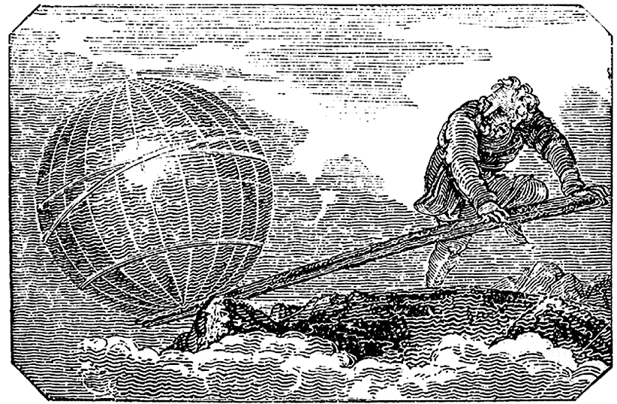
Outliers, Leverage, and Influence (cont.)
A data point can also be unusual if its x-value is far from the mean of the x-values.
Such points are said to have high leverage.
Points with values far from $\overline{x}$ pull more strongly on the regression line.

Slide 29
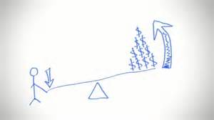
Outliers, Leverage, and Influence (cont.)
A point with high leverage has the potential to change the regression line, but it doesn’t always use that potential.
If this point lines up with the other points, then including it doesn’t change the estimate for our line.
It may however, strengthen our relationship, inflating the correlation and R².
We say that a point is influential if omitting it from the analysis gives a very different model.

Slide 30
Outliers, Leverage, and Influence (cont.)
Influence depends on both leverage and a large residual.
A case with high leverage whose y-value sit right at the line fit to the rest of the data is not influential.
Even though it will make your R² stronger, it will not change your slope.
A case with modest leverage, but a VERY large residual (like the Palm Beach County example) can be influential.
If a point has enough leverage, it can pull the line right to it.
It will be very influential, causing it to end up having a smaller residual.
The only way to see how influential one single point can be is to fit a regression to the points with and without it.

Slide 31
Comment:

Slide 32
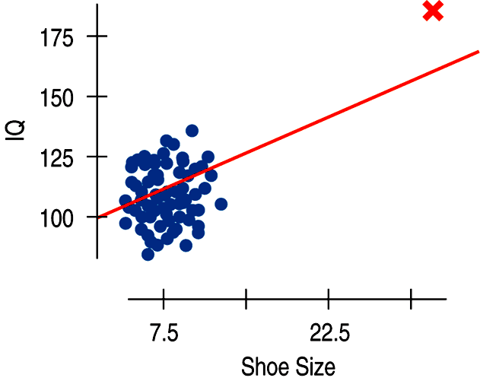
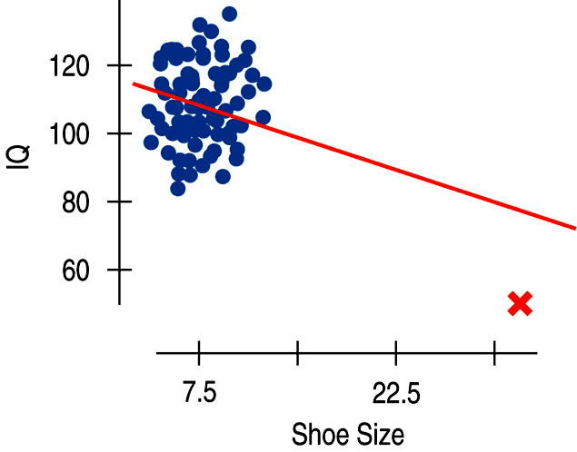
Outliers, Leverage, and Influence (cont.)
The extraordinarily large shoe size gives the data point high leverage.
Wherever the IQ is, the line will follow!

Slide 33
Outliers, Leverage, and Influence (cont.)
When we investigate an unusual point, you cannot simply delete unusual points from the data.
You can, however, fit a model with and without these points as long as you examine and discuss the two regression models to understand how they differ.
Your goal should be UNDERSTANDING the data, not making your R² as big as possible.

Slide 34
Outliers, Leverage, and Influence (cont.)
Warning!!!:
Influential points can hide in plots of residuals.
Points with high leverage pull the line close to them, so they often have small residuals.
You’ll see influential points more easily in scatterplots of the original data or by finding a regression model with and without the points.

Slide 35
Classwork:
Just Checking Box on Page 217.
Solutions:
Not high leverage, not influential, large residual.
High leverage, not influential, small residual.
High leverage, influential, not large residual.

Slide 36
Homework:
Pg # 224 – 229 Ex: 9, 10, 17, 19, 20, 26, 31, 33
Read Chapter 8
Complete the Guided Reading

Slide 37
Lurking Variables and Causation
No matter how strong the association, no matter how large the R² value, no matter how straight the line, there is no way to conclude from a regression alone that one variable causes the other.
There’s always the possibility that some third variable is driving both of the variables you have observed.
With observational data, as opposed to data from a designed experiment, there is no way to be sure that a lurking variable is not the cause of any apparent association.

Slide 38
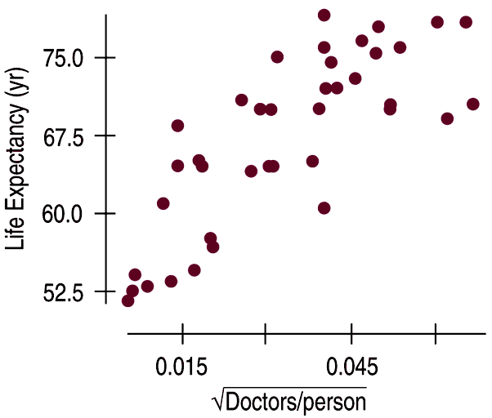
Lurking Variables and Causation (cont.)
The following scatterplot shows that the average life expectancy for a country is related to the number of doctors per person in that country:
The square root is used here to make sure the scatterplot fits the Straight Enough Condition.

Slide 39
Lurking Variables and Causation (cont.)
The graph would make you think that more doctors per person improves healthcare, leading to longer lifetimes.
The R² = 62.4%.
The strength of the association would seem to argue that we should send more doctor’s to developing countries to increase life expectancy.
Would this work?
Do doctor’s CAUSE greater life expectancy?
Perhaps, but this is observed data, so there may be another explanation for the association.

Slide 40
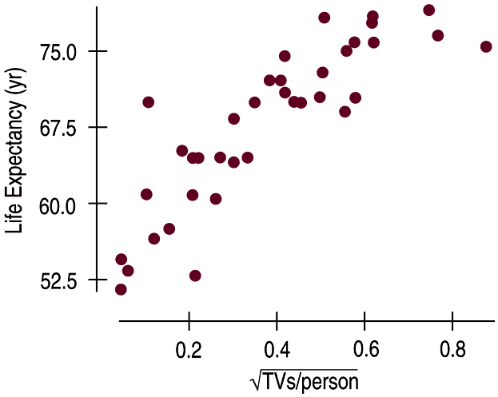
Lurking Variables and Causation (cont.)
This new scatterplot shows that the average life expectancy for a country is related to the number of televisions per person in that country:
The association in this scatterplot is even stronger.
R² = 72.3%

Slide 41
Lurking Variables and Causation (cont.)
Since televisions are cheaper than doctors, send TVs to countries with low life expectancies in order to extend lifetimes. Right?
How about considering a lurking variable? That makes more sense…
Countries with higher standards of living have both longer life expectancies and more doctors (and TVs!).
If higher living standards cause changes in these other variables, improving living standards might be expected to prolong lives and increase the numbers of doctors and TVs.

Slide 42
Make sure that you resist the temptation to conclude that x CAUSES y, no matter how obvious the conclusion may seem to you!

Slide 43
Working With Summary Values
Scatterplots of statistics summarized over groups tend to show less variability than we would see if we measured the same variable on individuals.
This is because the summary statistics themselves vary less than the data on the individuals do.

Slide 44
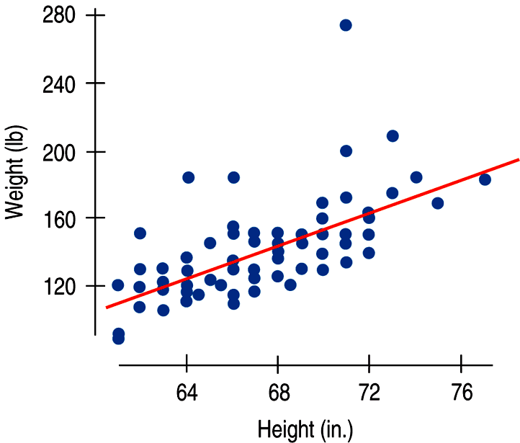
Working With Summary Values (cont.)
Comment on this graph:
There is a strong, positive, linear association between weight (in pounds) and height (in inches) for men:
The correlation is 0.644 and R² = 41.5%

Slide 45
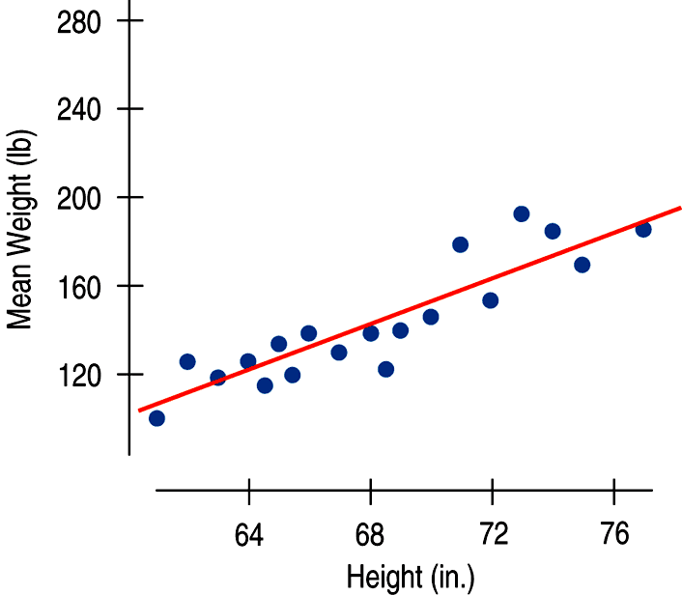
Working With Summary Values (cont.)
Comment on this graph:
If instead of data on individuals we only had the mean weight for each height value, we would see an even stronger association:
R² = 80.1%

Slide 46
Working With Summary Values (cont.)
Means vary less than individual values.
Scatterplots of summary statistics show less scatter than the original data on individuals.
This can give a false impression of how well a line summarizes the data.
There is no simple correction for this phenomenon.
Once we have summary data, there’s no simple way to get the original values back.
You should be suspicious of conclusions based on regressions of summary data. They may look better than they really are!

Slide 47
Homework:
Pg # 224 – 230 Ex: 13, 14, 23, 24, 28, 39
Read Chapter 8
Complete the Guided Reading
Quiz on Chapter 8 Thursday

Slide 48
What Can Go Wrong?
Make sure the relationship is straight.
Check the Straight Enough Condition.
Be on guard for different groups in your regression.
If you find subsets that behave differently, consider fitting a different linear model to each subset.
Beware of extrapolating.
Beware especially of extrapolating into the future!

Slide 49
What Can Go Wrong? (cont.)
Look for unusual points.
Unusual points always deserve attention and may well reveal more about your data than the rest of the points combined.
Beware of high leverage points, and especially those that are influential.
Such points can alter the regression model a great deal.
Consider comparing two regressions.
Run regressions with extraordinary points and without and then compare the results.

Slide 50
What Can Go Wrong? (cont.)
Treat unusual points honestly.
Don’t just remove unusual points to get a model that fits better.
Beware of lurking variables—and don’t assume that association is causation.
Watch out when dealing with data that are summaries.
Summary data tend to inflate the impression of the strength of a relationship.

Slide 51
What have we learned?
There are many ways in which a data set may be unsuitable for a regression analysis:
Watch out for subsets in the data.
Examine the residuals to re-check the Straight Enough Condition.
The Outlier Condition means two things:
Points with large residuals or high leverage (especially both) can influence the regression model significantly.
Perform regression analysis with and without such points to see their impact.

Slide 52
What have we learned? (cont.)
Even a good regression doesn’t mean we should believe the model completely:
Extrapolation far from the mean can lead to silly and useless predictions.
An R² value near 100% doesn’t indicate that there is a causal relationship between x and y.
Watch out for lurking variables.
Watch out for regressions based on summaries of the data sets.
These regressions tend to look stronger than the regression on the original data.

