Slide 1
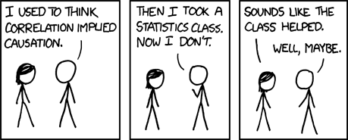
Chapter 9
Re-expressing Data:Get it Straight!

Slide 2
Straight to the Point
We cannot use a linear model unless the relationship between the two variables is linear.
Often re-expression can save the day, straightening bent relationships so that we can fit and use a simple linear model.

Slide 3
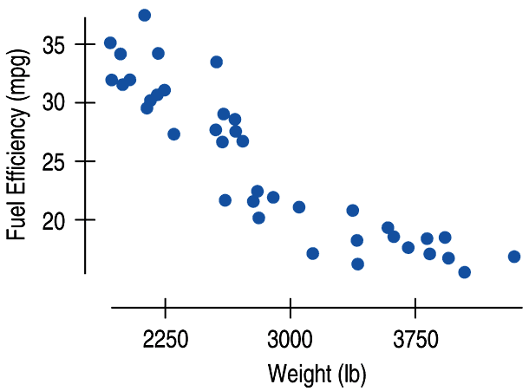
Straight to the Point (cont.)
Here is the scatterplot for fuel efficiency (in miles per gallon) vs weight (in pounds) for cars.
The graph looks fairly linear at first:

Slide 4
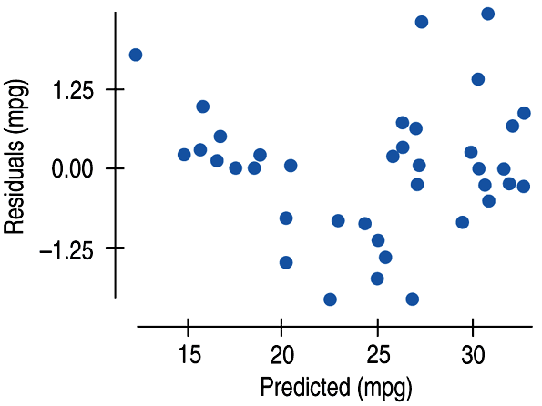
Straight to the Point (cont.)
A look at the residuals plot shows a problem:
What is wrong here?

Slide 5
Straight to the Point (cont.)
Even though the R² is 81.6%, the residuals don’t show a random scatter.
The shape is bent.

Slide 6
Looking back at the first scatterplot, you may be able to see this slight bend.
Now think about the regression line through these points.
How much do you think a car would have to weigh to have a fuel efficiency of 0 mpg?
Do you think this is accurate?

Slide 7
A Hummer H2 weighs about 6400 pounds.
This vehicle is not known for its fuel efficiency, but it does get a positive fuel efficiency.
Extrapolation is ALWAYS dangerous, but it becomes more dangerous as the model becomes more wrong.
We can re-express the data to get a model that is more linear.

Slide 8
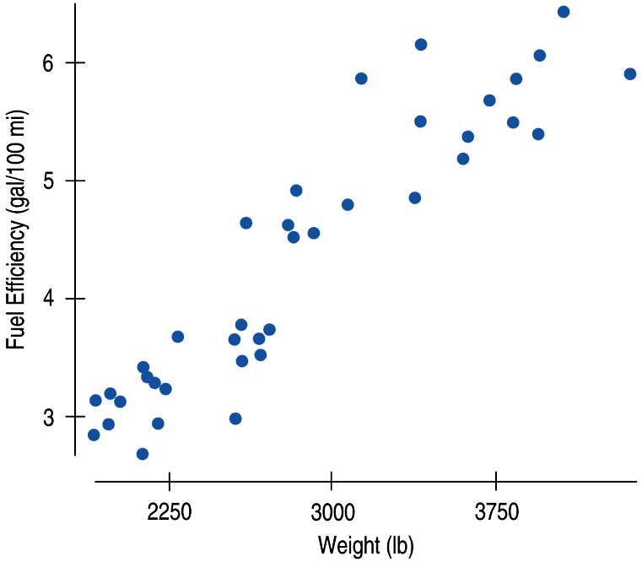
We can re-express fuel efficiency as gallons per hundred miles (a reciprocal) and eliminate the bend in the original scatterplot:
We will talk about different ways to re-express in a bit and which ones we should be using for certain scenarios...

Slide 9
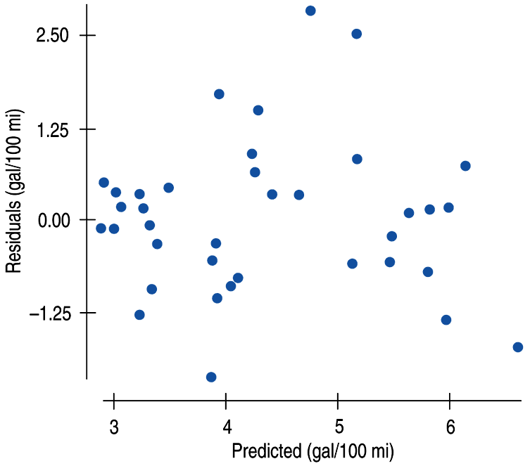
A look at the residuals plot for the new model seems more reasonable:

Slide 10
Now compare the two graphs:
The direction of the association is positive now.
Why?
Because we are measuring gas consumption and heavier cars consume more gas per mile.

Slide 11
Now compare the two graphs:
The relationship is much straighter now.
Question?:
What does the reciprocal model tell us about the Hummer?

Slide 12
The regression line for this graph predicts that the hummer, with a weight of 6400 lbs, will predict somewhere near 9.7 gallons.
What does this mean?
It means the car is predicted to use 9.7 gallons for every 100 miles.
Or, we can write it like this so it makes more sense:
$\frac{100 miles}{9.7 gallons}$
This is 10.3 mpg.
This is a much more reasonable prediction than earlier.
The Hummer actually gets 11 mpg, which was pretty close.

Slide 13
Why Do We Re-Express Data?
There are several reasons.
Each of the following goals help make the data more suitable for analysis by the methods that we know.

Slide 14
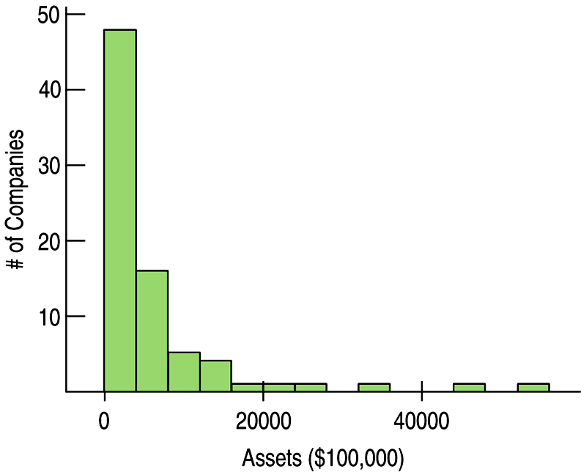
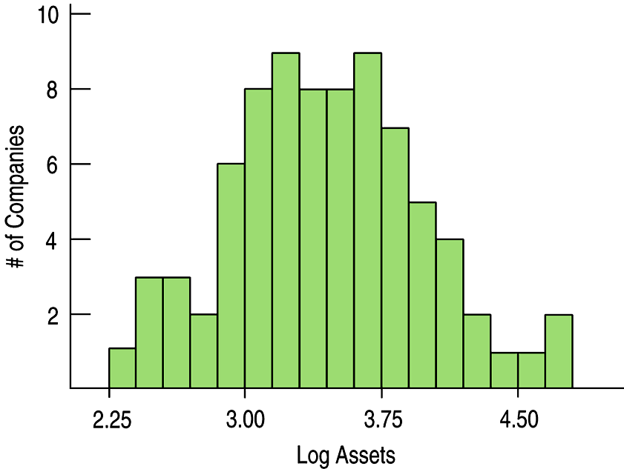
Goals of Re-expression
Goal 1: Make the distribution of a variable more symmetric.
Why?
Because it is easier to summarize the center.
If it is symmetric, we can use the mean and standard deviation.
If it is normal, we can use the Empirical rule and find out things using z-scores.

Slide 15
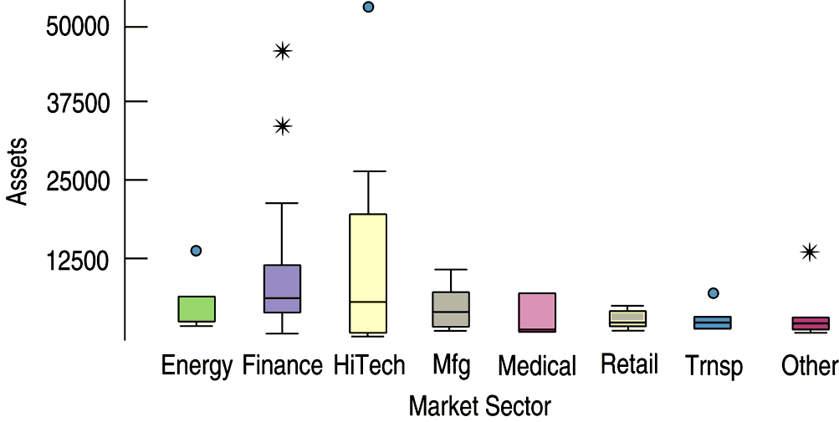
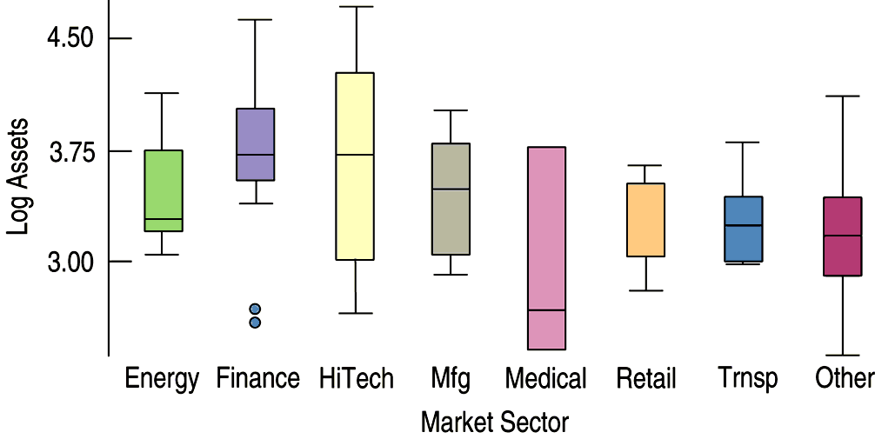
Goals of Re-expression (cont.)
Goal 2: Make the spread of several groups more alike, even if their centers differ.
Why?
Groups that share a common spread are easier to compare.
Taking the Logs of all the Assets makes the boxes more symmetric with spreads that are more equal.

Slide 16
Goals of Re-expression (cont.)
Doing this makes it easier to compare assets across market sectors.
It can also reveal problems in the data.
Some companies that looked like outliers turned out to be more typical.
Two companies in the finance sector now stick out.
They may have been placed in the wrong sector, but we wouldn’t have seen that in the original data.

Slide 17
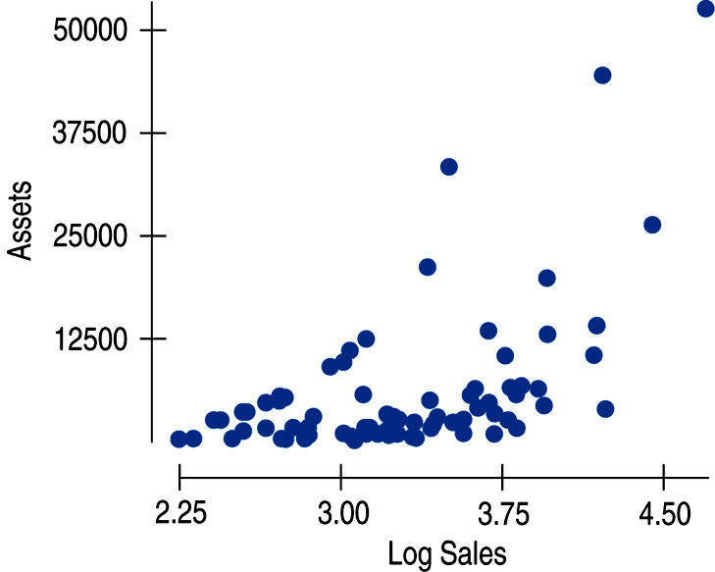
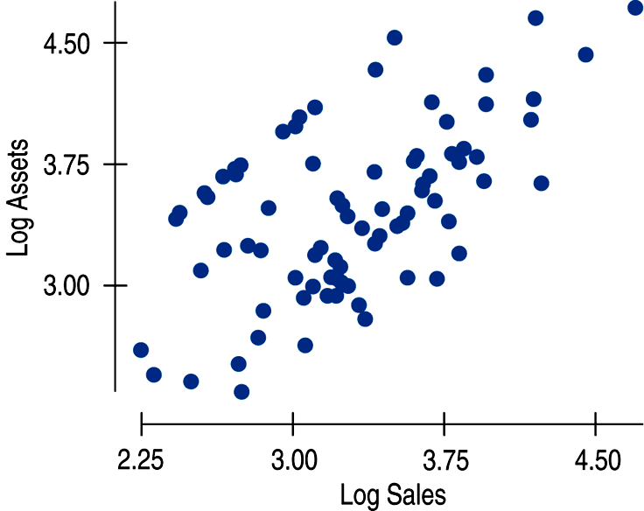
Goals of Re-expression (cont.)
Goal 3: Make the form of a scatterplot more nearly linear.
Why?
Linear scatterplots are easier to model.
We can fit a linear regression to a model once it is straight.
Taking the logs of the assets makes things much more linear.

Slide 18
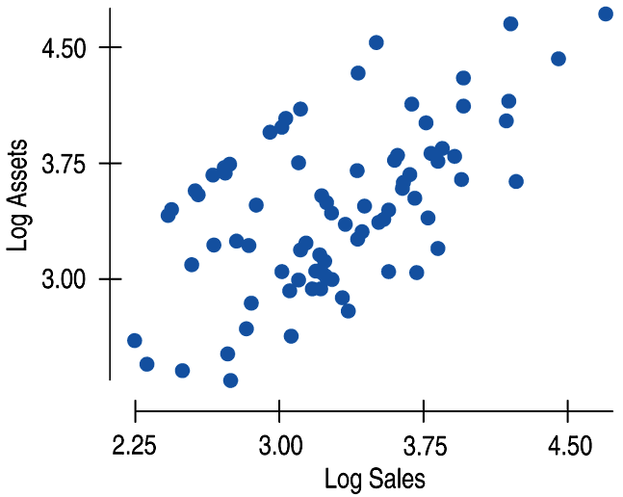
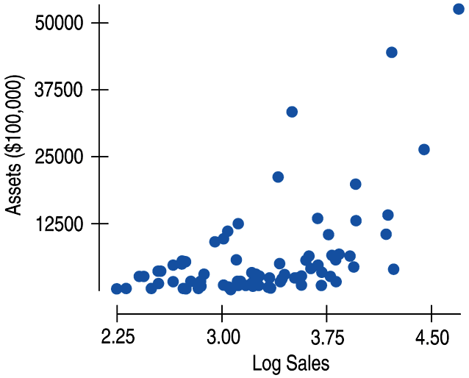
Goals of Re-expression (cont.)
Goal 4: Make the scatter in a scatterplot spread out evenly rather than thickening at one end.
Why?
Having a consistent scatter is an important condition for many of the methods we use in Statistics.

Slide 19
Question: What feature of each of these displays suggest that a re-expression may be helpful?
Solution:
The boxplots each show skewness to the high end.
The medians are low in the boxes and several show high outliers.

Slide 20
Question: What feature of each of these displays suggest that a re-expression may be helpful?
Solution:
The histogram of heart rates is skewed to the right.
Re-expression often makes skewed distributions look more symmetric.

Slide 21
Question: What feature of each of these displays suggest that a re-expression may be helpful?
Solution:
The scatterplot shows a curved relationship, concave upward.
Re-expressing either variable may help to straighten the pattern.

Slide 22
Homework:
Pg 247 – 250, Exercises 1 – 7, 9, 11, 13
Read Chapter 9
Work on the Guided Reading

