Slide 1
So how do we know what type of re-expression to use?

Slide 2
The Ladder of Powers
There is a family of simple re-expressions that move data toward our goals in a consistent way.
This collection of re-expressions is called the Ladder of Powers.
The Ladder of Powers orders the effects that the re-expressions have on data.
This can help you figure out where to start, and from there you can find a good re-expression.

Slide 3
The Ladder of Powers (Pg 237)

Slide 4
The Ladder of Powers:
The Ladder of Powers orders the effect that the re-expression has on your data.
Example: If the square root doesn’t straighten it enough, try to move down further on the ladder (use the logarithm or reciprocal root).
Those re-expressions will have a stronger effect on your data.
Don’t forget that when you take a negative power, the direction of the graph will change, but that is OKAY.
You will just analyze the graph in a different context.

Slide 5
How to Re-Express Data
Observe Flow Chart:
“How to Find the Best Linear Model”

Slide 6
Just Checking Box Pg 237
Solutions:
Start with the square root. Counts are often best transformed by using the square root.
Don’t do anything. It is already straight.
Even though these are counts, I would use the logarithm for this one. This is because populations grow exponentially, so something stronger would be better.

Slide 7
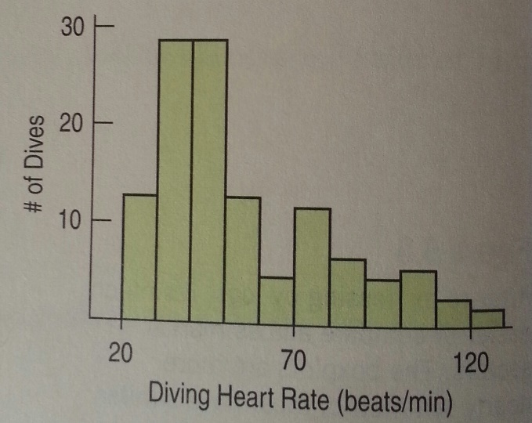
Now back to these graphs:
Let’s start the process of re-expressing.
Heart rate is in beats/minute.
Let’s try taking the negative reciprocal re-expression and use minutes/beat.
Let’s look at the re-expressed data…

Slide 8
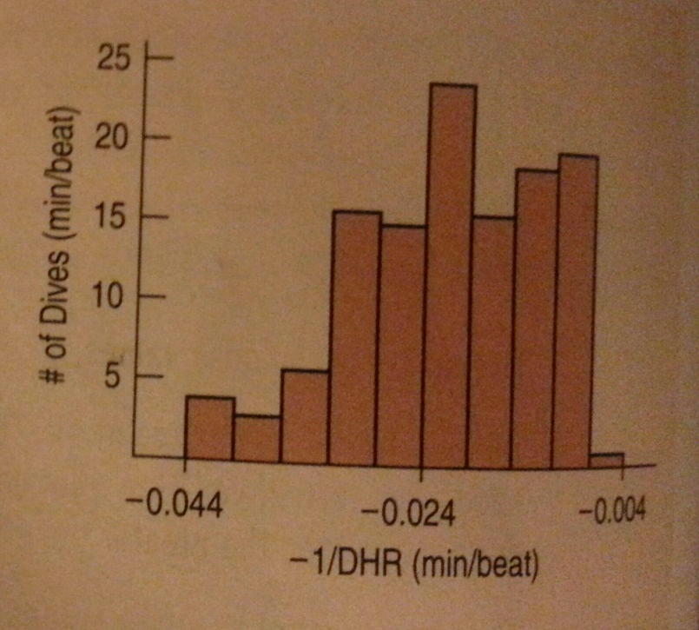
Re-Expressed:

Slide 9
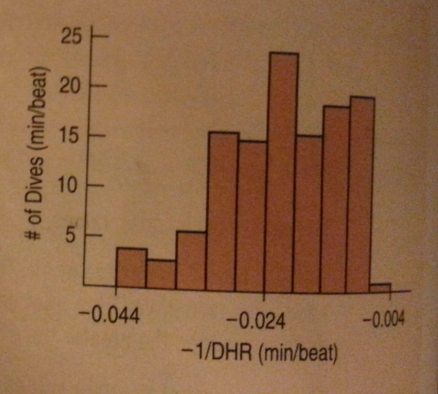
Were the re-expressions successful?
The scatterplot is more straight, but may be slightly concave down.
The histogram is slightly skewed to the left.
Most of the boxplots have no outliers. These ones look much better than the ones with the raw data.

Slide 10
Were the re-expressions successful?
Overall, it looks like it may have moved a bit too far.
If this happens, try a re-expression that is lower on the ladder.
Now, let’s try something halfway between 1 and -1, like the logarithm.

Slide 11
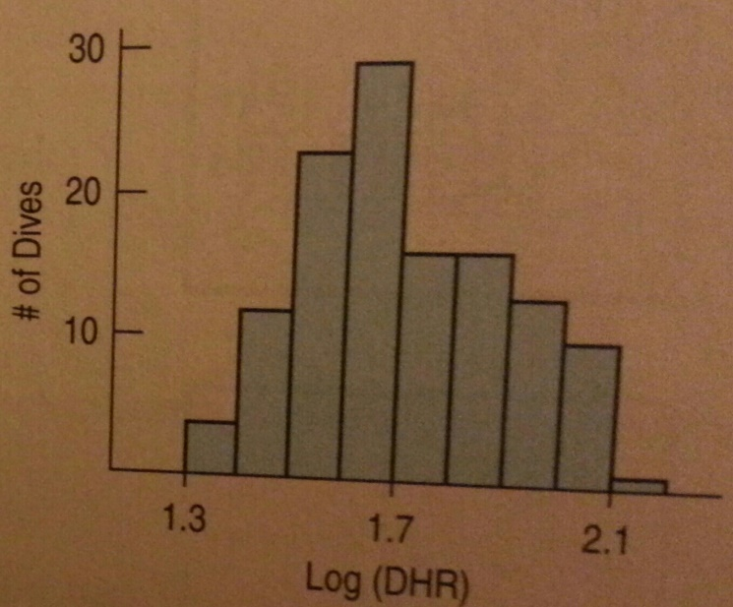
Were the re-expressions successful?

Slide 12
Were the re-expressions successful?
The data is now more linear and the histogram is symmetric.
The boxplots are still a little skewed to the right, but not as much as the original.
Never expect real data to cooperate perfectly.
This may be the best one that we get.

Slide 13
Classwork:
Calculator: Re-Expressing Data to Achieve Linearity

Slide 14
Homework:
Pg 248 – 252, Exercises 8, 10, 12, 15, 17, 24
Read Chapter 9
Complete the Guided Reading

Slide 15
Plan B: Attack of the Logarithms
The ladder of Powers is often successful at finding an effective re-expression.
Sometimes the curvature can be very stubborn though, and we may not be happy with the residuals plots of the re-expression.
When none of the data values is zero or negative, logarithms can be a helpful ally in the search for a useful model.
Try taking the logs of both the x- and y-variable.
Then re-express the data using some combination of x or log(x) vs. y or log(y).
You may find that one of these works pretty well.

Slide 16
Observe the Chart:

Slide 17
Warning!
Don’t expect to be able to straighten every curved scatterplot that you see.
Some may just not have an effective re-expression.
Don’t set your sights too high and remember that you won’t even find a “perfect” model.
We seek a “useful” model, not perfection.

Slide 18
Classwork:
Calculator Activity: Using Logarithmic Re-Expressions

Slide 19
Multiple Benefits
We often choose a re-expression for one reason and then discover that it has helped other aspects of an analysis.
For example, a re-expression that makes a histogram more symmetric might also straighten a scatterplot or stabilize variance.

Slide 20
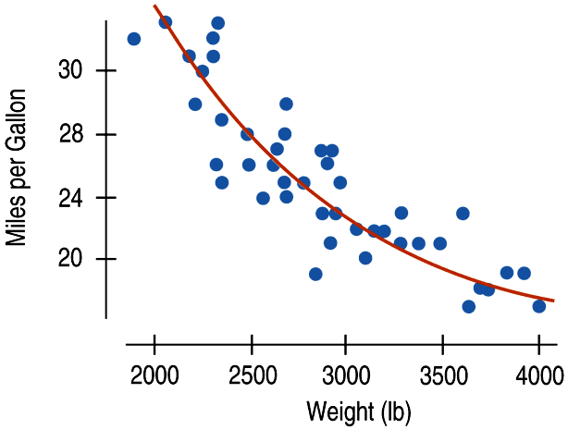
Why Not Just Use a Curve?
If there’s a curve in the scatterplot, why not just fit a curve to the data?

